Slide 1


Future-Proof
Your Team
Catherine Hakala-Ausperk
chakalaausperk@gmail.com

Slide 2
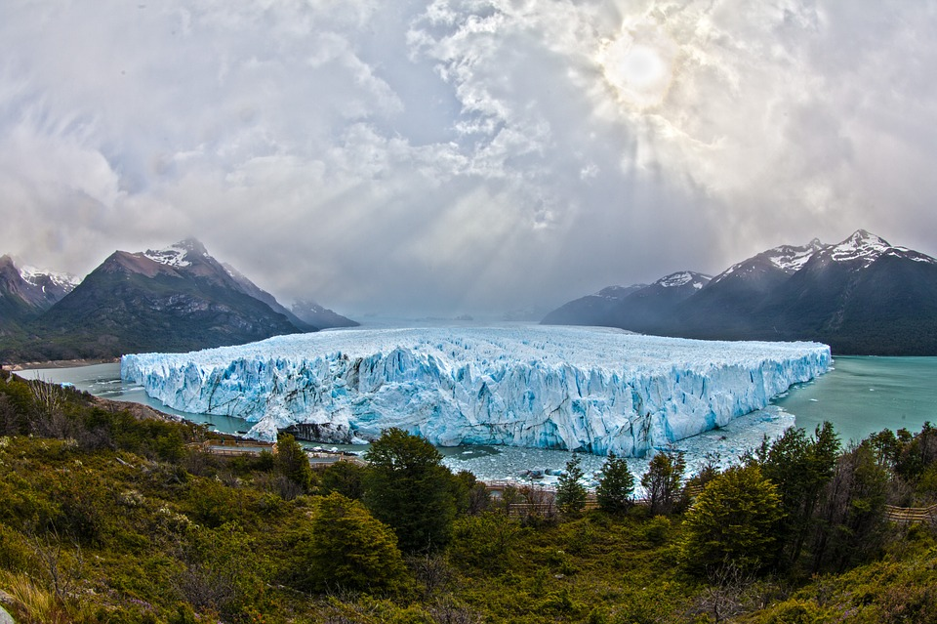
WHY BOTHER?

Slide 3
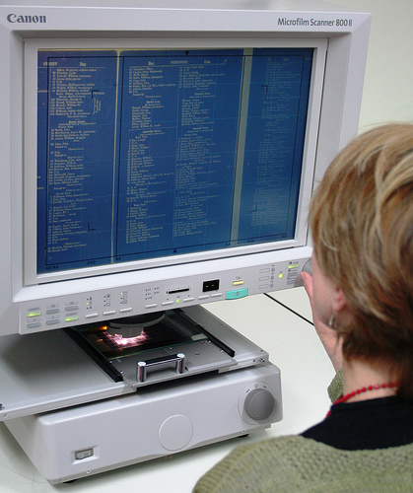
CHANGE

Slide 4


EXPECTATIONS

Slide 5

LEADERSHIP

Slide 6
WHY BOTHER?
EXERCISE
LIST AT LEAST 3 DAMAGING IMPACTS THAT RECENT CHANGES HAVE HAD ON YOUR TEAM?
_________________________
_________________________
_________________________

Slide 7
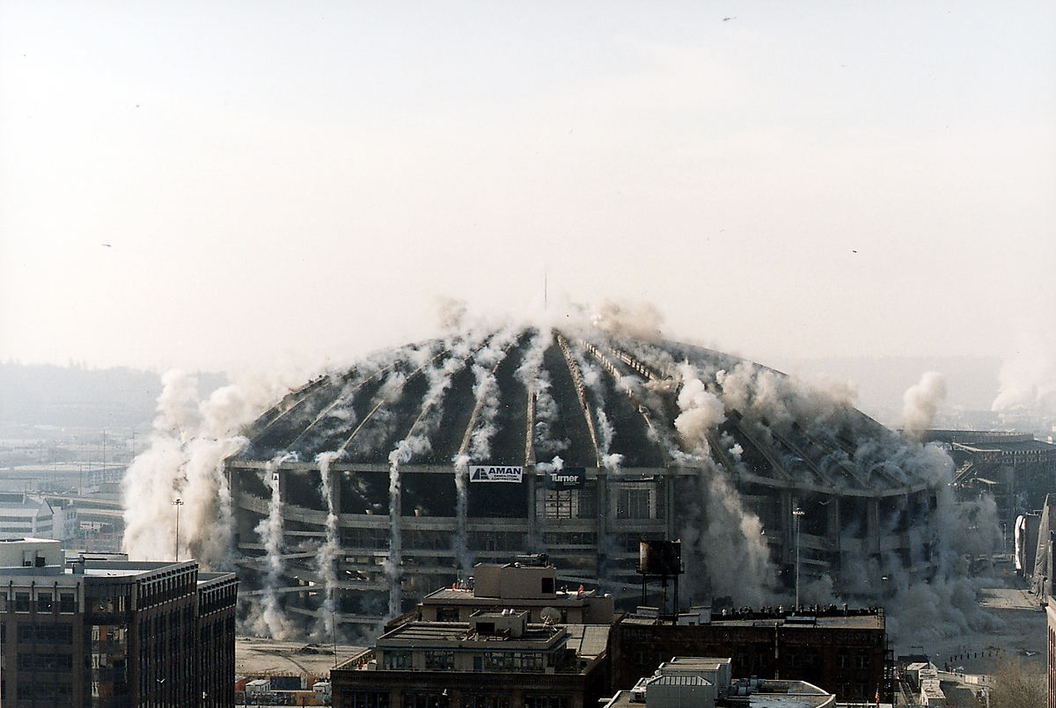
WHAT’S GOING ON?

Slide 8

TOO FAST?

Slide 9

TOO COMPLICATED?

Slide 10

LEADERSHIP (AGAIN)

Slide 11
WHAT’S GOING ON?
EXERCISE
LIST AT LEAST 3 EFFECTIVE TEAM TRAINING OPTIONS YOU CAN USE THAT COULD BE INEXPENSIVE AND PRACTICAL?
_________________________
_________________________
_________________________

Slide 12

WHAT DO YOU WANT TO HAPPEN?

Slide 13

INDIVIDUAL SUCCESS?

Slide 14


COMMUNITY SUCCESS?

Slide 15

ONGOING SUCCESS?

Slide 16
WHAT DO YOU WANT TO HAPPEN?
EXERCISE
THINK OF AT LEAST 3 WAYS YOU CAN BE CERTAIN THAT MEMBERS OF YOUR TEAM KNOW THEY’VE BEEN SUCCESSFUL?
_________________________
_________________________
_________________________

Slide 17

LEARN FROM EXPERIENCE

Slide 18

GOOD & NOT-SO-GOOD

Slide 19

FAIL FAST

Slide 20

ADMIT MISTAKES

Slide 21
LEARN FROM EXPERIENCE
EXERCISE
LIST AT LEAST 3 RELEVANT, ACCESSIBLE, AND AFFORDABLE RESOURCES YOU COULD USE TO HELP BUILD YOUR CHANGE MANAGEMENT SKILLS.
_________________________
_________________________
_________________________

Slide 22
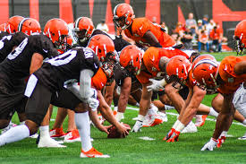
WHO DOES WHAT?

Slide 23
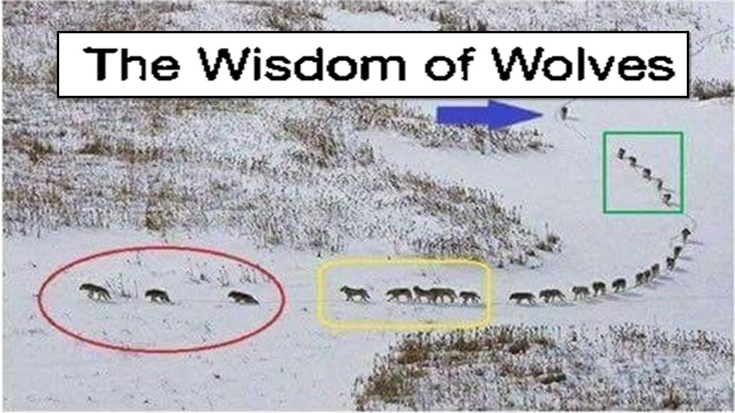
ROLES

Slide 24


STRENGTHS

Slide 25

SUPPORT

Slide 26
WHO DOES WHAT?
EXERCISE
IF YOU WERE PUTTING TOGETHER A TASK FORCE TO PREP FOR AN UPCOMING CHANGE IN THE FUTURE, WHO MIGHT FIT IN THESE ROLES?
CHANGE LEADER?
_________________________
A WILLING FOLLOWER?
_________________________
A SKEPTIC?
_________________________

Slide 27

BE READY

Slide 28

LOOK

Slide 29
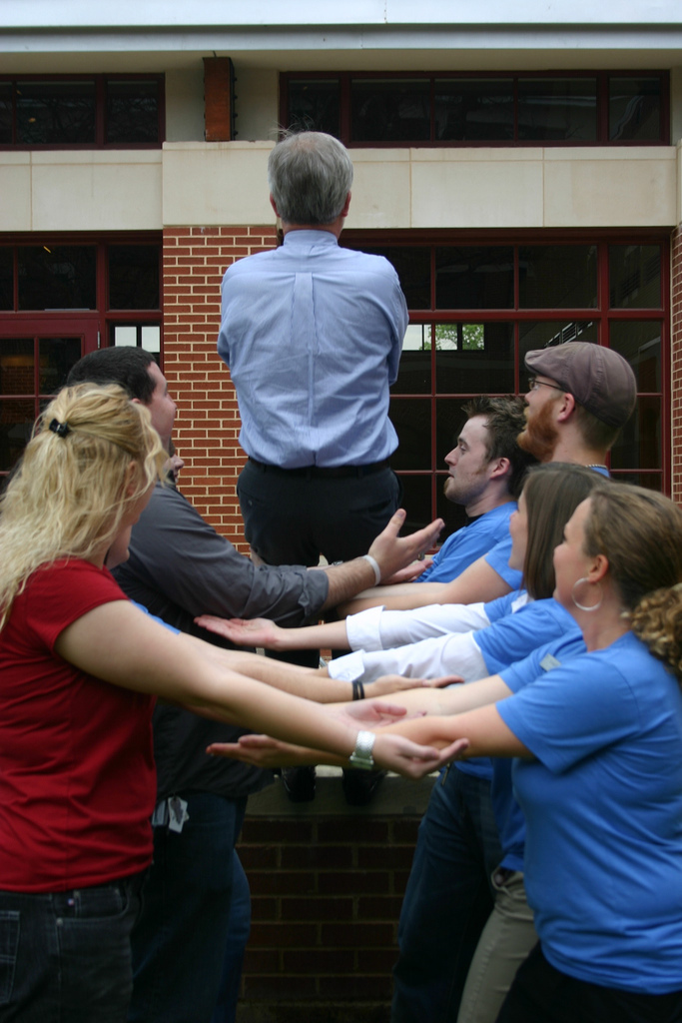
LISTEN

Slide 30

ASK

Slide 31
BE READY
EXERCISE
WRITE A COMPELLING ELEVATOR SPEECH THAT CONVINCES PEOPLE YOU ALL NEED TO GET BETTER AT FACING THE FUTURE.
_______________________________
_______________________________
_______________________________
_______________________________

Slide 32
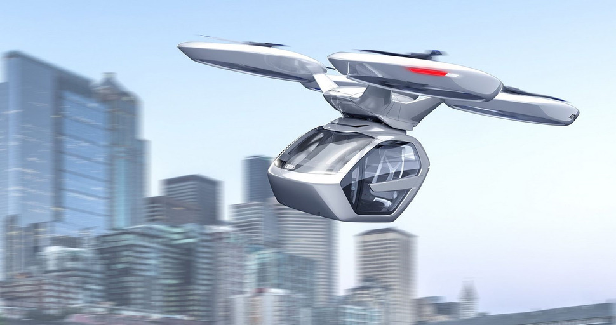
FOCUS ON THE FUTURE

Slide 33

PODCAST TRAININGS
RIGHT AWAY?
SOON?
NEAR FUTURE?

Slide 34
SUMMER CODING CAMP
RIGHT AWAY?
SOON?
NEAR FUTURE?

Slide 35
DRONE RESEARCH
RIGHT AWAY?
SOON?
NEAR FUTURE?

Slide 36
FOCUS ON THE FUTURE
EXERCISE
LIST AT LEAST 3 MAJOR CHANGES YOU CAN SEE ON THE HORIZON THAT YOU AND YOUR TEAM CAN BEGIN PREPARING TO SUCCESSFULLY IN THE FUTURE.
_________________________
_________________________
_________________________

Slide 37

CREATE YOUR
FUTURE-PROOF!

Slide 38


PLAN TO LEAD!
Thank you!
Email me at chakalaausperk@gmail.com

