Slide 1
Supporting Trans Library Employees
https://bit.ly/trans_employees
Stephen G. Krueger, MSLS
Pronouns: he/him or they/them
Scholarly Publishing Librarian, Dartmouth College
Stephen.G.Krueger@dartmouth.edu

Slide 2
Introduction

Slide 3
This is not Trans 101.
The Trans Language Primer www.translanguageprimer.org/

Slide 4
Gender inclusion: Not just for patrons
Notes:
There is a lot of excellent material on making libraries welcoming for trans folks. That said, most of it focuses on patrons. This is good and important, but we need to acknowledge that trans people work in libraries as well as use them. There is some overlap in inclusion efforts for the two groups, and a lot of the best practices for patron inclusion will also help your trans employees. This presentation will focus on specific things that you can do to support trans library workers.

Slide 5
Goals
Trans employees feel comfortable coming out at work if they want to
Employees can transition with minimal workplace stress
Trans employees do not face workplace difficulties or mistreatment due to gender
Not
All trans employees are out at work

Slide 6
Keep in mind...
This isn’t everything
Adapt to your situation
Different people, different experiences and needs
Ongoing work
Start small

Slide 7
The Basics
Notes:
This section covers some general practices that will help make your library more comfortable for trans employees. These are things that any library can and probably should put in place regardless of whether you think you have trans employees. These aren’t about personal behaviour; they’re spaces, policies, and practices that should just be part of how your organization functions.

Slide 8
Restrooms
Accessible, easily-reachable, well-labelled all-gender restrooms for employees
Tell new employees and job candidates about all restroom options (and then don’t worry about which they use)
Wastebaskets in all stalls

Slide 9
Gender-neutral language
Where?
Job descriptions and postings
Policies
Manuals
Announcements
Everywhere*
*unless specifically describing an individual or group whose pronouns and gender you are sure of
How?
Pronouns (they/them/theirs)
Nouns (person, employee, candidate)
Groups (people, folks, y’all)

Slide 10
Existing systems, spaces, policies, etc.
How does this affect someone who...
  Does not use their legal name
  Is not male or female
  Changes their name of use, legal name, and/or pronouns
Don’t wait for someone to ask
Use expert resources for help, not the nearest trans person

Slide 11
Trans inclusion training: Why?
Establishes baseline knowledge
Gives all employees opportunity to learn
Demonstrates that trans inclusion is part of the job
Saves trans employees from having to educate out of self-defense

Slide 12
Trans inclusion training: How and who?
Local resources
  Campus LGBTQ+ center
  Local organizations
  Team up with other groups
Specialists: https://bit.ly/trans-lis-presenters
For all employees
  Voluntary = people who most need it won’t go
  Flexible scheduling, multiple sessions

Slide 13
Be very careful about asking trans employees to educate others.
Notes:
It’s quite possible that you have a trans person on your staff who might be qualified to do trainings or lead discussions. Be very careful about asking them to do so if these things are not explicitly part of their job description. I obviously can’t speak for everyone, and some people might very well be fine with it, but I know that I would be intensely uncomfortable trying to educate my coworkers about my own identity. If you do happen to have a qualified employee -- meaning someone who is knowledgeable about the content, regardless of their gender identity -- talk to them one-on-one to make sure they really are comfortable with it, making clear that it is optional. And ‘optional’ doesn’t mean ‘you don’t have to do it, but that means it won’t happen.’ The choice needs to be between doing it themselves and having someone else do it.
Bringing in an outside trainer also lends authority to the topic by demonstrating that the library felt it worth the time and money to do. Even it’s exactly the same content, it can be easy for people do dismiss it if it’s coming from someone they regularly interact with.

Slide 14
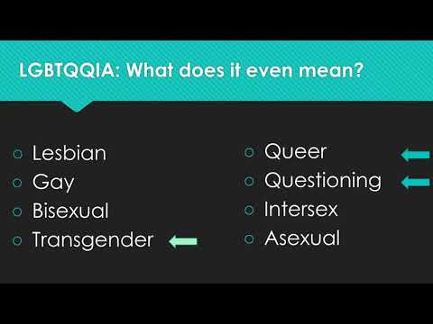
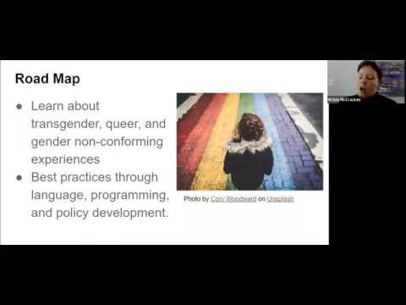
Staff viewings and discussion
Reimagining Transgender ‘Inclusion’ for Libraries
Reed Garber-Pearson, Micah Kehrein, Sunny Kim, and Bean Yogi
Trans and Gender Non-conforming Inclusion in Libraries
Krista McCracken
Notes:
If you can’t afford to bring in a trainer, consider having group or asynchronous staff viewings of these webinars, followed by group discussion about how to apply the content to your library. This may be a good option if you are having trouble scheduling training, or if you want to incorporate trans inclusion into volunteer training but don’t have time for a more in-depth session.

Slide 15
This is the bare minimum (and it’s the easy part).
Notes:
Nothing I’ve mentioned so far should be noteworthy (emphasis on should, as I have yet to see a library where all of this is the norm). If it seems like a lot, that’s because of a widespread lack of support for trans employees, not because any of this is particularly extraordinary. This is actually the easy part; it’s fairly straightforward to implement and maintain. Interpersonal behavior is much more difficult to manage.

Slide 16
New Employees

Slide 17
New employee names
Check name of use before making any announcements or creating email addresses, directory listings, name tags, etc.
Be clear about what information you need
Information should go through HR and/or IT, so coworkers only ever see the name of use

Slide 18
Example language
Please provide the information below. It will be used for your new employee announcement, work email address, and name tag.
Name of use*________________________
*This should be the name you go by for work. It does not need to match your legal name.
Pronouns (optional) __________________

Slide 19
Example language for email signatures
Template
Name: This should be whatever name you want people to call you. It does not have to match your legal name.
Pronouns (optional): For more information about pronoun sharing, see www.mypronouns.org.
Title
Examples
Stephen G. Krueger
he/him or they/them
Scholarly Publishing Librarian
Stephen G. Krueger
Scholarly Publishing Librarian
Rosie Krueger
she/her
Very Important Job

Slide 20
Health insurance
Are transition costs covered?
Is coverage information easy to find, especially for new employees?
Does an employee have to risk outing themselves by asking a manager or coworker to find out more?
Not trans-specific
Notes:
Most employees aren’t in a position to affect this, but in case you are, think about what your health insurance covers and how employees can learn details for themselves. This is another of those things that is important for a lot of trans folks (but not all) and also important for a lot of people for different reasons.

Slide 21
Orientation
Restroom locations
Where to find information about…
  Health insurance
  Local resources
  HR
Trans inclusion training
Notes:
This is about setting workplace expectations for all new employees, not just providing information for trans ones.

Slide 22
Transition At Work

Slide 23
Employee name changes
Name of use
Legal name
One place to notify name changes
  Trickle down through all systems without additional employee action
Responsibility of employer to set up system
Instructions should be easy to find and simple to follow
  Normalized process
  No explanation needed
  Minimize in-person interaction

Slide 24
Managing a transitioning employee
Be familiar with processes and resources
Provide options for sharing information
  Announcement from employee
  Announcement from someone else
  No public announcement
  Flexibility about what to share
Ask what support they want/need
Provide options for problems (you, HR)
Invite feedback on process

Slide 25
When an employee/coworker transitions...
Do
Use the name and pronouns they have asked you to use
Remind others to use the new name and pronouns
Talk to them about non-gender-related topics
Treat them normally
Do not
Comment on restroom use
Ask about their transition
Make unsolicited comments about their appearance
Tell them how their transition impacts you
Ask them to educate you

Slide 26
Human Interaction

Slide 27
Scenario
Apologize (briefly)
Correct yourself
Move on
Improve
You misgender a coworker.
“He - I’m sorry, they - will check the bookdrop on Thursdays.”
“That is Victor’s project. I’m sorry, I mean Lilia.”

Slide 28
Doing better
Educate yourself
  www.mypronouns.org/
  https://pronoun.is/
Practice
  Using different pronoun sets
    Try using pronouns that are unfamiliar to you in ways that won’t hurt anyone when you make mistakes (such as for pets, fictional characters, or passers-by).
  Talking about individuals
    Outside of work, practice using your coworker’s new name and pronouns.

Slide 29
Scenario
Are you sure?
Use the correct language yourself
Details depend on situation
“Remember to use he/him pronouns for Stephen.”
“If I hear someone misgendering you, would you like me to correct them?”
Coworker A misgenders Coworker B.

Slide 30
Scenario
Politely correct/remind as appropriate
Talk to a manager if possible
This is what required training is for
A coworker regularly uses offensive language and/or intentionally misgenders others.

Slide 31
Conclusion
Trans people exist in library work
Don’t wait until a situation comes up
Set expectations and provide resources for all employees
Trans inclusion is not optional

Slide 32
Resources
Zotero group: Trans Inclusion for Libraries
Not Cis in LIS: A Roundtable Discussion about being Trans in Libraries
Trans inclusion in LIS presenter list
Trans Allyship Workbook
Ask a Manager: How Can We Help Gender Transitions at Work Go Well?
Transgender Employees in the Workplace: A Guide for Employers
Transgender in the Workplace: The Complete Guide to the New Authenticity for Employers and Gender-Diverse Professionals

Slide 33
Questions?
Supporting Trans Library Employees by Stephen.G.Krueger is licensed under a Creative Commons Attribution 4.0 International License.

