Slide 1
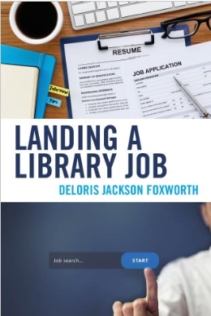
Staying relevant in the library profession
*Author of Landing a Library Job
Presented by Deloris Jackson Foxworth*

Slide 2
About the presenter
Author of
Landing a Library Job
Education
Graduate certificate career services from Western Kentucky University
MSLS from University of Kentucky
Employment
Academic advisor, College of Communication and Information (UK)
Part-time instructor, School of Information Science (UK)
Lecturer, School of Information Science (UK)
Technology manager, Scott County Public Library
Library-related publications
Landing a Library Job
Empowerment, teamwork, and personal growth
Starting a device club
Public library summer reading registration on Google forms
Library-related presentations
Tracking Wi-Fi
Starting a device club
Table of Contents
Identifying types of jobs
Finding jobs
Applying for jobs
Interviewing for jobs
Following the interview
Staying relevant

Slide 3
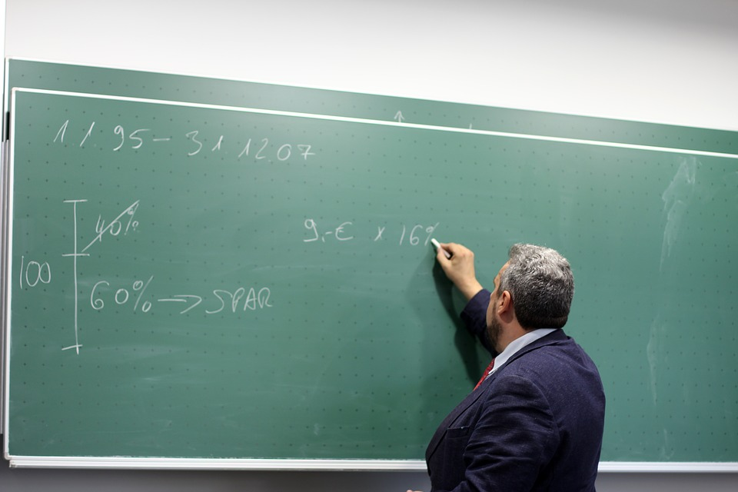
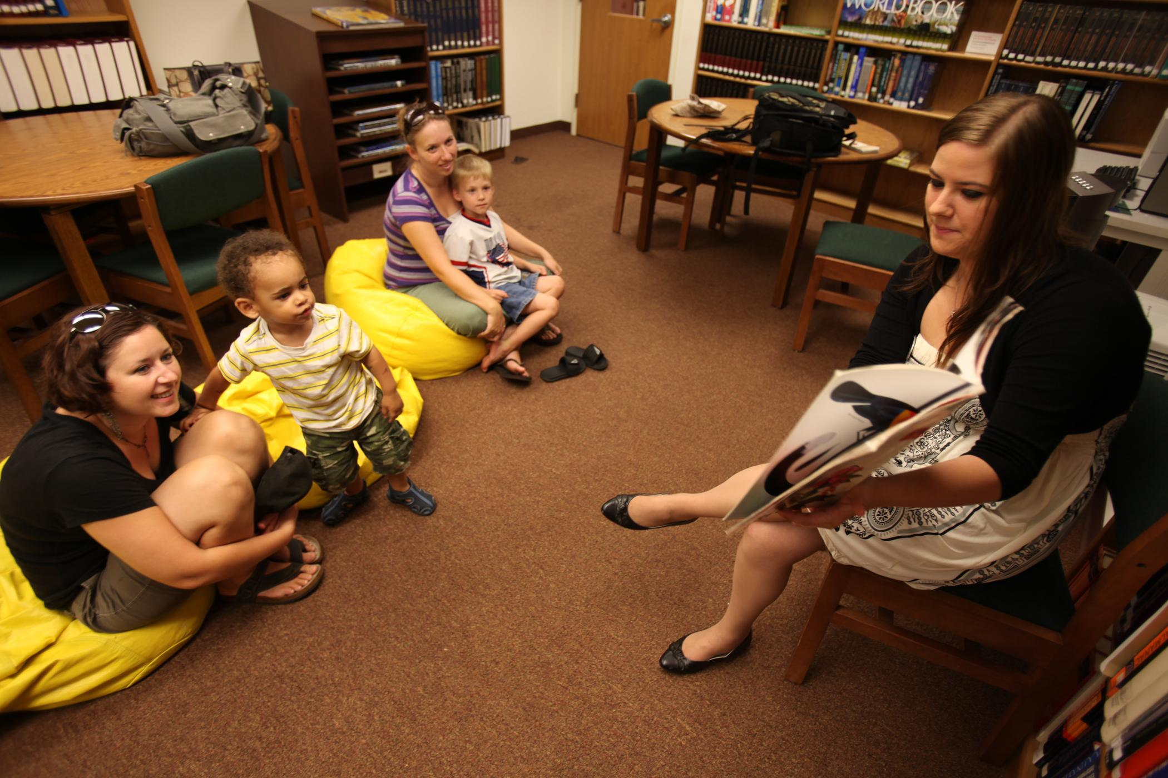

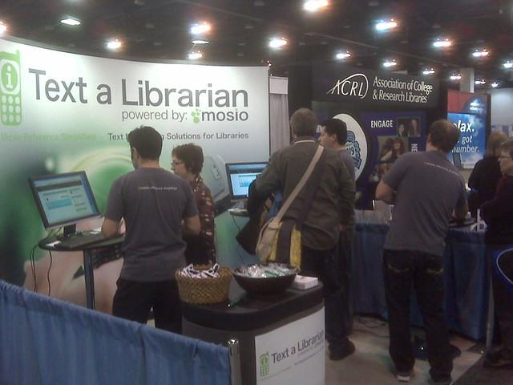
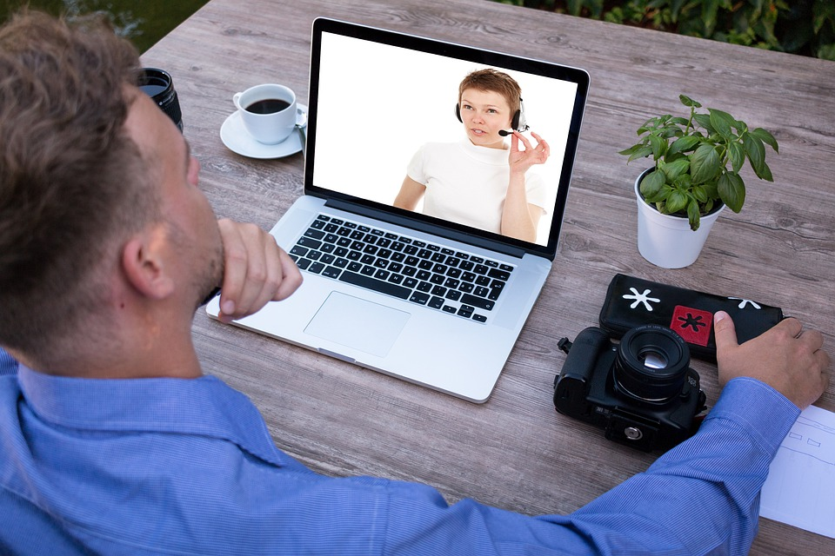

Which is an example of professional development?
Teaching
Leading Storytime
Volunteering at summer camp
Playing a game
Attending an ALA conference
Participating in a webinar
Notes:
Okay before we get started with our discussion on professional development. Take a quick look. Which of these images do you think demonstrate professional development?

Slide 4
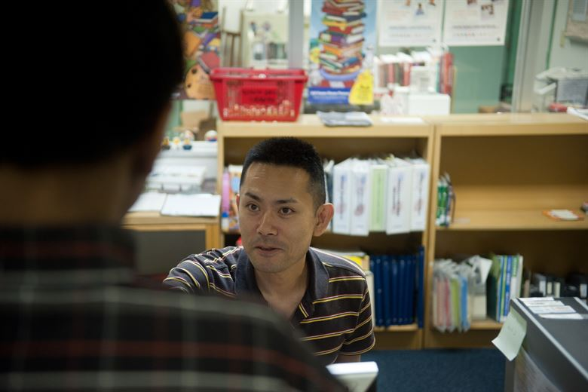
Some things professional development is not
Doing your daily tasks at work.
Participating in regular staff meetings.
Working long hours to complete a project or task.
Visiting a library while on vacation.
Sharing your library’s events on your personal social media feed.

Slide 5
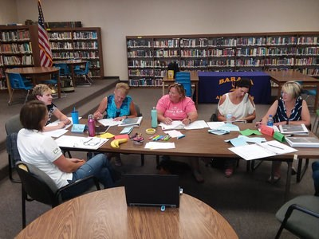
Professional development defined
The Cambridge Dictionary definition:
“training that is given to managers and people working in professions to increase their knowledge and skills.”
The Business Dictionary definition:
“Process of improving and increasing capabilities of staff through access to education and training opportunities in the workplace, through outside organization, or through watching others perform the job.“
“Professional development helps build and maintain morale of staff members, and is thought to attract higher quality staff to an organization. Also called staff development.”
My definition:
Activities that increase your knowledge, skills, or experience in a particular field (usually related to your current position)
Notes:
So how do we define professional development?
https://dictionary.cambridge.org/us/dictionary/english/professional-development
http://www.businessdictionary.com/definition/professional-development.html

Slide 6
Professional development significance
The Bureau of Labor Statistics reports the average person changes jobs 11.9 times between the age of 18-50.
The World Economic Forum describes the job market as a place of change highlighting the potential for new job creation- the creation of jobs that did not even exist five or ten years ago.
Your employer or potential employer expects or requires professional development.
Your position has state-, federal-, or governing-body-mandated certification or licensure requirements.
You want to expand your credentials and/or employability.
You want to make connections in the library and information science profession.

Slide 7
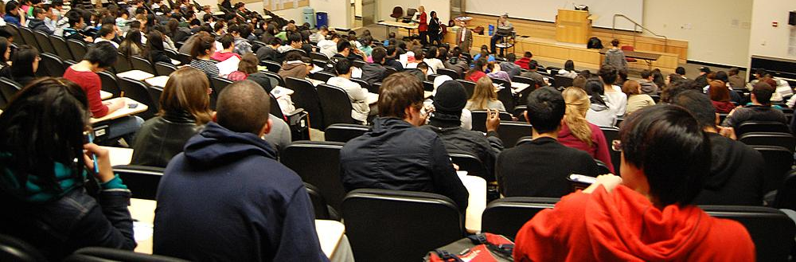
Higher education
Types of Degrees
Associate
Bachelor’s
Master’s
Doctoral
Tips regarding higher education:
Each education level is independent of the other- meaning you do not have to study the subject at the previous level to study it at a higher level.
The master’s degree is typically the highest level required to hold most librarian positions and not all require a master’s. If you plan to teach or research librarianship you may opt for the doctoral.
Additional degrees outside library and information science may be significant especially for academic librarians.
Employers and/or friends associations may sometimes help with educational costs.
Notes:
Ask about level of education for attendees.
Educational costs- employer plans, friends scholarships, etc.

Slide 8
Certifications
Types of Certifications
Library paraprofessional
Library Support Staff Certification through ALA and the Allied Professional Association
State-mandated certification
Professional librarian
Certified Public Library Administrator through ALA and the Allied Professional Association
School Media certification (mandatory)
State mandated-certification
Information and Technology
CompTIA certifications
Vendor specific- Cisco, Microsoft, Google
Tips regarding certifications:
Find out if the certification is required for your particular position, the position you hope to achieve, or your by your employer.
Research to see if there are continuing education requirements and/or additional costs to maintain the certification.
Check the the minimum requirements for the certification.
Keep track of your continuing education units or contact hours.
Consider practicing and studying for a certification even if you cannot obtain said certification.
Notes:
Required certifications are sometimes required by state associations

Slide 9
Professional & affiliated associations
Types of professional and affiliated associations:
Library and information science professional associations
State library associations
Cooperatives and consortiums
Vendors
Tips regarding professional and affiliated associations:
Designate interest groups on your membership applications.
Sign up for listservs (This is usually free and can sometimes be done without joining the association).
Volunteer to serve on committees.
Look for free and discounted webinars, e-tutorials, and even live training sessions.
Attend conferences.
Submit a conference proposal
Write a review or blog post
Notes:
Don’t forget to also look for staff development

Slide 10
Other professional development avenues
Other types of professional development
Cross-training
Mentorship/job shadowing
Conducting research
Writing/Publishing
Leading trainings
Teaching classes
Tips regarding other avenues of professional development:
Consider collaborating with others in your library and/or related organizations or professions.
Some of these opportunities may even pay.
Many of these opportunities are promoted on listservs or through social media.
Ask others in the profession what they are doing for professional development and what they are interested in learning about.

Slide 11
Scale of cost$
Be a mentor
Write & Publish
Submit to present
Get a certification
Lead a training
Join an
interest group
Sign up for listservs
Teach a class
Get a degree
Cross-train
Become a member
Serve on a committee
Attend a conference
Less expensive
More expensive

Slide 12
Documenting professional development
Types of information to document:
Title (if applicable)
Presenter (if applicable)
Host or affiliated organization
Date(s) and time(s)
Number of contact hours or continuing education units
Location and/or conference title (if applicable)
Description or summary of the event/activity
Contact information for any professional connections you make
Tips regarding documenting professional development:
Keep any programs, notes, or handouts from professional development opportunities.
Send follow up correspondence to presenter and/or others you connected with during through the opportunity.
Add the opportunity to your resume.
Set a goal for how you will implement what you have learned.
Notes:
CEU is equal to a certain number of contact hours. For example, the Kentucky Department of Libraries suggests to convert 1.5 CEUs to contact hours you simply move the decimal one place ot the right. This is the equivalent of multiplying 1.5 by 10 meaning they count 10 contact hours per each CEU. (https://kdla.ky.gov/librarians/staffdevelopment/Pages/CertificationFAQs.aspx)

Slide 13


Questions?
Table of Contents
Identifying types of jobs
Finding jobs
Applying for jobs
Interviewing for jobs
Following the interview
Staying relevant
Deloris Jackson Foxworth Author of Landing a Library Job
deloris.foxworth@uky.edu https://www.linkedin.com/in/deloris-foxworth-06ab4a19
https://twitter.com/DelorisFoxworth

