Slide 1

Practicing intellectual freedom in libraries
Shannon M. Oltmann
University of Kentucky
May 15, 2019

Slide 2

Background on me
Associate professor at the School of Information Science, University of Kentucky
Focus on intellectual freedom, privacy, information ethics, and libraries in research and teaching
19 research articles, 2 book chapters, and numerous conference presentations about these topics
I teach about these issues every semester
Kentucky Department of Libraries and Archives annual seminar on intellectual freedom
Wrote a book on intellectual freedom

Slide 3
Basic structure of webinar
First part: theoretical and philosophical background of intellectual freedom
What does it mean?
Why is it important in the U.S. and to librarianship?
What are the foundations of intellectual freedom?
Second part: more practical stuff
Intellectual freedom in various types of libraries
Intellectual freedom and collection development
Intellectual freedom and the #MeToo movement
Intellectual freedom and internet filtering

Slide 4

Defining intellectual freedom
“The right of every individual to both seek and receive information from all points of view without restriction. [Intellectual freedom] provides for free access to all expressions of ideas through which any and all sides of a question, cause or movement may be explored” (ALA, Intellectual Freedom & Censorship Q&A, 2007, para. 1)

Slide 5
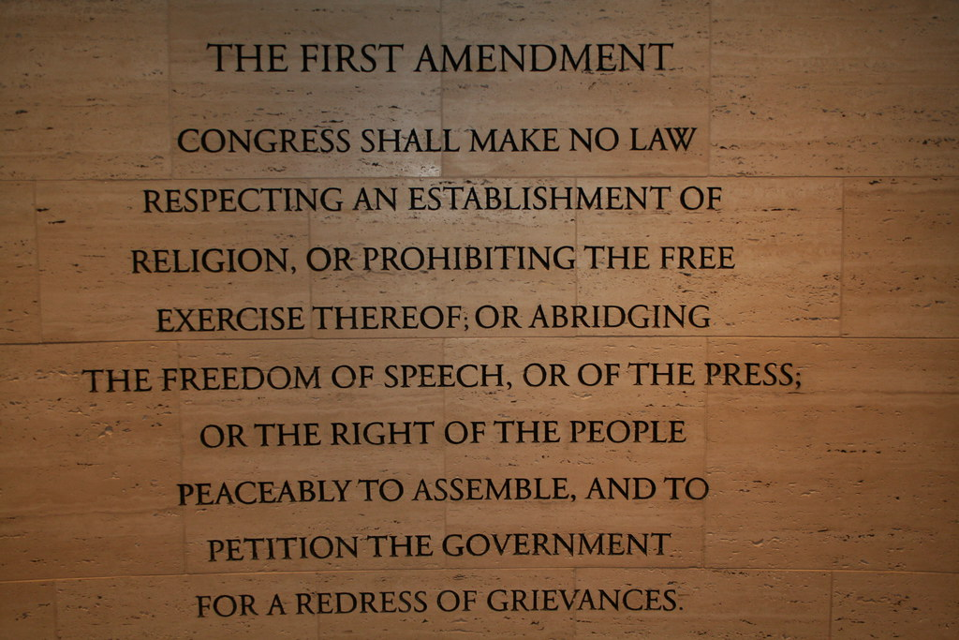
Intellectual freedom is closely entwined with the First Amendment
First Amendment is about not abridging the freedom of speech
Judges and legal experts have argued that freedom of speech is meaningless without the right to access information as well
Mart (2003) noted that “by 1969, the right to receive information had become a fundamental right” (pp. 178-179)

Slide 6
Intellectual freedom is closely entwined with the First Amendment
Relevant Supreme Court cases:
Martin v. City of Struthers (1943)
Thomas v. Collins (1945)
Griswold v. Connecticut (1965)
Lamont v. Postmaster General (1965)
Stanley v. Georgia (1969)
Richmond Newspapers Inc v. Virginia (1980)
Board of Education v. Pico (1982)

Slide 7
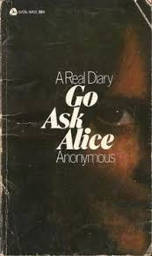
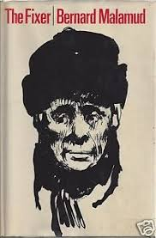
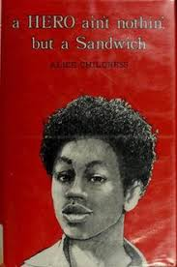
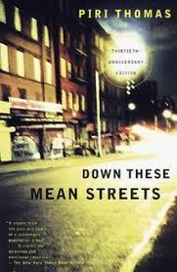
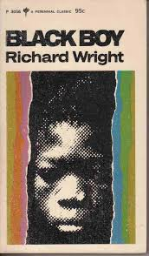
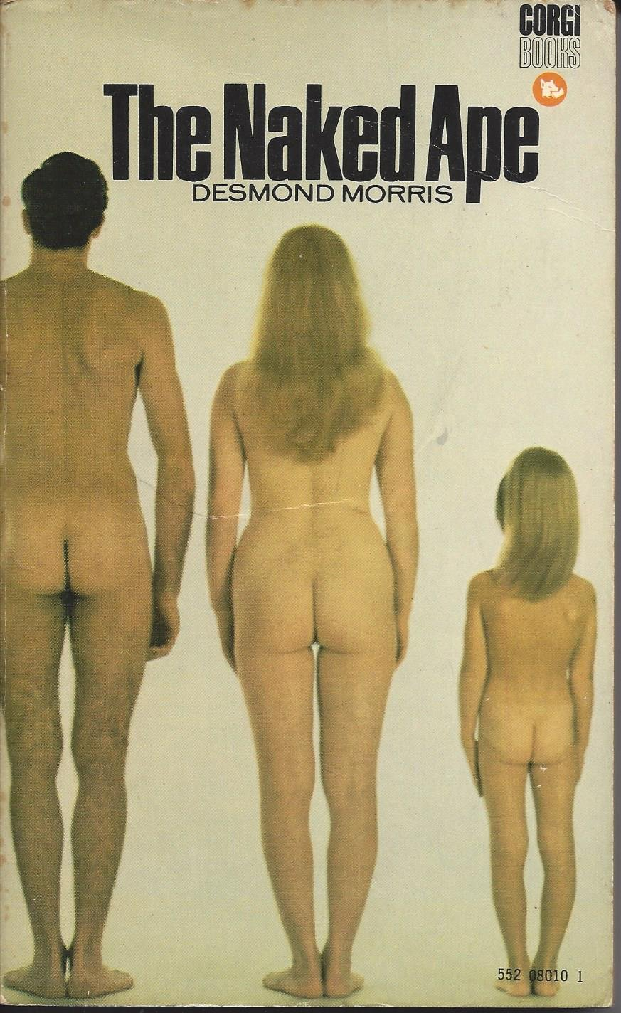

Board of Education v. Pico (1982)
School board voted to remove several books that they deemed “anti-American, anti-Christian, anti-Semitic, and just plain filthy”
In a 5-4 decision, the Supreme Court ruled that the board could not remove books just because they disagreed with them

Slide 8
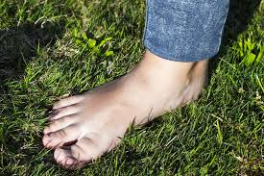
A few more legal cases
Kreimer v. Bureau of Police for Morristown (1992)
Sund v. City of Wichita Falls, Texas (2000)
Tattered Cover v. City of Thornton (2002)
Neinast v. Board of Trustees of the Columbus Metropolitan Library (2003)

Slide 9

“Receiving information” as a corollary of the First Amendment
Corollary: proposition that follows or flows logically from a previous statement
Without someone to receive (or access) one’s ideas, the right of speech is diminished
The whole point of speech is to communicate with others
Receiving information is necessary to forming (and expressing) one’s own opinion
We build our thoughts and opinions on the ideas that came before us

Slide 10
The Library Bill of Rights and intellectual freedom
The American Library Association affirms that all libraries are forums for information and ideas, and that the following basic policies should guide their services.
I. Books and other library resources should be provided for the interest, information, and enlightenment of all people of the community the library serves. Materials should not be excluded because of the origin, background, or views of those contributing to their creation.
II. Libraries should provide materials and information presenting all points of view on current and historical issues. Materials should not be proscribed or removed because of partisan or doctrinal disapproval.
III. Libraries should challenge censorship in the fulfillment of their responsibility to provide information and enlightenment.
IV. Libraries should cooperate with all persons and groups concerned with resisting abridgment of free expression and free access to ideas.
V. A person’s right to use a library should not be denied or abridged because of origin, age, background, or views.
VI. Libraries which make exhibit spaces and meeting rooms available to the public they serve should make such facilities available on an equitable basis, regardless of the beliefs or affiliations of individuals or groups requesting their use.
VII. All people, regardless of origin, age, background, or views, possess a right to privacy and confidentiality in their library use. Libraries should advocate for, educate about, and protect people’s privacy, safeguarding all library use data, including personally identifiable information.

Slide 11

The Library Bill of Rights, Principle #1
I. Books and other library resources should be provided for the interest, information, and enlightenment of all people of the community the library serves. Materials should not be excluded because of the origin, background, or views of those contributing to their creation.
Intellectual freedom applies to all library resources (not only books)
“Interest, information, and enlightenment” covers a broad range of possible motivations for seeking information and ideas
Shouldn’t exclude material based on the authors’ or creators’ backgrounds (more on this later)

Slide 12

The Library Bill of Rights, Principle #2
II. Libraries should provide materials and information presenting all points of view on current and historical issues. Materials should not be proscribed or removed because of partisan or doctrinal disapproval.
Explicit emphasis on providing all points of view
Even if we disagree with them

Slide 13

The Library Bill of Rights, Principle #5
V. A person’s right to use a library should not be denied or abridged because of origin, age, background, or views.
Sometimes the most controversial principle
because of “age”
However, ALA has repeatedly reaffirmed the
inclusion of age here
Age alone is not a sufficient reason to restrict access

Slide 14
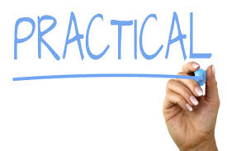
Moving on…
Intellectual freedom in various types of libraries
Collection development
Reconsideration and challenges
#MeToo movement
Internet filtering

Slide 15

Intellectual freedom in your library’s community
Every library has a community it serves
Not always geographically bound (especially with the internet)
“a group of persons (a) engaging in social interaction, (b) within a geographic area, and (c) having a common tie or ties” (Goe and Noonan 2006, p. 457)

Slide 16
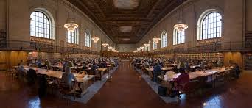
Intellectual freedom in public libraries
Community: generally town or county in which the library is located
Reciprocal agreements with surrounding area
Issues include:
Minors in the library
Internet filtering (covered later)
Patron record confidentiality

Slide 17

Intellectual freedom in school libraries
Community: K-12 students, teachers, staff members (sometimes others affiliated with the school, such as parents)
Key difference: school employees act in loco parentis
Other issues:
Students learning critical thinking and becoming good citizens
Age appropriateness of materials
Internet filtering
Accelerated Reader (AR) and other similar programs

Slide 18
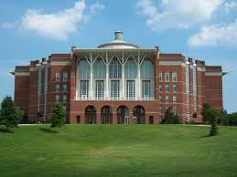
Intellectual freedom in academic libraries
Community: faculty, staff, students (sometimes alumni and local public)
Religious institutions: institutional belief system often trumps professional values like intellectual freedom
But some pushback is reasonable
Internet filtering, collection development, codes of conduct
Secular institutions: do not have a religious orientation
or commitment
Confidentiality of library records, limited access
for some community members, licensing agreements

Slide 19
Intellectual freedom issues in special libraries
Community: often dependent on the parental organization (e.g., the hospital, university, or corporate law offices)
“Special libraries” encompasses a wide range of institutions
Often have some restricted access to certain patron groups because of small budgets and limited resources (and special collections)

Slide 20
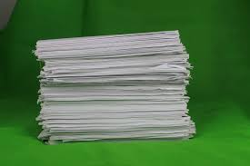
Intellectual freedom and collection development
Important: have a collection development (CD) policy regardless of the type of library in which you work
Description of the library and its patrons
List of criteria by which materials are selected
Statement about intellectual freedom
Referral to a reconsideration policy (more on that later)
And referral to key statements from the ALA

Slide 21
Possible criteria for selecting materials
Content or subject
Language
Currency
Veracity (truthfulness, accuracy)
Writing style (well written, easy to read, aesthetic aspects)
Completeness and scope of treatment
Reputation, credential, or authoritativeness of author, publisher, editor, reviewers
Instruction design, if intended to meet certain instructional objectives
Geographic coverage
Quality of scholarship
Frequency the title is referenced in bibliographies or citations
Reading or user level to which content is directed
Frequency of updates or revisions
Access points (indexes, level of detail in the table of contents)
Ease of use
External resources that index the publication
Physical quality
Uniqueness of content, capabilities, or features
Availability of equipment required for hearing or viewing audiovisual material
Cost in relation to quality of item and its projected use
Drawn from Johnson, 2018

Slide 22
Possible criteria for selecting materials
Content or subject
Language
Currency
Veracity (truthfulness, accuracy)
Writing style (well written, easy to read, aesthetic aspects)
Completeness and scope of treatment
Reputation, credential, or authoritativeness of author, publisher, editor, reviewers
Instruction design, if intended to meet certain instructional objectives
Geographic coverage
Quality of scholarship
Frequency the title is referenced in bibliographies or citations
Reading or user level to which content is directed
Frequency of updates or revisions
Access points (indexes, level of detail in the table of contents)
Ease of use
External resources that index the publication
Physical quality
Uniqueness of content, capabilities, or features
Availability of equipment required for hearing or viewing audiovisual material
Cost in relation to quality of item and its projected use
Drawn from Johnson, 2018

Slide 23

Collecting controversial items
Acknowledge that “controversial” is subjective and not universal
Thoughtful approach:
Reduce stress, anxiety, and possible negative publicity
Create a well-rounded, diverse, and appealing collection
Ensure an item is not rejected immediately because it is (or could be) controversial to some patrons in your community

Slide 24
Collecting controversial items
Focus on the merits of the item
Does the item meet the criteria of the CD policy?
As librarians, we are selectors not censors (we look for reasons to provide access, not curtail or limit access)
Two boys kissing (by David Levithan, 2013)
Asheim (1953) said: “For to the selector, the important thing is to find reasons to keep the book. Given such a guiding principle, the selector looks for values, for strengths, for virtues which will over shadow minor objections. For the censor, on the other hand, the important thing is to find reasons to reject the book; his guiding principle leads him to seek out the objectionable features, the weaknesses, the possibilities for misinterpretation”

Slide 25

Building a balanced collection
Most libraries should aim for including multiple viewpoints and perspectives
Doesn’t (necessarily) mean an equal number of books
Simplistic approach
Instead, think about the breadth of perspectives

Slide 26

Balance and controversy test case
Well-known far right activist
On the other hand, his message is popular among some people
How do libraries decide whether to purchase it?
Turn to Library Bill of Rights
Turn to CD policy
Use the same evaluation tools that are used for other library materials
Neutral, fair, balanced

Slide 27
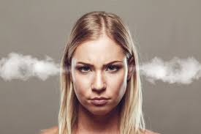
Reconsiderations and challenges
Challenge: a patron challenges the inclusion of an item in the library collection

Slide 28
Reconsiderations and challenges
Challenge: a patron challenges the inclusion of an item in the library collection
Reconsideration form: a form that the patron should complete to formally challenge the item’s inclusion (and formally ask that the library reconsider its inclusion)
Shows patrons you respect their opinions
Provides a fair, neutral process
Starts documenting the concern

Slide 29
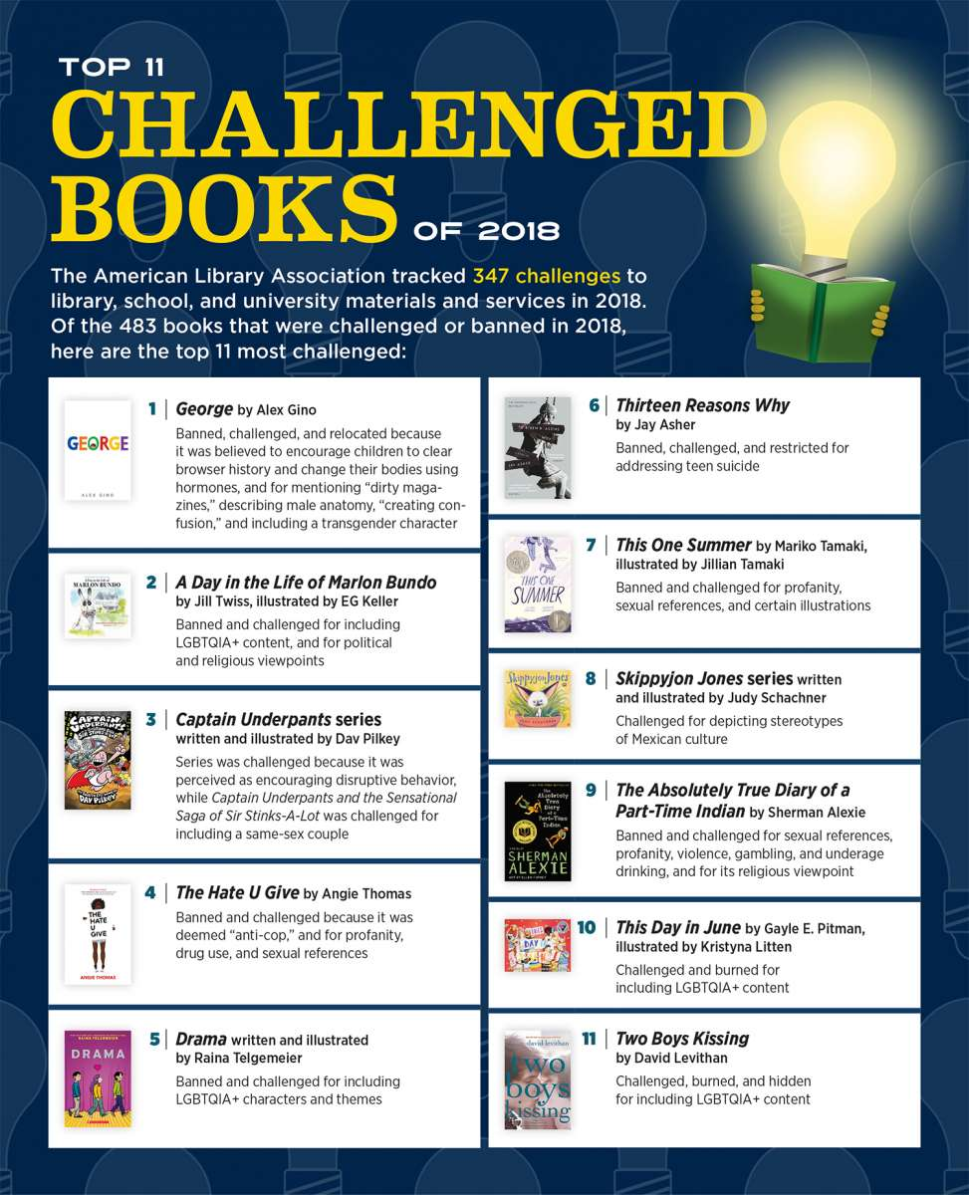
From ALA, 2013

Slide 30
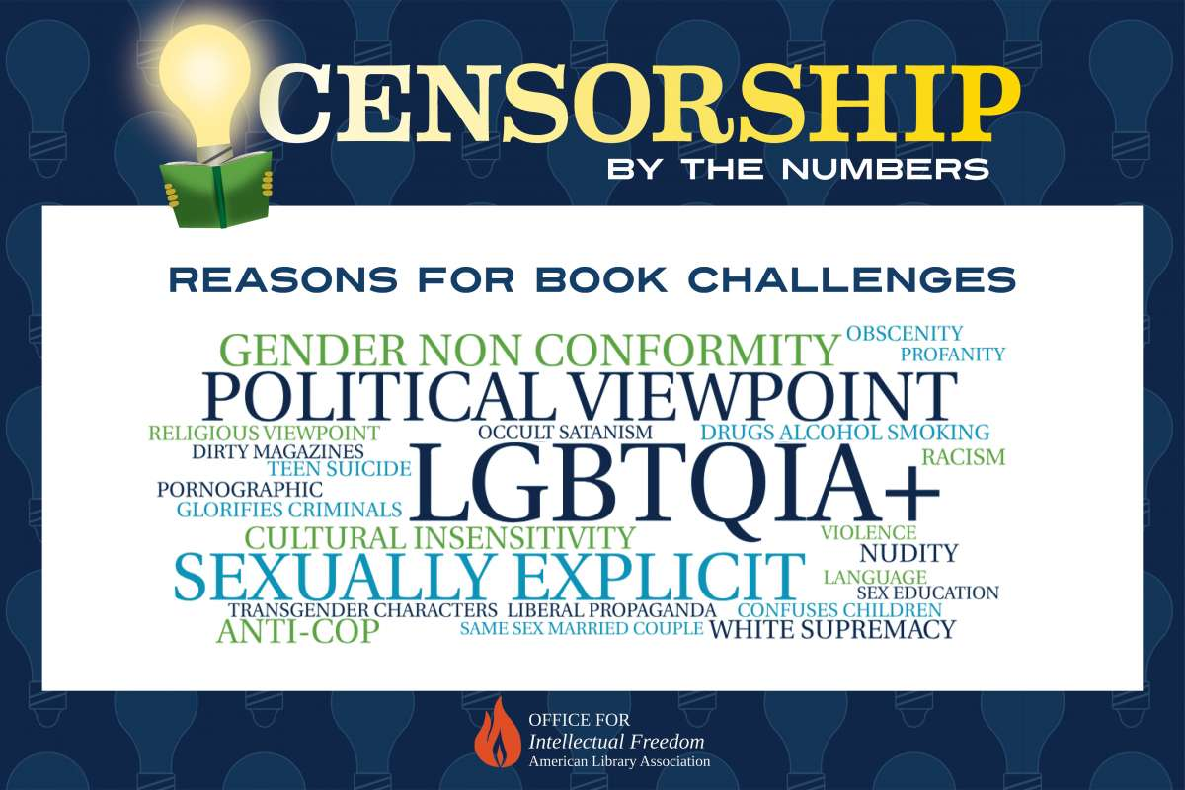

Reasons for challenges to library materials

Slide 31
What to do when materials get challenged
Form a committee to review and evaluate the material
Consider reviews, critiques, etc.
Review CD policy and ALA documents
Deciding what to do
Retention
Removal or relocation
Other, less common options
Writing a letter to the challenger
The library seeks to provide materials that represent a variety of viewpoints, ideas, and concepts. The First Amendment to our Constitution affords the library its role as a provider of diverse materials to the community it serves, endows the artist with the freedom to express him/herself as seen fit, as well as bestowing the individual right of citizens to freely express their beliefs on the validity of those same items. When we discuss these issues, whether supporting or objecting to a work, we are practicing our right to freedom of speech guaranteed by our Constitution.

Slide 32
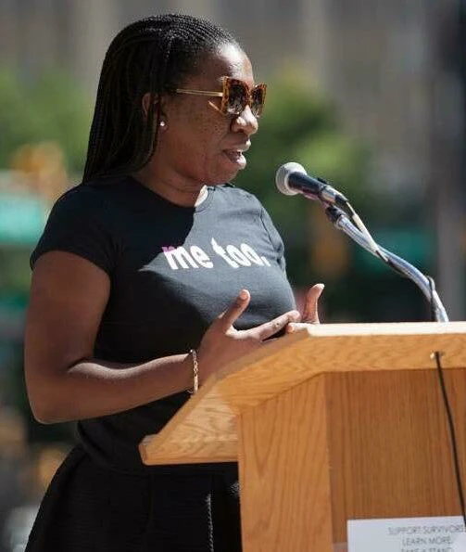
Intellectual freedom and the #MeToo movement
Quick background on #MeToo movement
Began in 2007 by Tarana Burke
Gained momentum in 2017 via social media
Numerous authors, illustrators, and others in the publishing industry have been implicated
When authors and illustrators are implicated, should we remove their books from circulation or place them in a special, restricted area?
Or do we keep them on the shelves as if nothing has changed?
What do we owe to our patrons, our co-workers, and ourselves?

Slide 33

Turning back to our core values
Library Bill of Rights: “Materials should not be excluded because of the origin, background, or views of those contributing to their creation” (principle 1)
Core Values of Librarianship: “We uphold the principles of intellectual freedom and resist all efforts to censor library resources” (para. 8)
Freedom to Read Statement: “It is contrary to the public interest for publishers or librarians to bar access to writings on the basis of the personal history or political affiliations of the author. No art or literature can flourish if it is to be measured by the political views or private lives of its creators...” (para. 10)

Slide 34
An approach informed by intellectual freedom
Removing the books because of their creators’ sexual misconduct would be contrary to our foundational principles
It’s okay to dislike things in your library collection
But that can’t be the basis of deciding what gets included in the collection
Evaluate a work on its merits
Does it fit with the CD policy?
Does it circulate?

Slide 35

What else can be done?
Patron discussion group about #MeToo movement
Discussion of intellectual freedom principles
Creative writing group to generate new stories
Deliberately seek out new voices (especially marginalized folks)
Decline to host or feature those who are implicated
Professional/ personal distinction

Slide 36
Internet filtering: how it works
Adult/mature
Illegal drugs
Pornography
Arts/entertainment
LGBT
Society/daily living
Software that prevents access to certain websites
Usually through categories (blacklists/whitelists)
Proprietary information
Problematic for controversial or sensitive subjects
What gets included in a category?
LGBT: gay pride parades, safer sex practices, anti-bullying campaigns, and erotica
Illegal drugs: information about drugs, their effects, anti-drug education, and sites about beating addiction

Slide 37
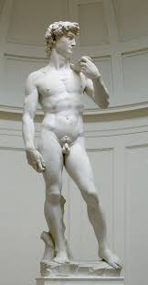
Why use internet filters at all?
Children’s Internet Protection Act (CIPA), 2000
Ties some federal funding to the use of internet filters in public schools and public libraries
Must block images that are obscene, child pornography, and “harmful to minors”
Nudity? Artwork?
United States v. American Library Association (2003)
“Bona fide research” exemption (in most public libraries)

Slide 38

Problems with internet filtering
Overblocking & underblocking
Removes responsibility from users (poor digital citizenship)
No variation for different maturity levels
Categories do not match “harmful to minors” legal requirement
Subjectivity of deciding which information people can access

Slide 39
What can be done about internet filtering?
It’s not going to go away (especially in schools)
Least restrictive approach
What is the least restrictive internet filter available?
How much information will the company share about its philosophy and practices?
Which categories of information (really) have to be blocked?
What is the potential harm of allowing access to?
Consider what would be included in a very broad conceptualization of the category
Ensure the filter can be removed upon request

Slide 40
Wrapping up
Overall, a “least restrictive” approach in your library can be beneficial
Pro-intellectual freedom approach
Emphasizes access over restrictions

Slide 41

For more information…
From Libraries Unlimited
Due in August 2019
Discount offer via email from Niche Academy (20% off)

Slide 42
Introduction
Part I: Conceptualizing Intellectual Freedom
Chapter 1: Intellectual Freedom and Access to Information
Chapter 2: Three Theories behind Access to Information
Chapter 3: The Freedom to Explore
Chapter 4: Core Values and Intellectual Freedom
Chapter 5: Intellectual Freedom in the Daily Lives of Libraries
Part II: Intellectual Freedom in Action
Chapter 6: How to Handle Materials Challenges
Chapter 7: Collection Development and Weeding
Chapter 8: Addressing the #MeToo Movement in Literature
Chapter 9: Programs, Meeting Rooms, and Exhibit Spaces
Chapter 10: Internet Filtering
Chapter 11: Fake News, False Information, and Intellectual Freedom
Chapter 12: Law Enforcement and Intellectual Freedom
Chapter 13: Copyright Issues
Chapter 14: Intellectual Freedom Trends and Their Implications

Slide 43
Questions and comments!
Always willing to discuss these ideas and issues: shannon.oltmann@uky.edu
If you have an intellectual freedom dilemma at your library
If you have an intellectual freedom question
If an item is being challenged at your library
If you have an idea for a research project

