Slide 1

Our Professional Challenge
"I wish my learners would be as excited about reading as they are about
technology"

Slide 2
Positionality
My Why…

Slide 3
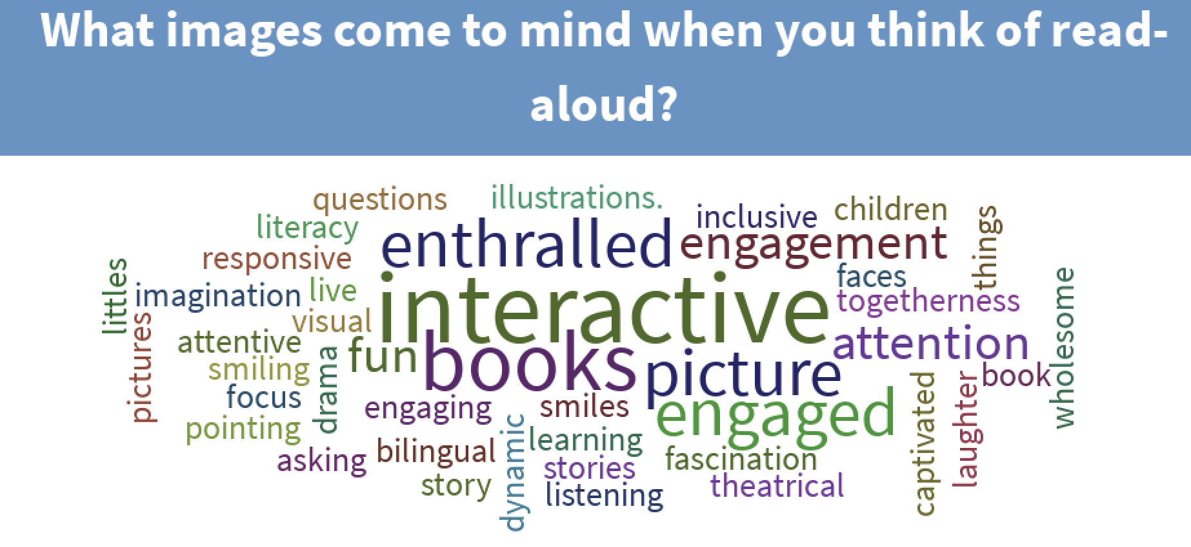
What We Know
Notes:
What images come to mind when you think of read-aloud?
https://www.polleverywhere.com/free_text_polls/z48mIvW7a3QrNPVsC18my

Slide 4
Traditional read-aloud is a societal force for the greater good.
Literacy development skills
Motivation to read
Future Academic Performance
What We Know

Slide 5
Read-alouds have traditionally lacked technology.
Should we care?
What We Know

Slide 6
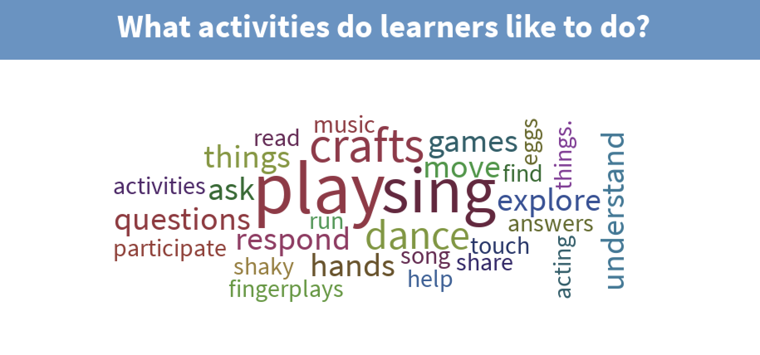
What We Know
Notes:
What activities do students like to do?
https://www.polleverywhere.com/free_text_polls/5KUaGOhOsihPI4wHfSuZE

Slide 7
Our learners, according to the Kaiser Foundation’s longitudinal study, are screen time technology users at the rate of 6 hours 19 minutes a day to 7 hours 38 minutes a day for those up to age 10.
The screen time technology use increases with age and tops out with 18 year olds at as much as 11 hours and 28 minutes.
What We Know

Slide 8
How can we address the addition of more minutes of screen time for educational purposes due to Covid 19?
Can we bridge between the traditional read-aloud experience and technology to optimally engage learners?
What We Want to Know

Slide 9
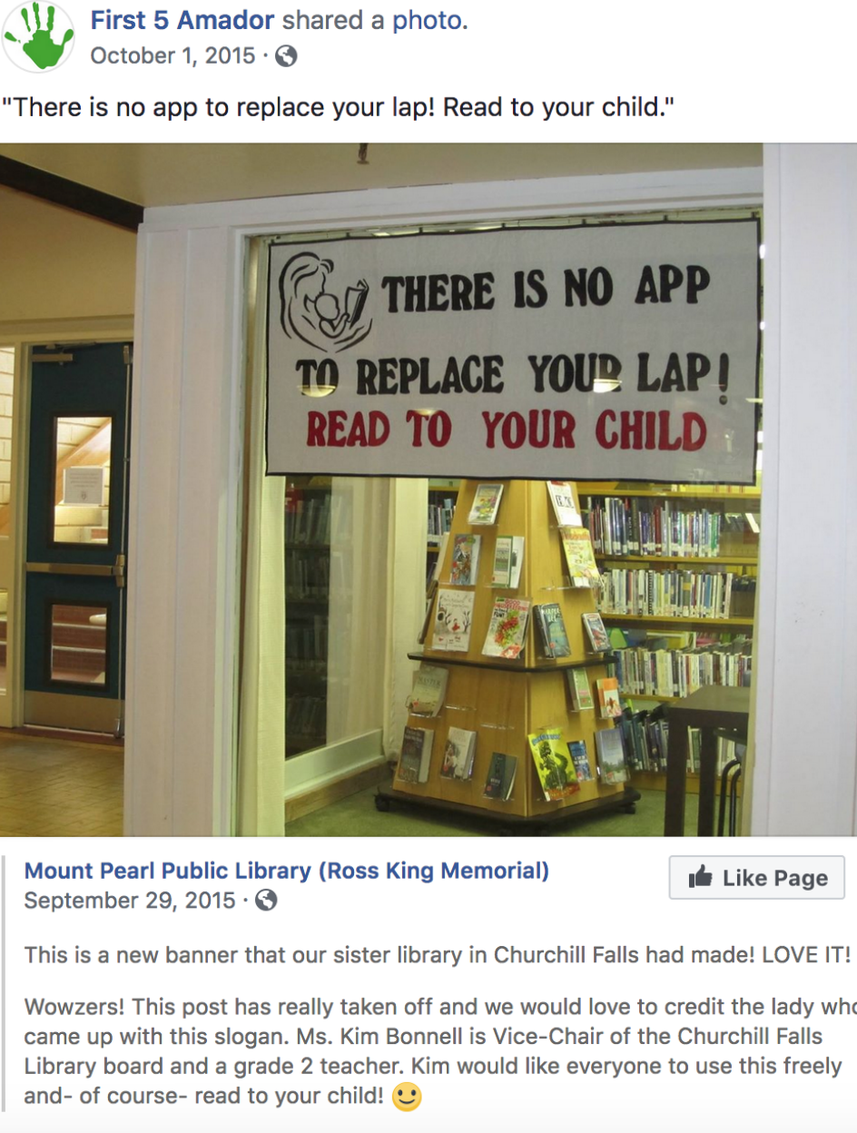
Best of Both Worlds
Yes! It is possible to retain important aspects of traditional read-aloud while embracing elements of screen time technology and engage our learners.
Have you seen a learner interact with an ebook?

Slide 10
Librarians can be the model for technology rich best practices for reading.
Librarians Rock!

Slide 11
Techno-storytime
Digital Read-alouds
Online Read-alouds
A read-aloud that has been powered-up with digital aspects.
What does this look like in the Covid 19 world?
Idea Defined

Slide 12
What are the categories of digital literature?
Categories

Slide 13
Augmented Reality
Categories
Augmented Reality makes use of book materials that are standalone while incorporating materials that are digital.
https://www.youtube.com/watch?v=tX8tZLdAJt8

Slide 14
Dynamic Dialogue
Categories
Dynamic Dialogue consists of materials that contain embedded audio, dictionary or other digital functions.
http://openlightbox.com/follett-demo/

Slide 15
Story Author
Categories
Story Author embraces project based tools and selected digital objects to create their own original books to engage during read-aloud.
https://www.youtube.com/watch?time_continue=8&v=Bik4xvcnCDI

Slide 16
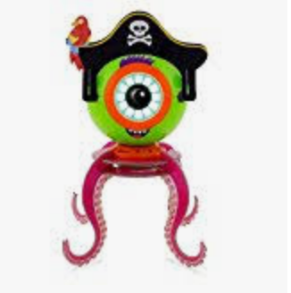
Code Author
Categories
Code Author embraces project based tools and selected digital objects to create and share their own stories through the use of coding.

Slide 17
Execution
Time to Deliver
➢ Set the scene
➢ Complete a run-through
➢ Creatively edit when necessary
➢ Read and direct learners with expression and enthusiasm
➢ Select the appropriate materials to digitally support the text in a meaningful way
➢ Make time to present techno-storytime
➢ Make it interactive
➢ Select carefully when reading to older learners between materials that are appropriate for hearing and those for individual reading
➢ Handle failure with grace and have a back-up plan in case of technology issues (Paganelli 2016).

Slide 18
Thank you for your time.
If we model appropriate technology use during read-aloud will learners follow that example?
We can’t be sure, but leading learners to view technology use and quality literature as hand-in-hand companions is a positive.

