Slide 1
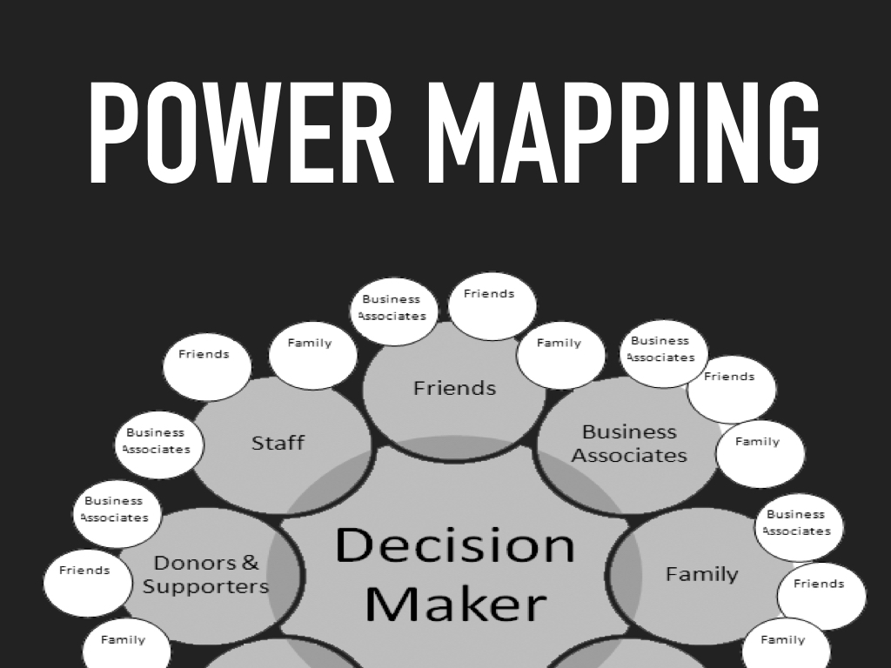
Notes:
Talk about what power mapping is, lance warner Tea party, Kentucky BBQ

Slide 2

Notes:
-

Slide 3


Slide 4


Slide 5


Slide 6
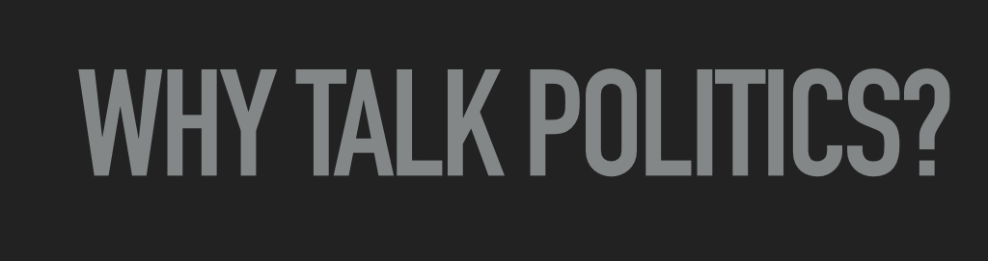
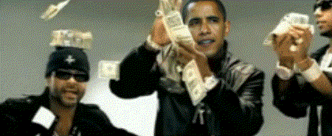

Slide 7
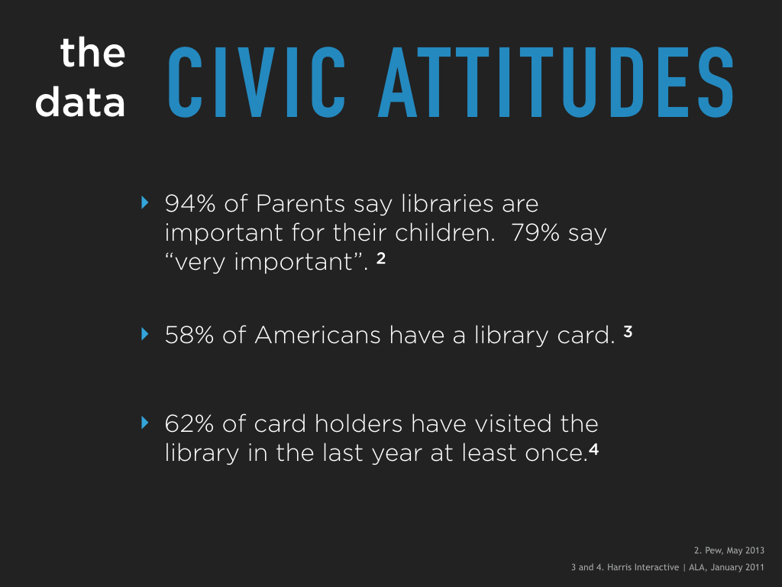

Slide 8
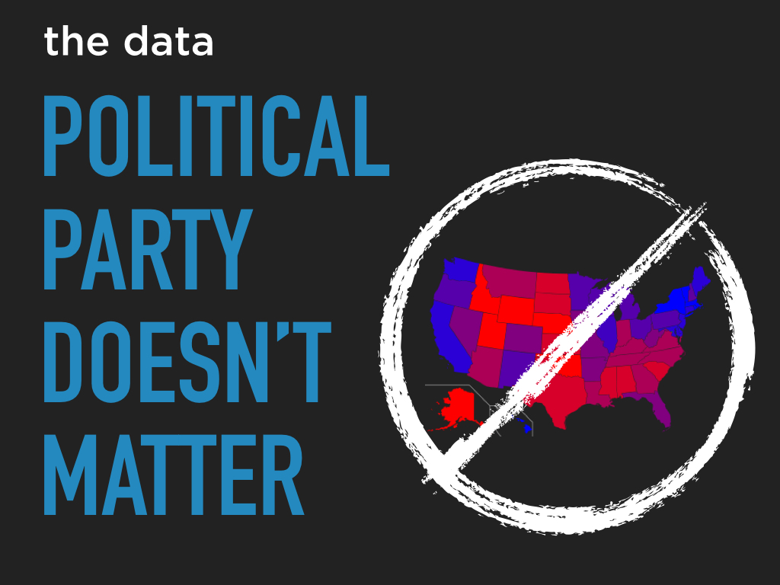

Slide 9
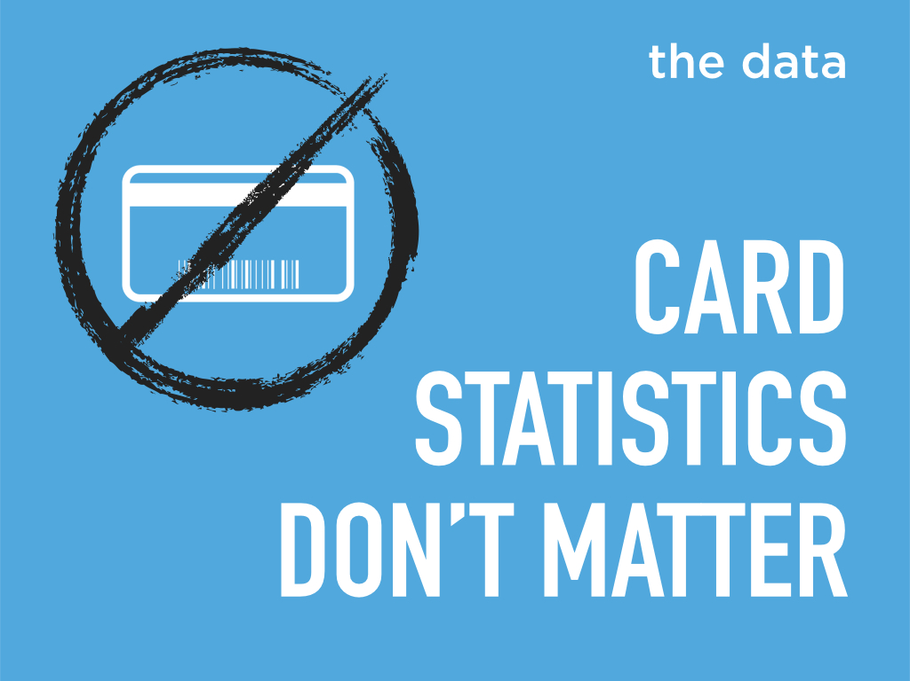

Slide 10


Slide 11


Slide 12
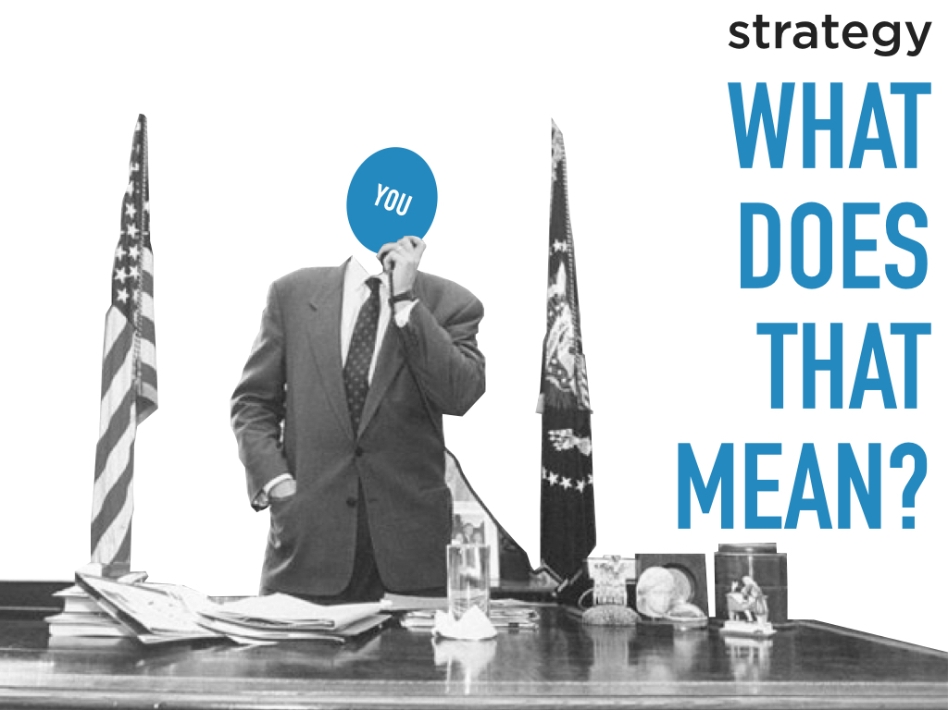

Slide 13
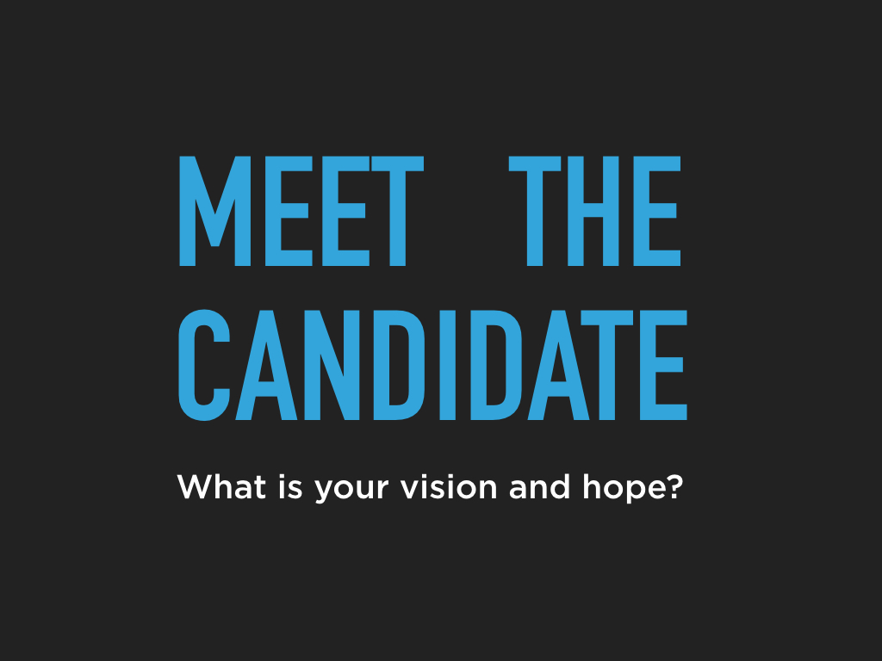

Slide 14

Notes:
They start by building relationships

Slide 15
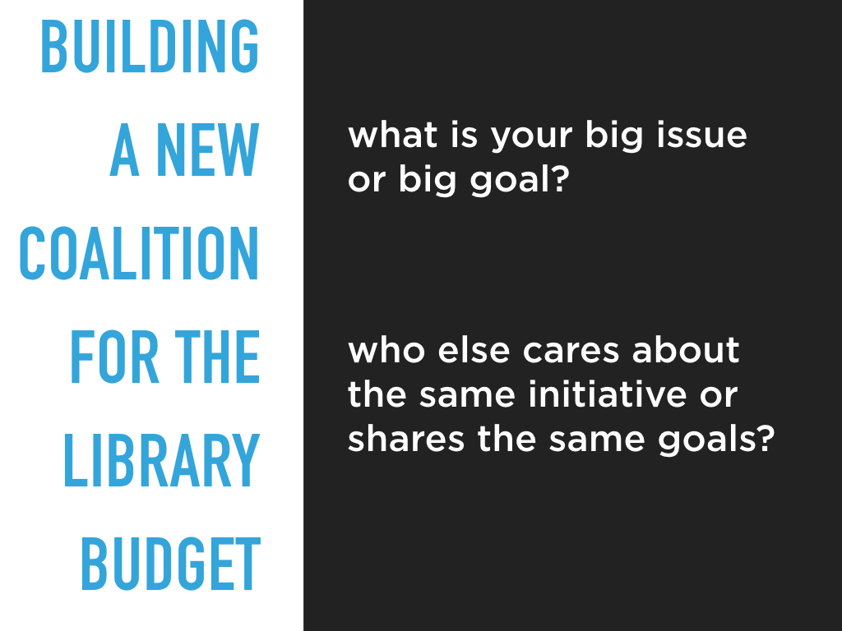

Slide 16
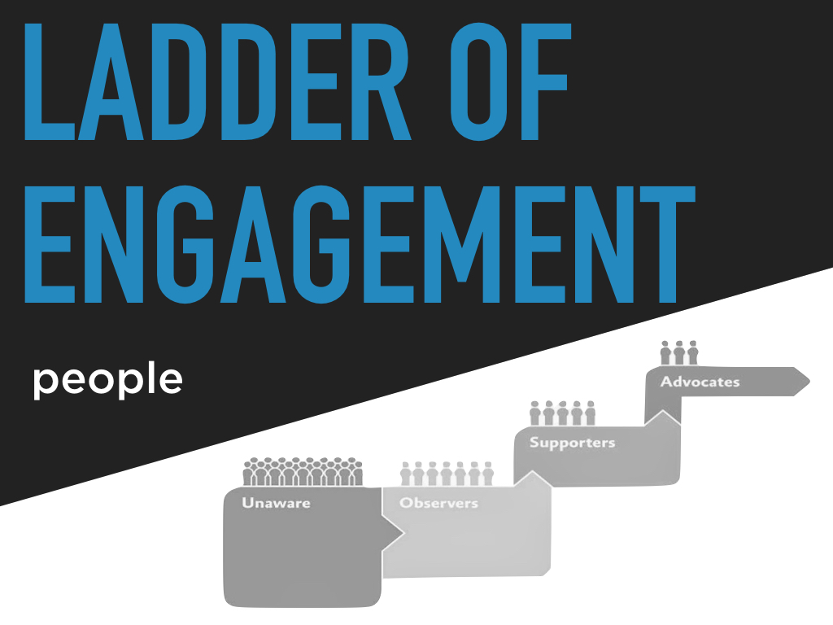

Slide 17

it always starts with an audience
Notes:
AtoZ databases or Reference USA or facebook, Trumps campaign had 1200 audiences. Its good to start with a wide net sometimes and then build relationships with people who show up.

Slide 18

who do you know?
Notes:
Create a list of everyone you know

Slide 19
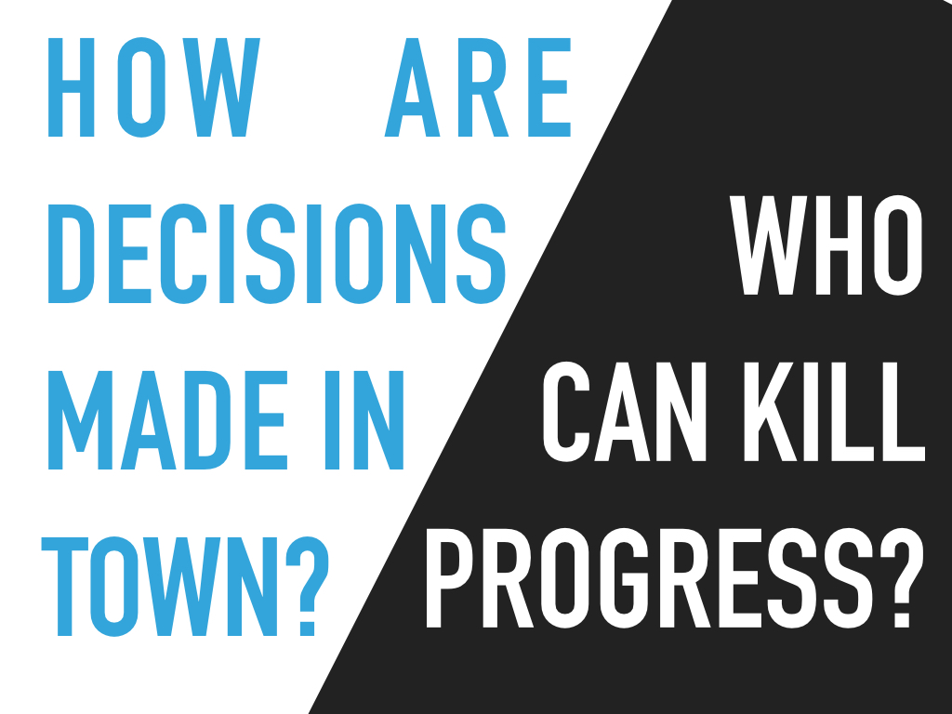

Slide 20

who do you need to influence?
Notes:
Kentucky BBQ story

Slide 21
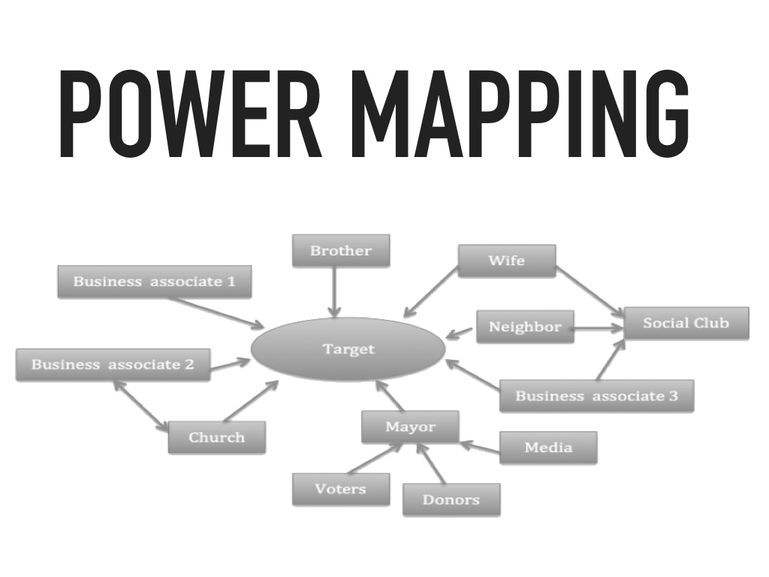
Map the closest relationships

Slide 22
who can you influence?

Slide 23
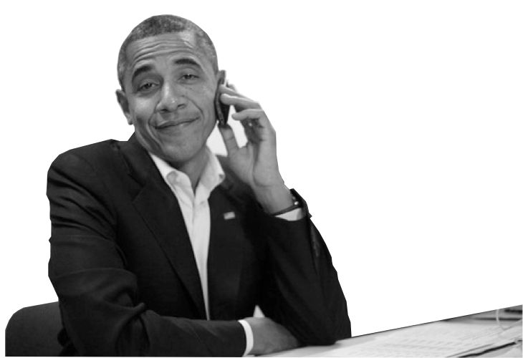
putting
it to
work

Slide 24
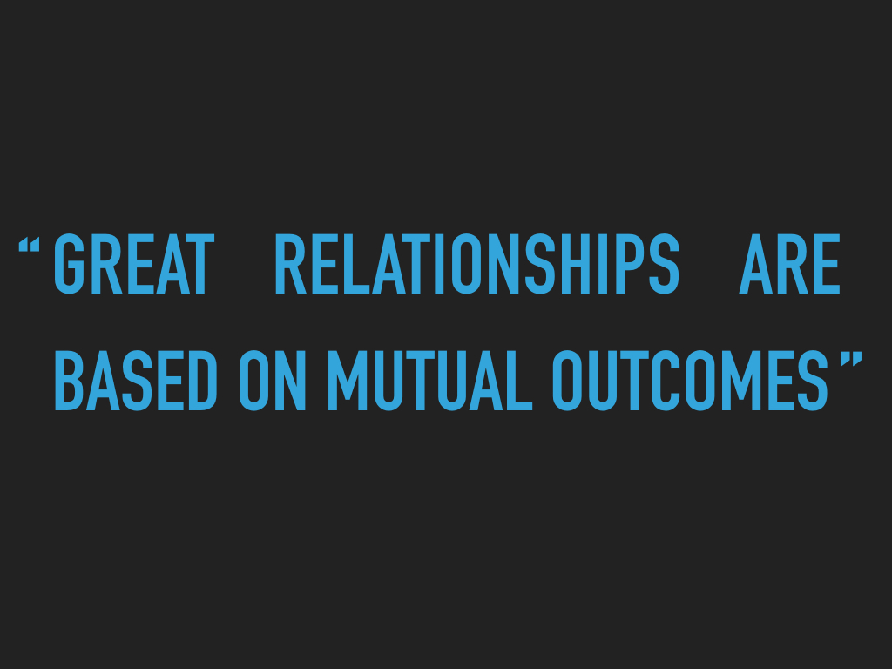
Notes:
On your first meeting be an active listener. Ask questions, take notes. Its ok if there is no ask on your first meeting. It’s about a long term relationship.

Slide 25
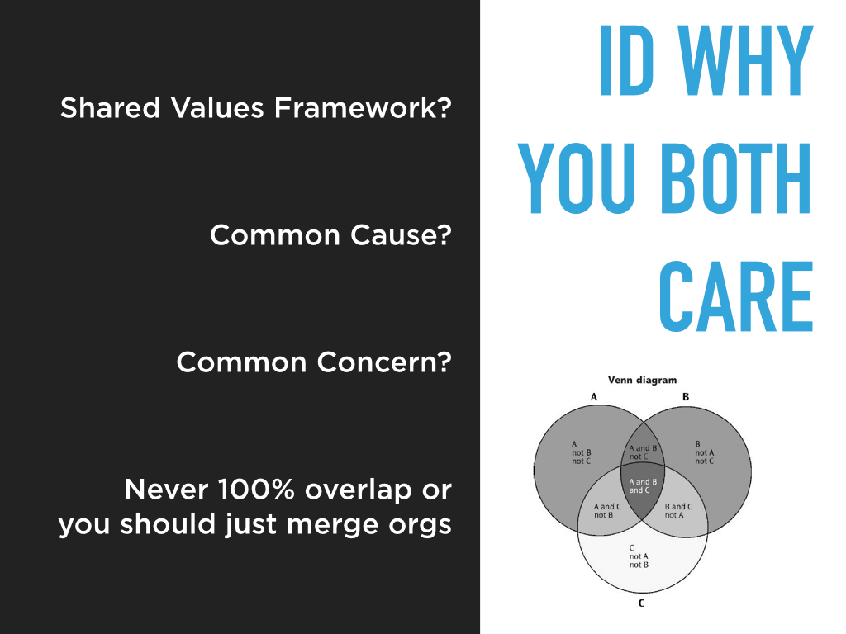
Notes:
Are you both interested in Literacy? Education? What is it that this person, group, etc.. Cares about? Can you write a message that resonates with them? Bleach Story, sheriff storytime, etc…

Slide 26
27
words
9
seconds
3
points
Notes:
Create a message that resonates with them

Slide 27
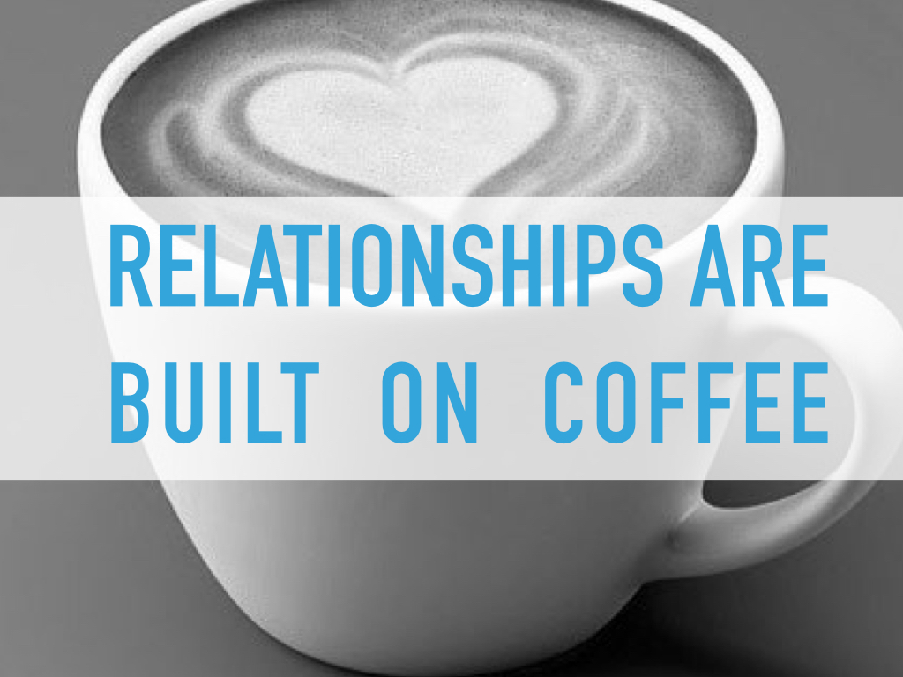
Notes:
Just reach out. Don’t be shy about asking the people on your map to have coffee and meet with you

Slide 28
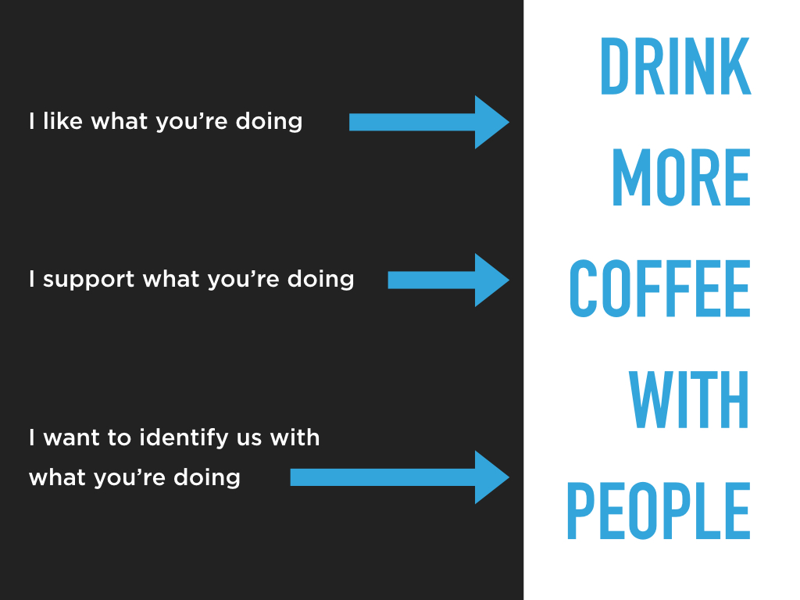

Slide 29
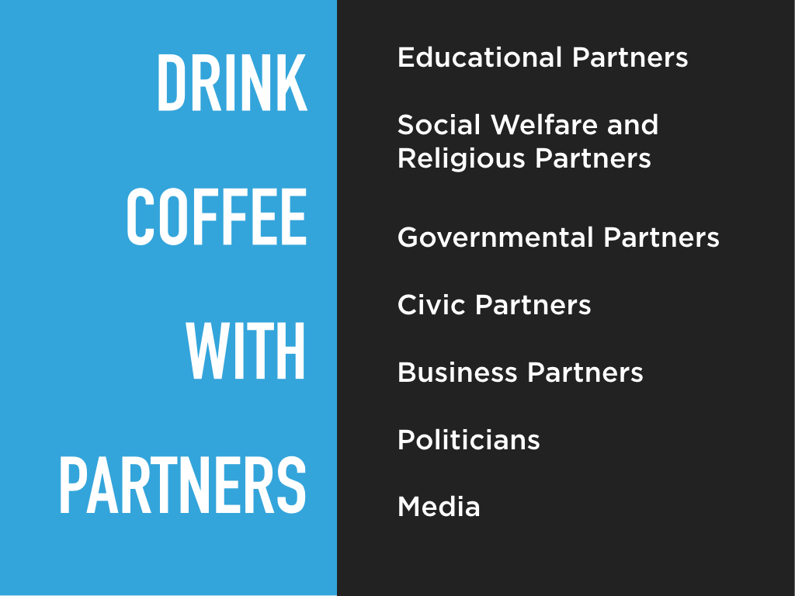

Slide 30

what is your ask?
Notes:
Once you have a relationship, you can start to make an ask.

Slide 31


Slide 32
get our worksheets

Slide 33
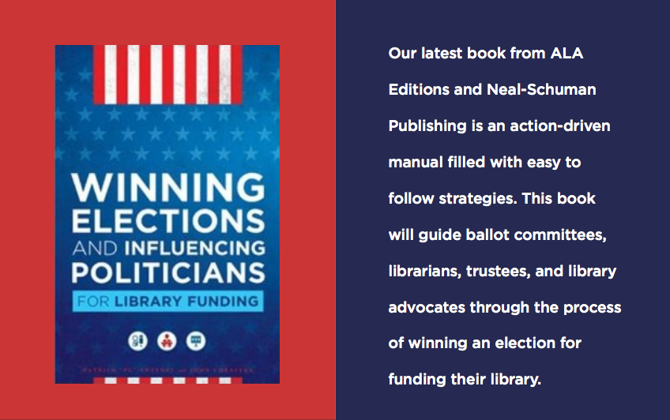

Slide 34


