Slide 1

On the Go with Senior Services
Library Programs for Any Place and Any Time

Slide 2
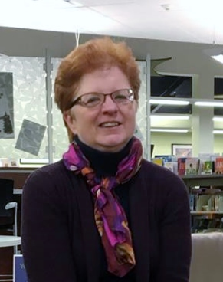
My name is Phyllis Goodman
https://authorphyllisgoodman.wordpress.com/
amazon.com/author/phyllisgoodman
abc-clio.com/ABC-CLIOCorporate/product.aspx?pc=A6142P
Instagram.com/authorphyllisgoodman

Slide 3
Topics that Will be Discussed
Who is the older adult population
Working with the older adult population
Creating programs for older adults
Programs that have worked

Slide 4
Libraries have a Role to Play
The older adult population is growing fast.
Cognitive and physical issues may make it hard to visit the library.
Programs for older adults are missing or lumped together under adult programming.
The ALA (2017) updated it’s guidelines for older adult programming.

Slide 5

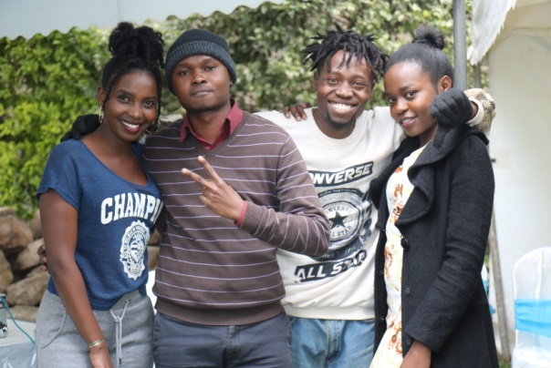
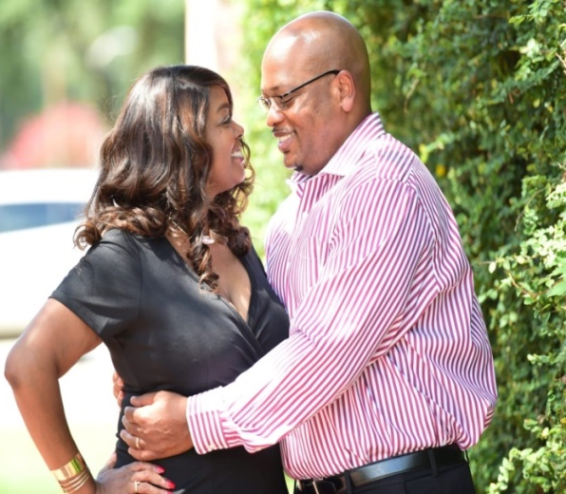

Younger Adults
Middle Years
Raising children
Switching careers
Sending their children off to college and jobs
Caring for an elderly family member
Saving for retirement
Completing formal education programs
Beginning careers
Starting families

Slide 6
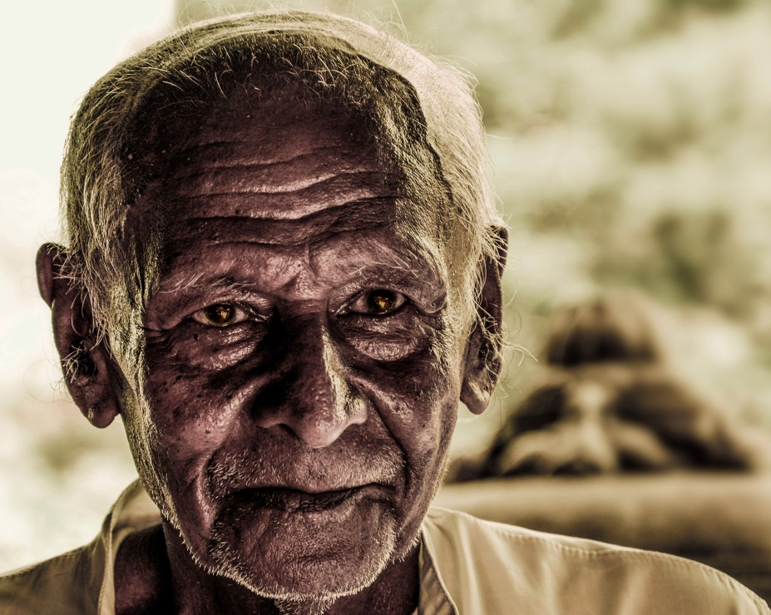
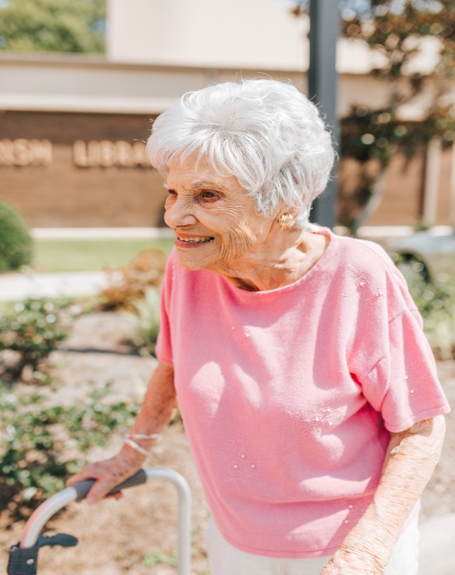
Older Adult Population
Planning for retirement
Dealing with health issues
Long term health care

Slide 7
The Older Adult Population is Growing
14.6 million
37.2 million
6.4 million
49.2 million
2016
2040
2006
85 – 100 years old
2016
65 years and Older
2060
Those aged 100 years and older have doubled since 1980.
98 million

Slide 8
There will always be someone turning 65.
---Library Services for Adults in the 21st Century, Elise Okobi, 2014

Slide 9
Greatest or GI Generation (born before 1928)
In 2020: they will be 93 years and older
Great Depression, World War II
Frugal, trust institutions, value marriage and family
The “Talkies”
Music of Louis Armstrong and Tommy Dorsey

Slide 10
The Silent Generation(1928-1945)
In 2020: they will be 75 – 92 years old
Korean War, Cold War and the Space Race
Peace of postwar America
Stay at home moms
Birth of Rock and Roll, Television
Familiar Activities and Environments are important

Slide 11
Baby Boomers
Born between 1946 and 1964.
Began entering the older adult population in 2011.
They impacted events and societal issues throughout their life.

Slide 12
Baby Boomer I (1946-1954)
In 2020: they will be 66 to 74 years of age
Idealistic, educated and question authority
Civil Rights Movement, Woodstock, Vietnam War
Mickey Mouse club, Gilligan’s Island, Twilight Zone, Ed Sullivan Show
Rock and Roll and Motown

Slide 13
Baby Boomer II (1955-1964)
In 2020: they will be 55-65 years old
Post Watergate and Nixon resignation
1979 oil embargo, Iranian hostage crisis
Heavy metal and hard rock
College educated
May have learned technology as part of their job

Slide 14
Generation X (1965-1980)
On the Horizon
In 2020: they will be 40-55 years of age
Millennials (1981-1996)
In 2020: they will be 24-39 years of age

Slide 15

Health of the Older Adult

Slide 16
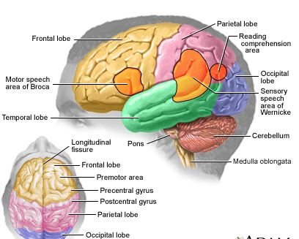
The Aging Brain
Medlineplus.gov

Slide 17
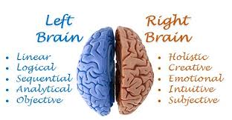
Bi-Lateralization

Slide 18


2001 Creativity Study

Slide 19

Dementia
One in ten have some form of Dementia
50% of cases go undiagnosed
Alzheimer’s disease accounts for 60-80% of dementia cases
(Alzheimer’s Association, 2019; WebMD, 2016)
Memory, Speech, Perception
***Many still visit the library in the early stages of the disease***

Slide 20
Living Arrangements
Nine out of ten older adults prefer to age at home. (AARP, 2012)
More housing and living options are available than for previous generations.
Living in assisted living, long term care or nursing homes
Attending adult day care centers or memory cafes
Administration on Aging, 2018

Slide 21
Use of Technology Among Adults 65 and Older
Pew Research Center, 2017

Slide 22
Technology use is limited among those ages 75 and up
Pew Research Center, 2016

Slide 23
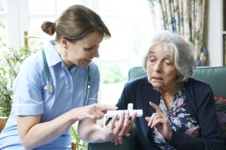
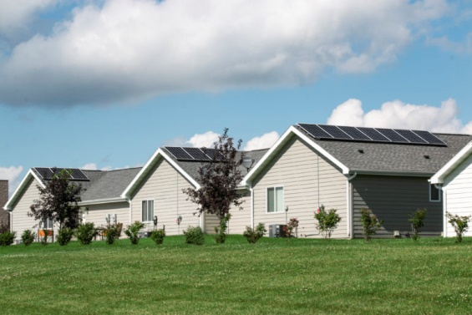
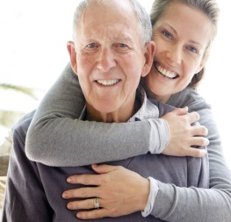
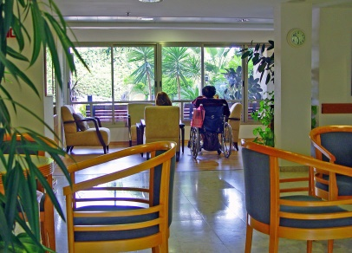
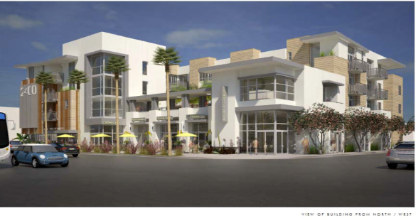
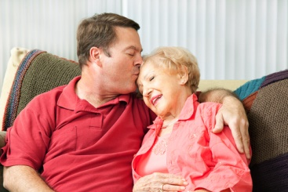

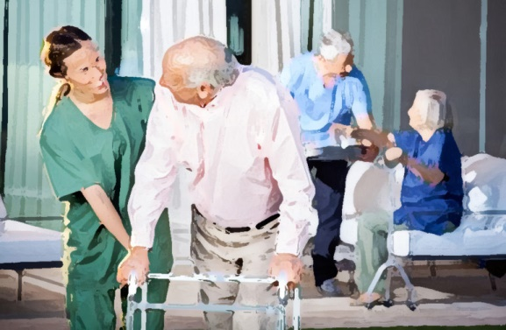
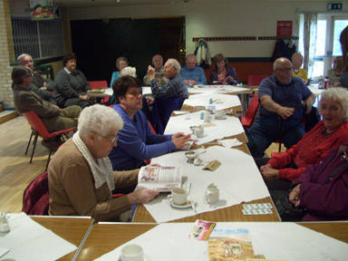

Where are the Older Adults in your Community?
What information are you looking for?
Library Statistics
Organizations working with older adults
Caregiver support groups
American FactFinder, U.S. Census, American Community Survey
Focus Groups, Surveys

Slide 24
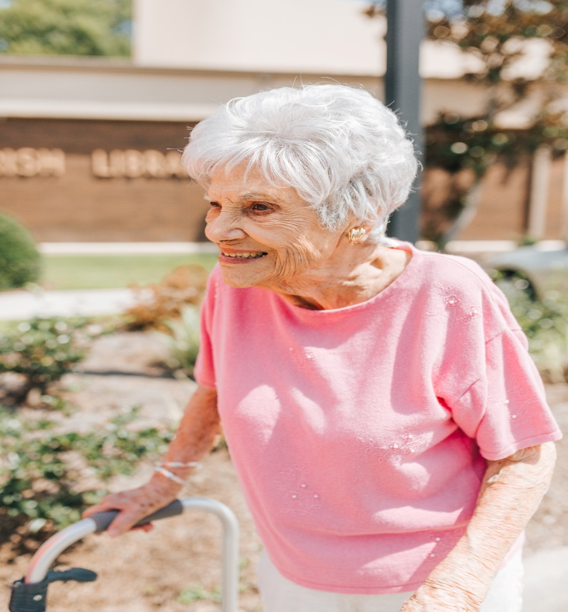
Interacting with Older Adults
Know Yourself
Capitalize Own Your Strengths
Arrive Early
Be Flexible
Be Consistent
Encourage participation
Evaluation
Get to Know Your Audience
Make Sure Everyone Can See and Hear You
Seat at tables or in a semi-circle
Make eye contact
Speak clearly, distinctly and moderately
Ask questions

Slide 25

Interacting with Older Adults
Large pictures and illustrations
Large Fonts for reading
Magnifiers, recorders, helpers to assist with physical disabilities
Engaging activities
Materials
Know group’s abilities
Plan ahead for difficult tasks
Consider whether the craft adds to the program.
Crafts
Skills or expertise to present a program
Help with activities or crafts
Volunteers

Slide 26
Dementia
“When you’ve met one person with dementia, you’ve met one person with dementia.”

Slide 27
Interacting with Individuals who have Dementia
Treat as adults with individual interests, abilities and experiences.
Focus on remaining strengths.
Preserve dignity, self esteem and independence
Provide opportunities for social interactions and participation in activities.
Speak slower and allow time to respond.
Accept the individual’s reality.
Persons with Dementia still enjoy reading.

Slide 28

There is No One Size Fits All Programming

Slide 29


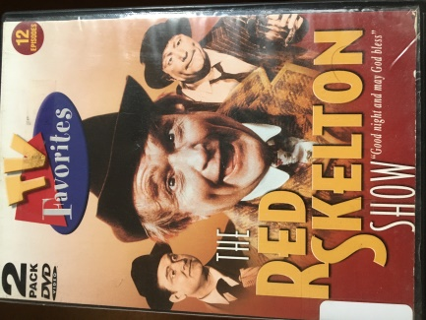

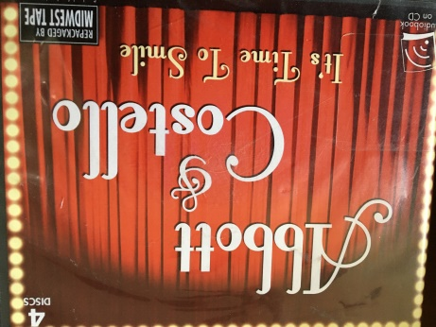

Look at Your Own Resources First

Slide 30

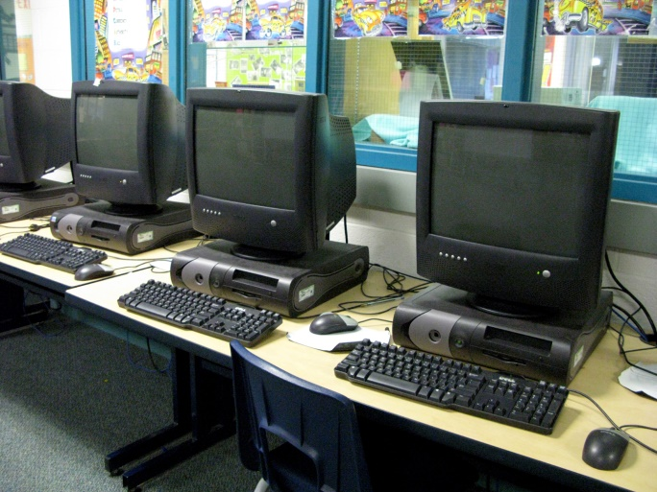
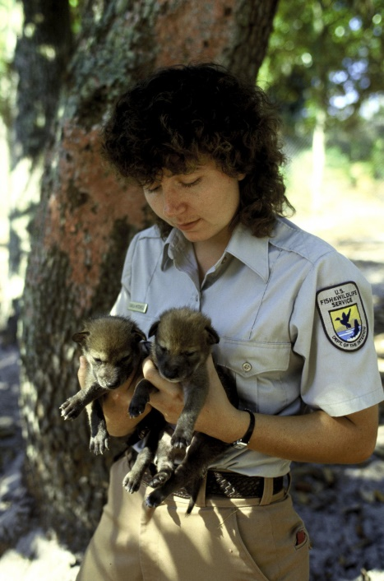

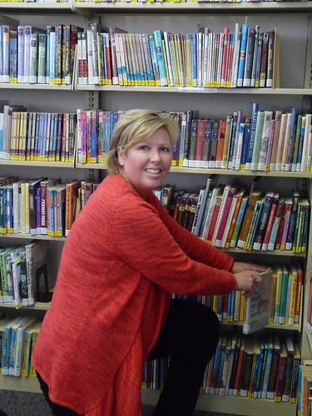
In-House Programs
Computer Programs
Staff or Volunteers expertise
Local Organizations presenting in-house programs

Slide 31
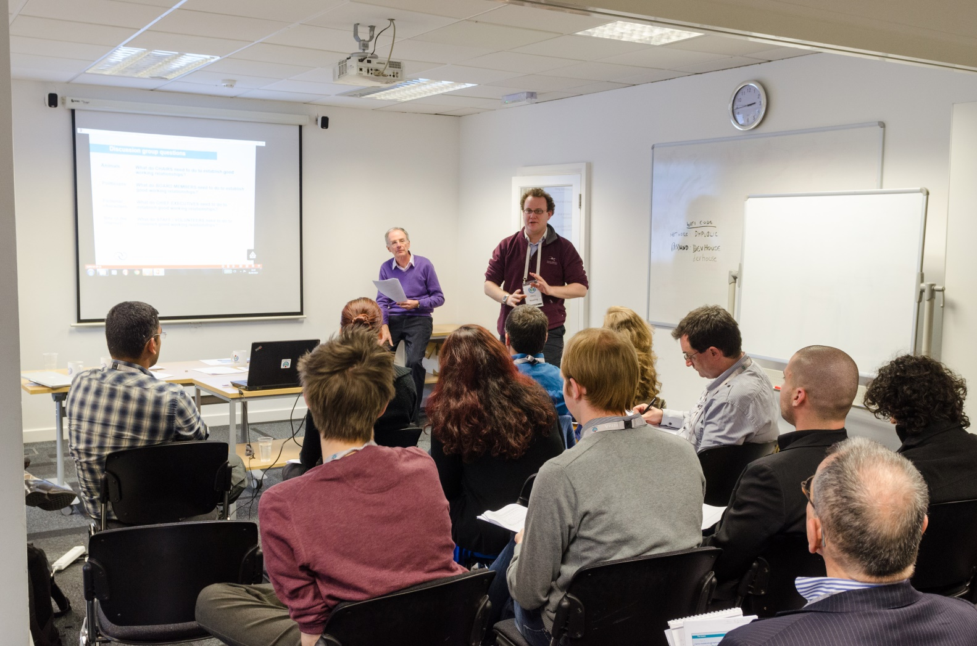
Toot Your Own Horn

Slide 32





A Few More Ideas
Network
Internet
Free quizzes
Trivia
Coloring Sheets
Bingo boards

Slide 33


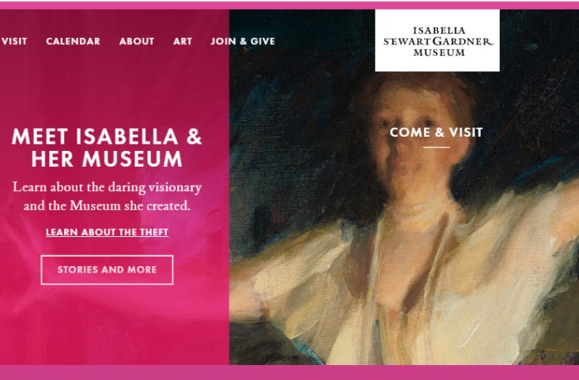
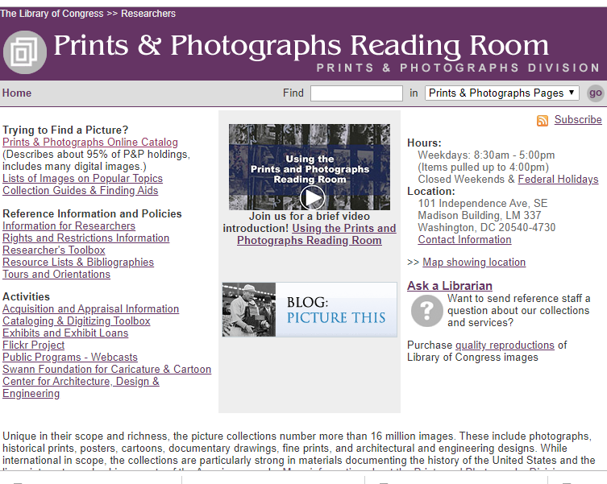
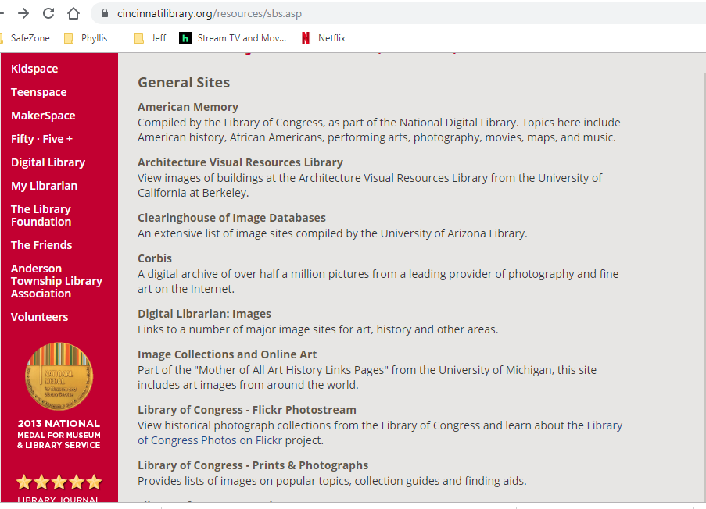

A Few More Ideas
Music and Memory Kits
Program Kits to Check Out
Virtual Visits and Photo Collections

Slide 34

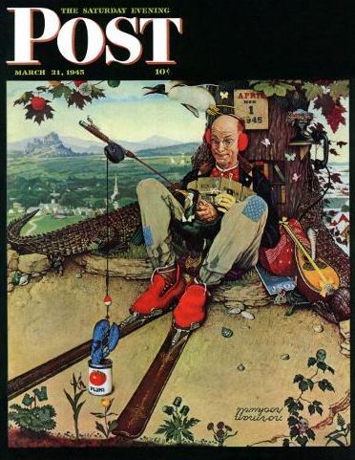
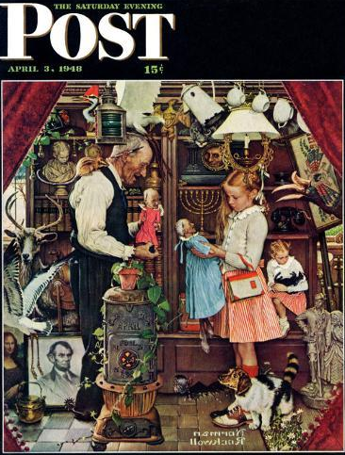
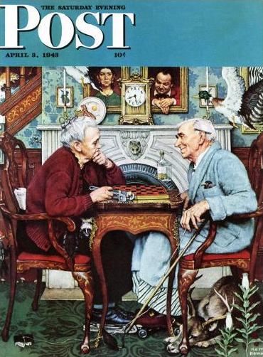

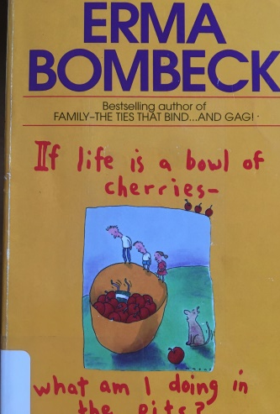

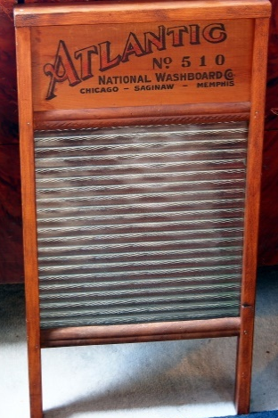


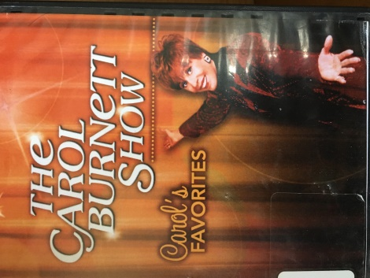
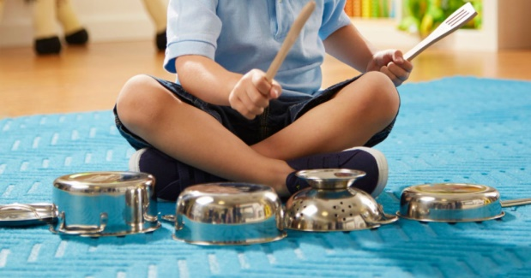
Let’s Have a Good Laugh
April Fools Covers – Saturday Evening Post
Funny Headlines, Jokes
Harmless Pranks

Slide 35

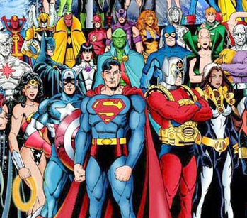

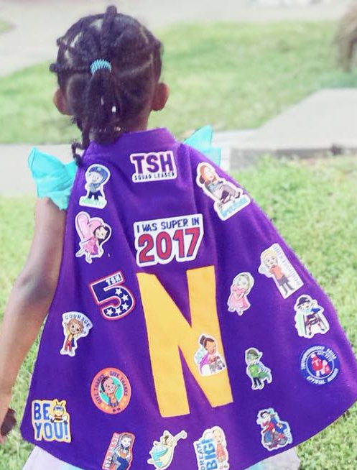
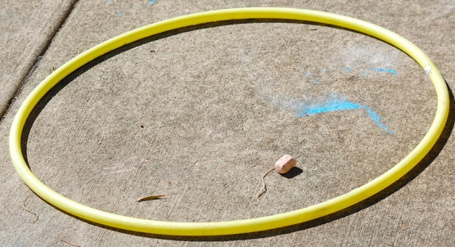

Superheroes
Theme song
Pictures of Superheroes
Yellow hula hoop
Tiny Heroes Program

Slide 36
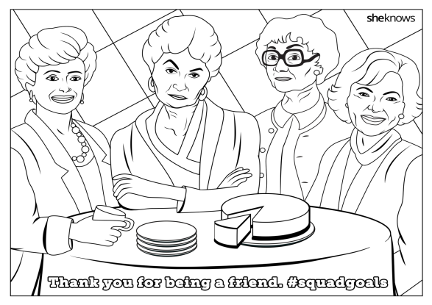
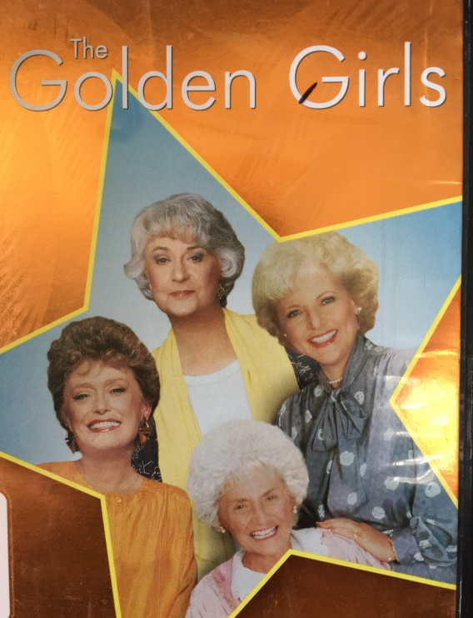

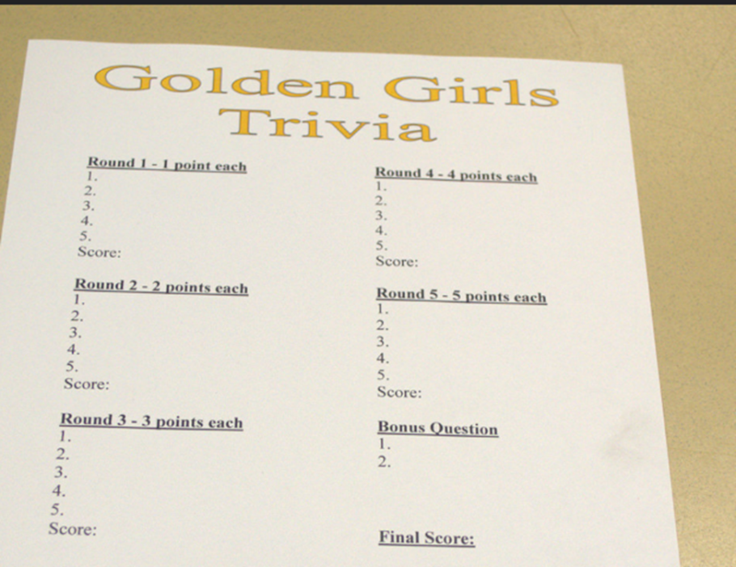
TV Trivia:
Golden Girls
Golden Girls TV Show Trivia Questions
Round One—Each question is worth one point
1. Dorothy brought Sophia to live with her when a fire burned the retirement home she was living in called _____________?
2. What fairytale story do the Golden Girls perform in a play?
3. St. Olaf was located in what state?
4. Dr. _________ lived next door to the Golden Girls.
5. “The older you get, the better you get, unless you’re a _____.”
Answers
1. Shady Pines; 2. Henny Penny; 3. Minnesota; 4. Harry Weston; 5. Banana

Slide 37
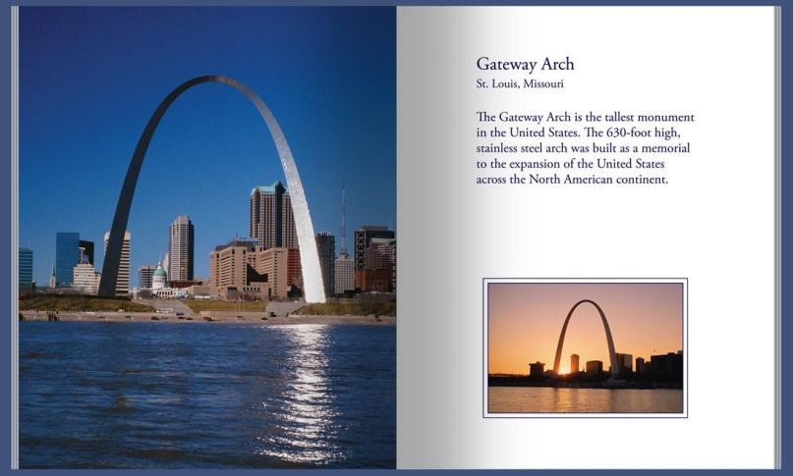

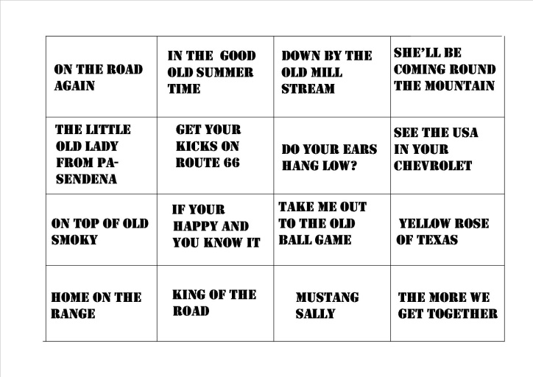

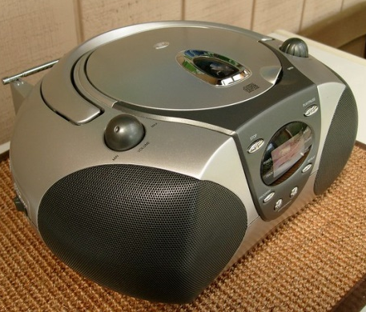
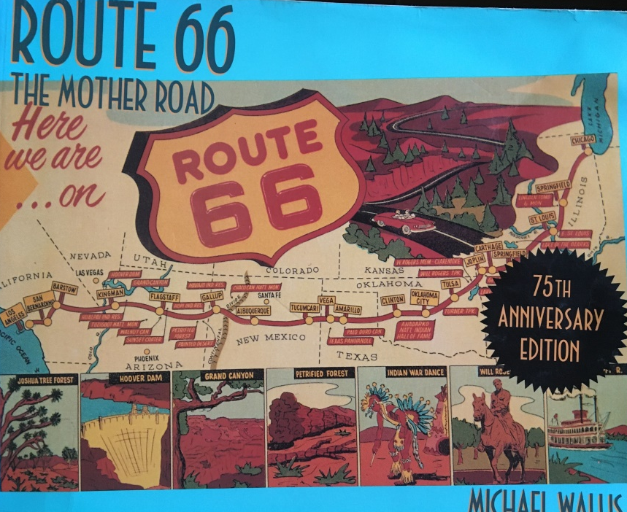

Road Trip Memories
Travel songs

Slide 38







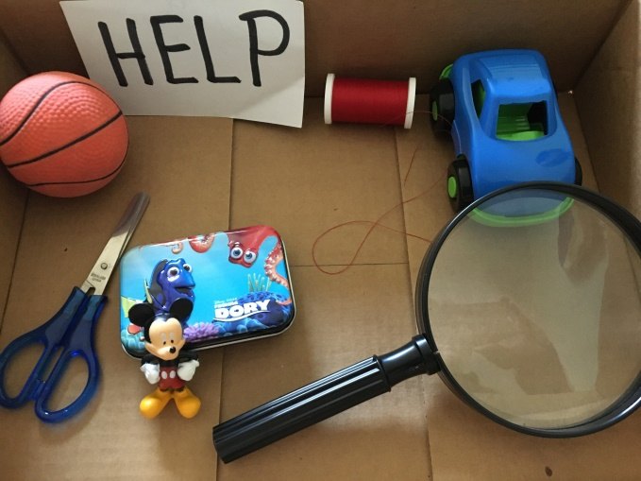
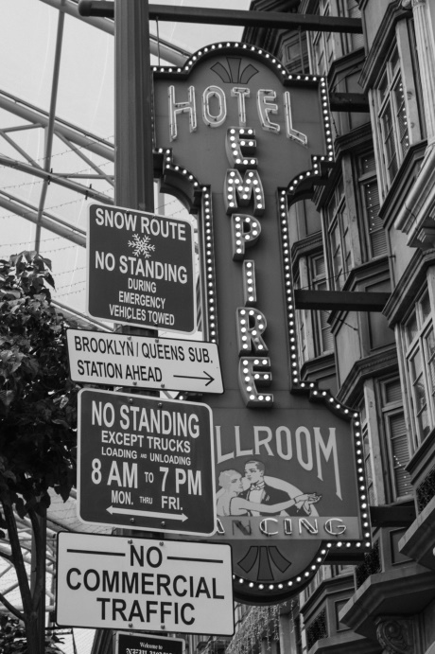
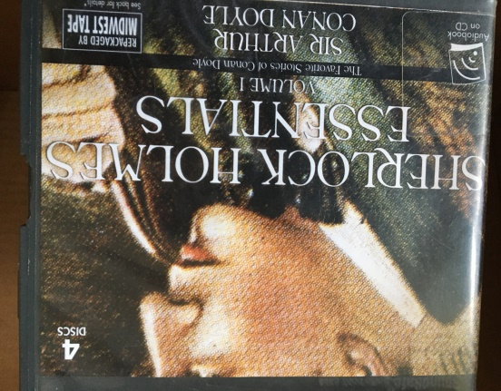

Mystery Box
Detectives & Mysteries
How good of a detective are you?
Books & Old Radio Shows, Podcasts

Slide 39


Words & Stories
Bi-Folkal kits
  Originally created to use with older adults in reminiscence programs.
  Contained VHS/DVD’s, cassettes, pictures and an activity guide on specific events or themes to stimulate memories and discussion.
  Kits are still part of many library collections.
  Updated to include PowerPoint slides, laminated pictures, Realia, and props. Includes trivia and extra facts.

Slide 40
Summer Reading
Be sure to include older adults when planning activities for summer reading.
  Game board to keep track of reading
  Prizes to hand out for each milestone
2017 Summer Reading - Build a Better World
Oriental Trading quilt squares were decorated showing what they felt was important in their community.
Later hung in the center’s lobby.

Slide 41


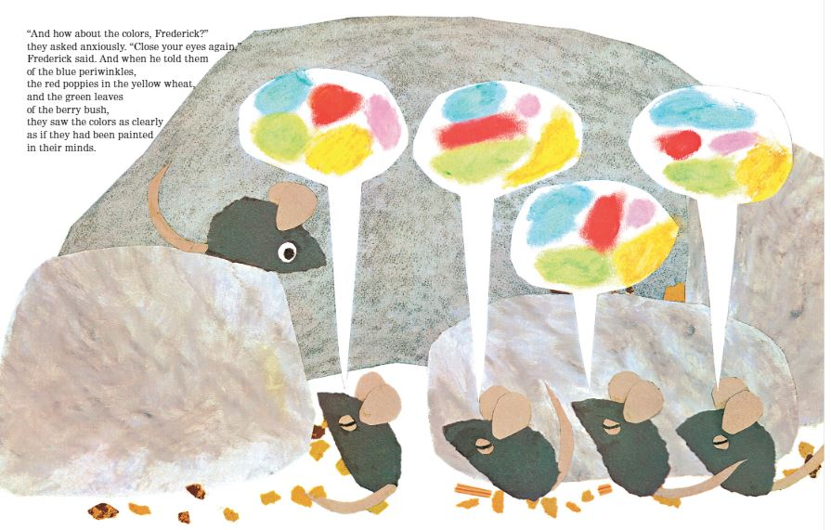

Art Based Programs

Slide 42

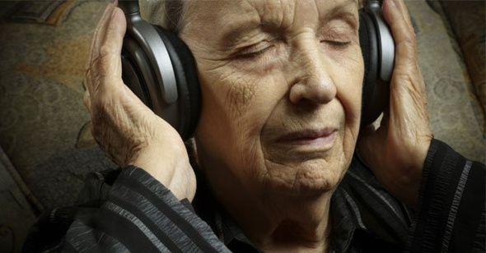
Mind and Memory
Music
Memory Cafes

Slide 43


Technology
Modify in-house computer programs.
Virtual Reality

Slide 44



Appy Hour

Slide 45
Features
Insights into how to better serve all seniors
Step-by-step instructions for dozens of programs
Covers segments of the senior population not thoroughly addressed in other professional sources
Includes guidance on working with seniors with dementia or Alzheimer's
Extensive Resource directory

Slide 46
Credits
Special thanks to the people who created and released many of the photographs used for free:
Photographs from Canva
Special thanks to libraries around the country for sharing their senior programs to present here and in my book.

