Slide 1


Healthy Living at the Library
Welcome Day-Spring 2020
Noah Lenstra lenstra@uncg.edu @NoahLenstra
@LetsMoveLibrary
Slides at LetsMoveLibraries.org/niche-academy/

Slide 2
What we’re talking about
What is Health Equity?
Health equity is when everyone has the opportunity to be as healthy as possible.
Welcome Day-Spring 2020

Slide 3
Join the movement!!!
ALA Immediate Past President Loida Garcia-Febo (2019) writes "bringing wellness to library workers can also impact library patrons."
Welcome Day-Spring 2020
LetsMoveInLibraries.org

Slide 4
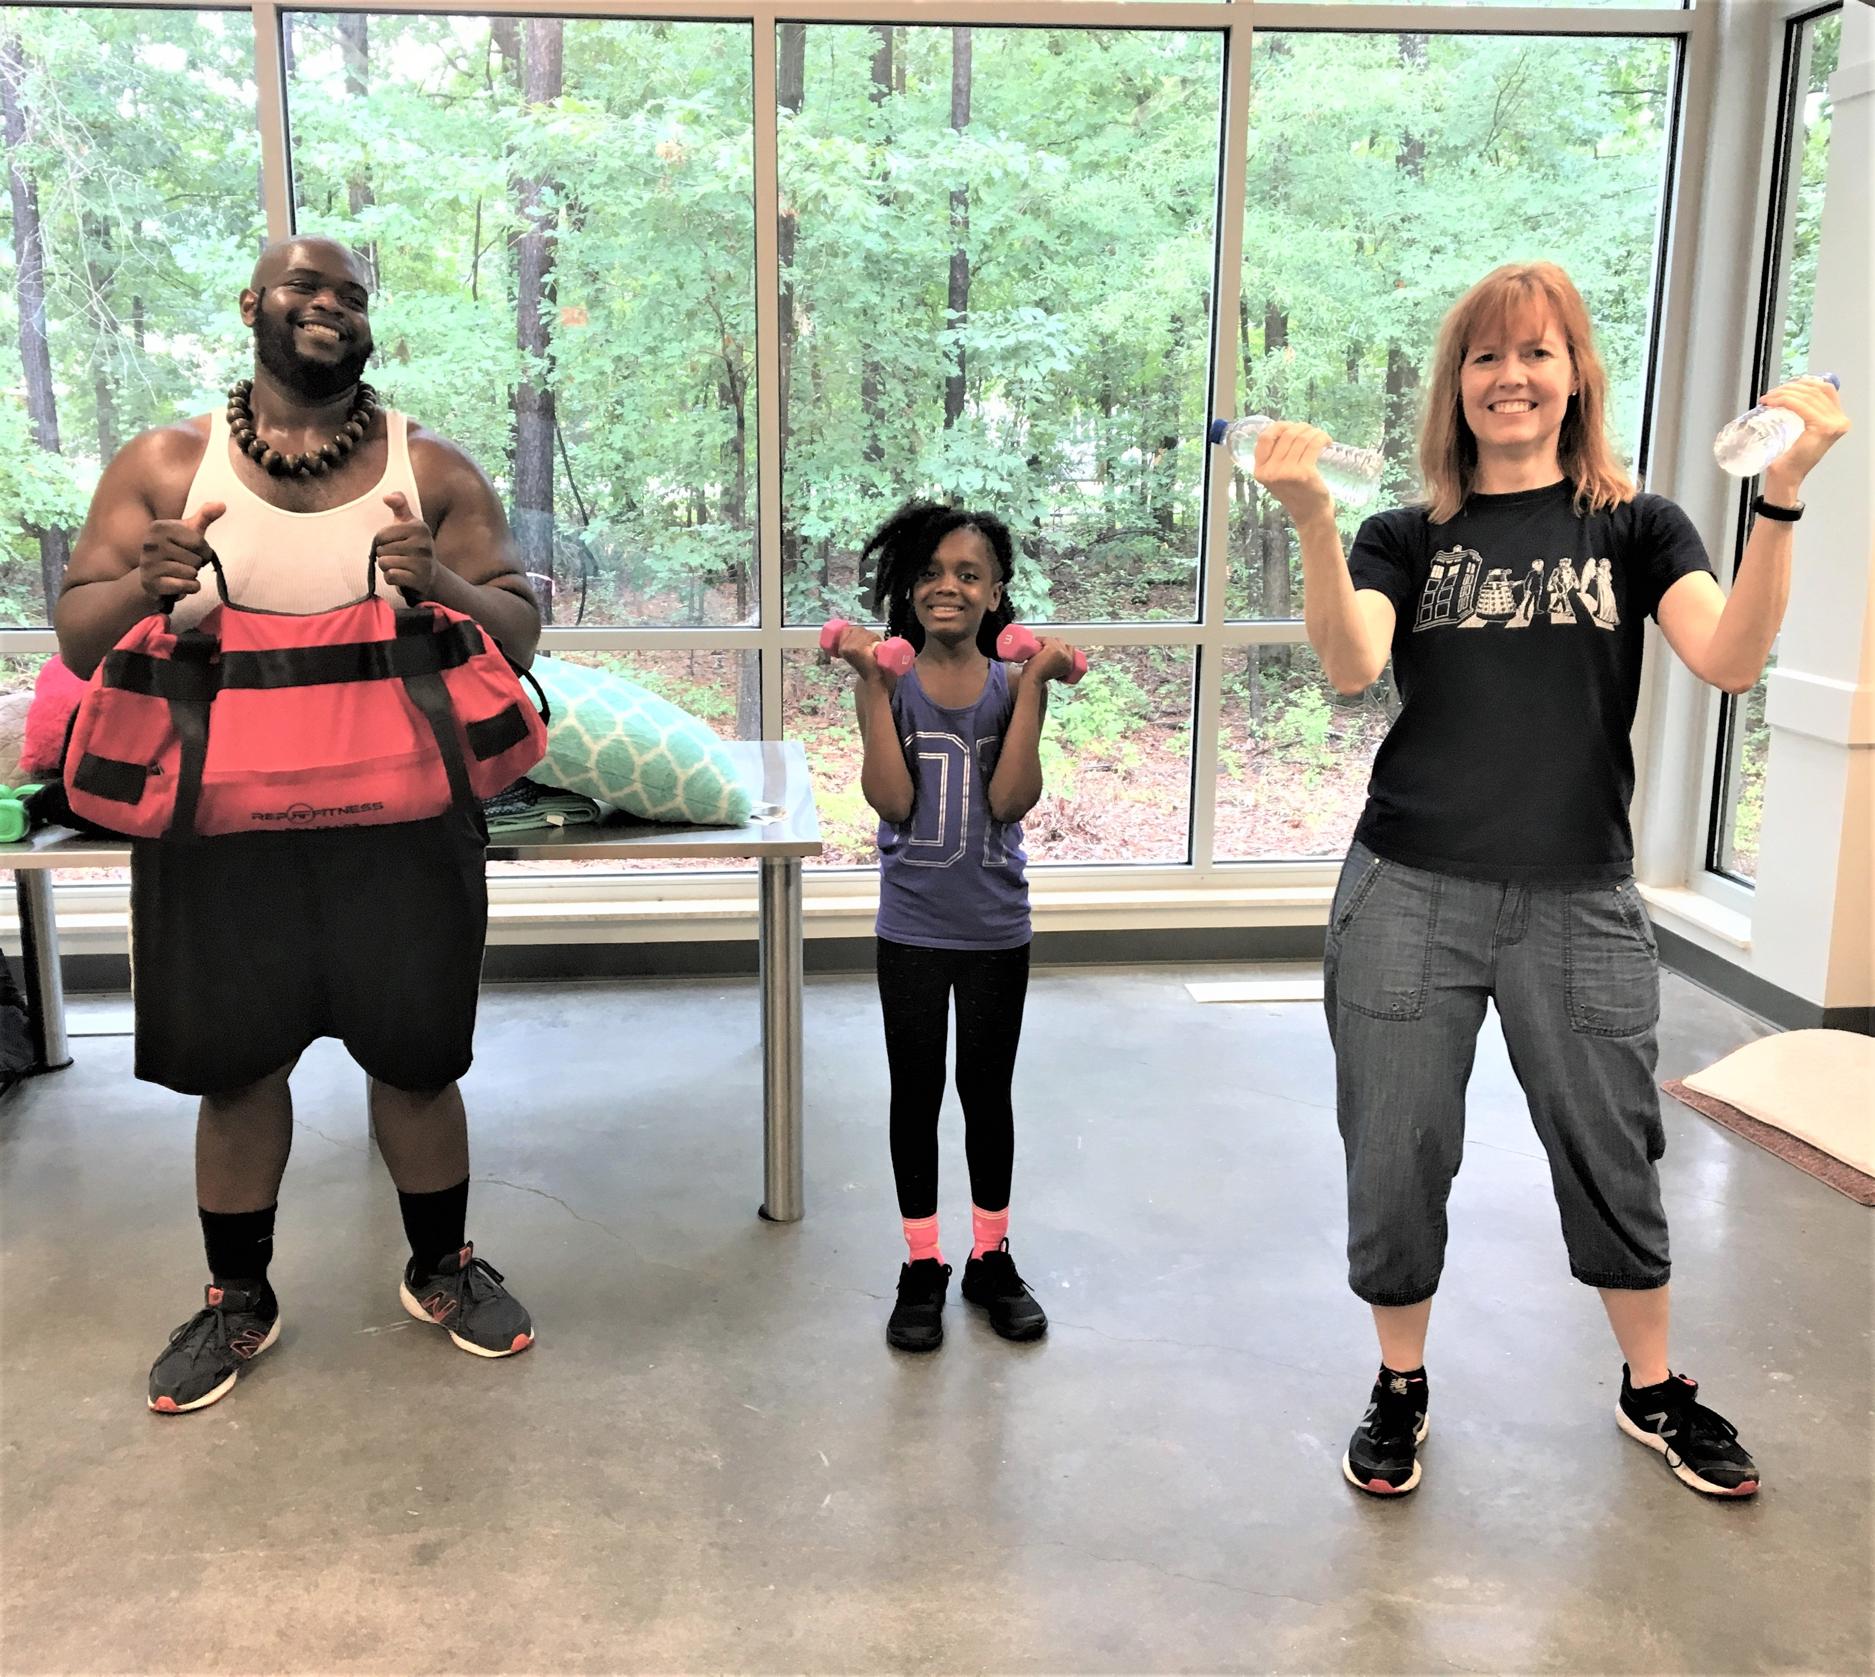
Look Inward to Get Started!
“A Saturday morning fitness class is a unique contribution from a man who also happens to be the Assistant Branch Manager of the library, but Harlem’s personal history motivates him to help.”
Welcome Day-Spring 2020
LetsMoveInLibraries.org

Slide 5

From inward to outward!
In Fall 2012 library “struggling to implement a wellness plan for the staff, a challenge for seven far-flung branches with anywhere from 1 to 15 employees”
Library administrators put their heads together to think about what they could to develop something that would increase employee health across all their branches. The director came up with the idea of making bikes available, and the staff said “why keep them just for the staff? Why not let patrons borrow them?”
Welcome Day-Spring 2020
LetsMoveInLibraries.org

Slide 6
Administrative buy-in key
https://nnlm.gov/class/wellness-works-importance-healthy-workplace
Welcome Day-Spring 2020
LetsMoveInLibraries.org

Slide 7
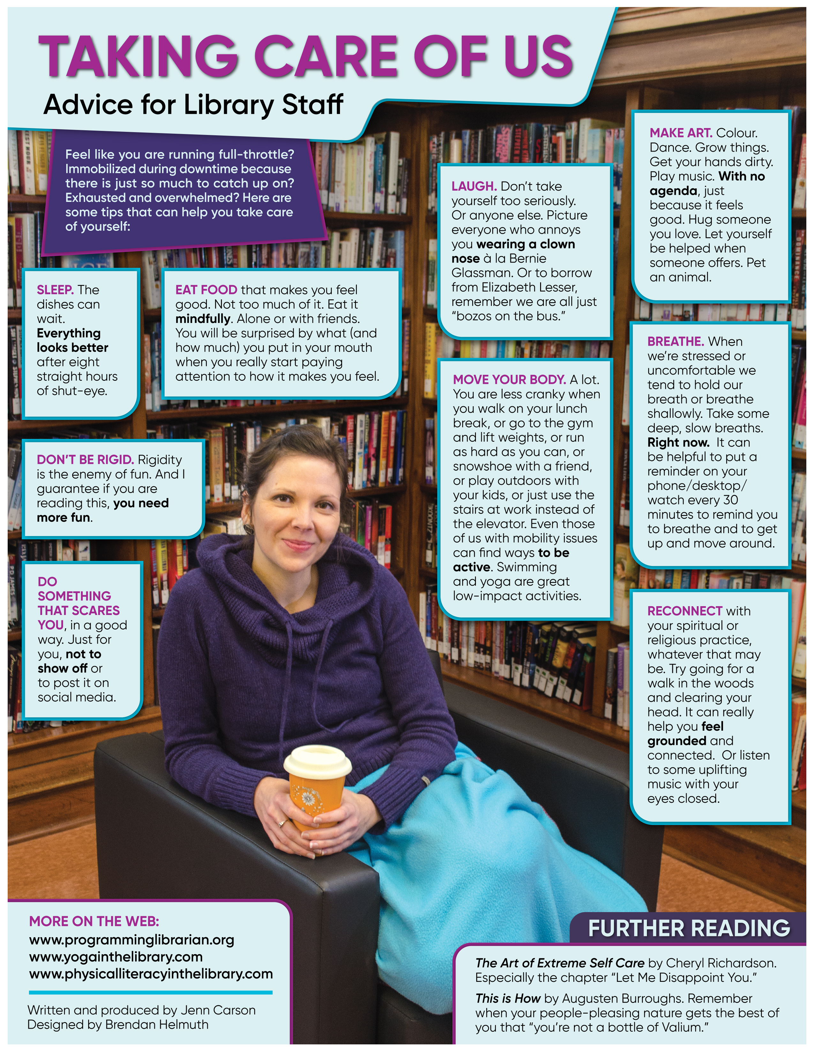
Welcome Day-Spring 2020
http://jenncarson.com/resources.html
LetsMoveInLibraries.org

Slide 8
Four steps to a healthy library
1. Inform – Just takes one person to start!
2. Update – “Don’t forget about weekly walk!”
3. Coordinate – Tie it to Mayor’s challenge
4. Collaborate – Want to join us?
Welcome Day-Spring 2020
LetsMoveInLibraries.org

Slide 9
What is health?
Welcome Day-Spring 2020
LetsMoveInLibraries.org

Slide 10
What is health?
Welcome Day-Spring 2020
LetsMoveInLibraries.org

Slide 11
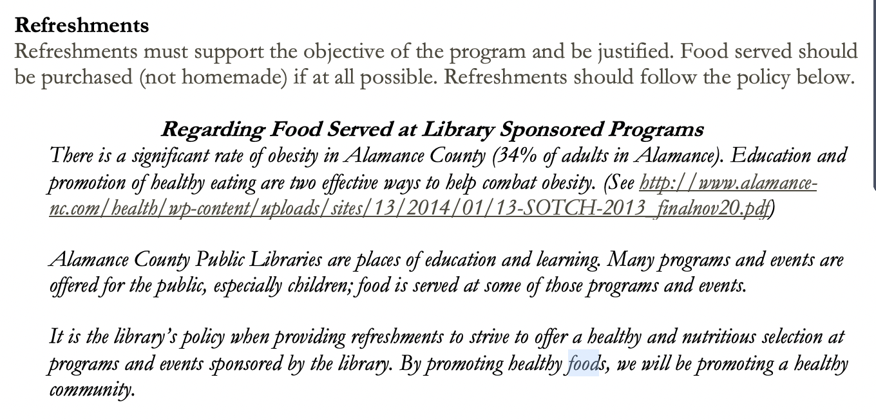
Make it policy
Welcome Day-Spring 2020
LetsMoveInLibraries.org

Slide 12
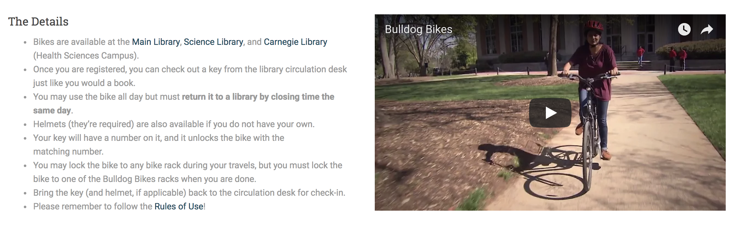


What does it look like in practice?

Slide 13
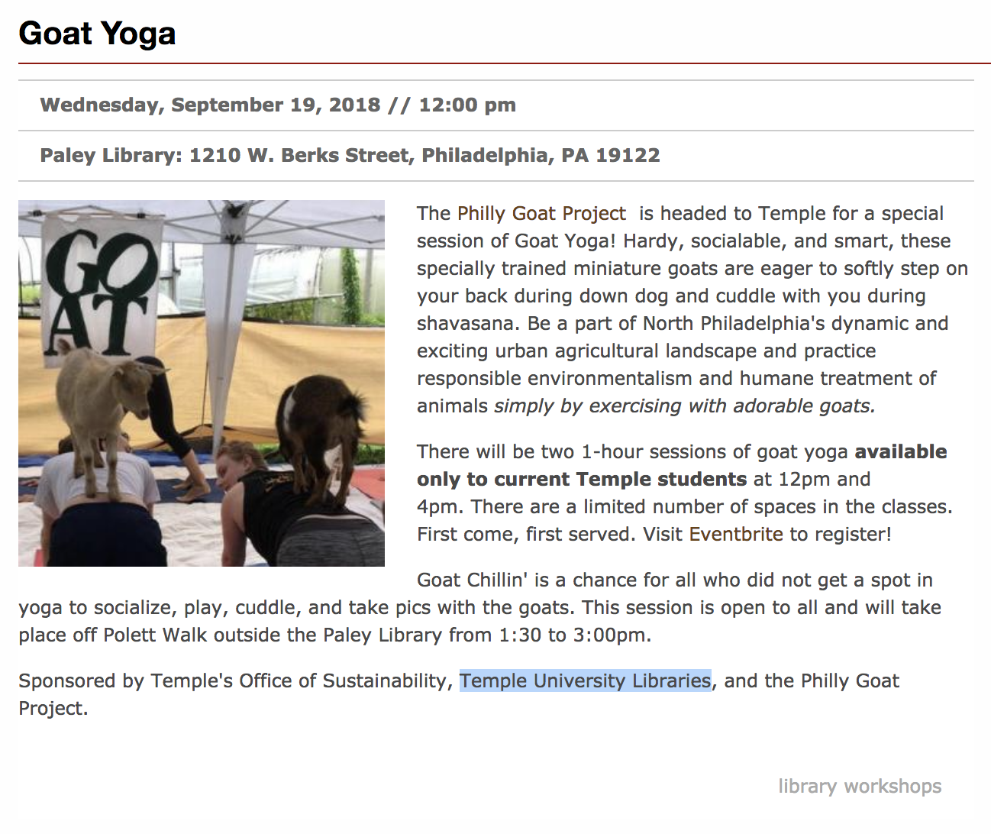

Slide 14

“When you walk into the Eudora Middle School library, you are greeted with the sound of students’ legs moving up and down, and you notice their eyes are continually darting across the pages of the books in their hands. It isn’t something you typically see in a school library, a group of 12 stationary bikes with students actively engaged in pedaling and reading at the same time” – Eudora Schools Foundation Annual Report 2016

Slide 15
"For 89-year-old Dean Stevens, the free yoga class she attends weekly at the Nashville Public Library has given her a newfound stability she says her peers are often lacking."

Slide 16
From Stillwater, Oklahoma, Public Library
(NOTE: Then library director Lynda Reynolds NOW Consultant for Public Library Management in State of North Carolina)

Slide 17
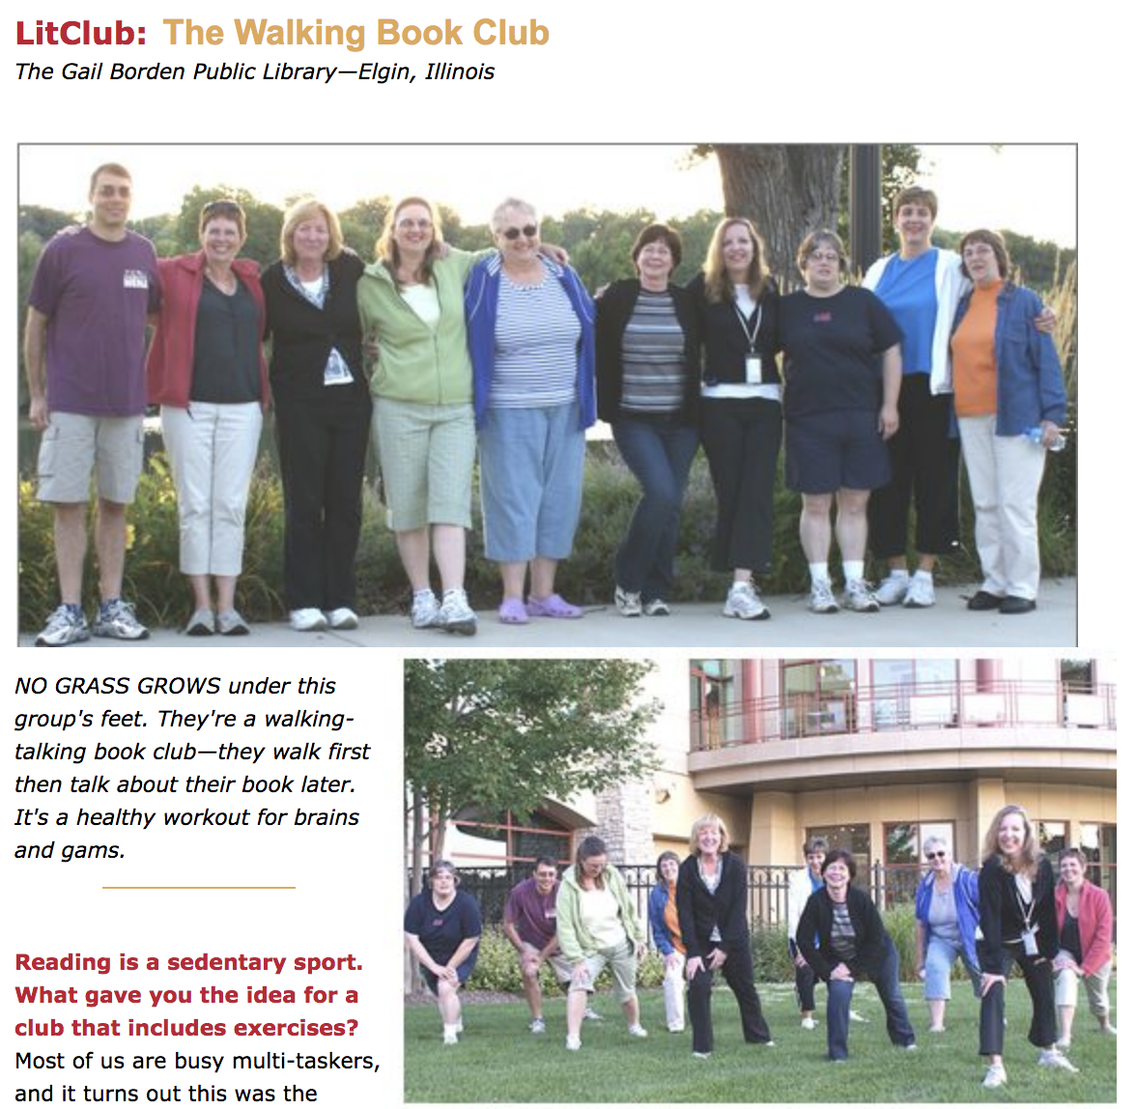
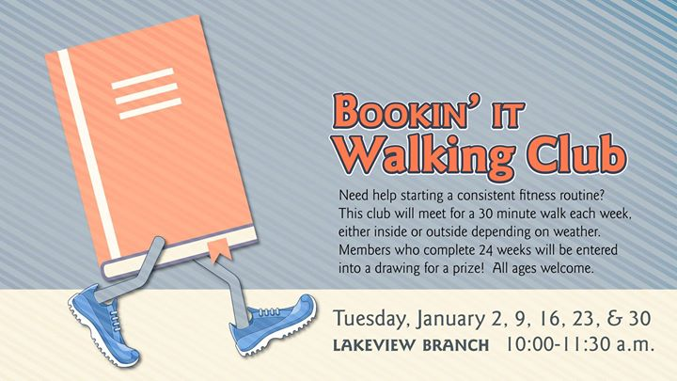
“If it plays in Peoria…”

Slide 18



Slide 19

Made possible by a partnership between the North Wilkesboro Recreation Department, Town of North Wilkesboro, the Wilkesboro Tourism Development Authority, and the Wilkes County Library, “Checkout Wilkes” is a lending program that provides equipment that can be used to enhance recreational experience in Wilkes County. Current Items Available for Checkout:
Pickleball Equipment
Disc Golf Sets
Fishing Poles
Basketballs
Volleyballs
Horseshoes
Binoculars and Birding Books
If you normally use our Traphill Branch, just ask to have any of these items sent your way for checkout!

Slide 20



Slide 21
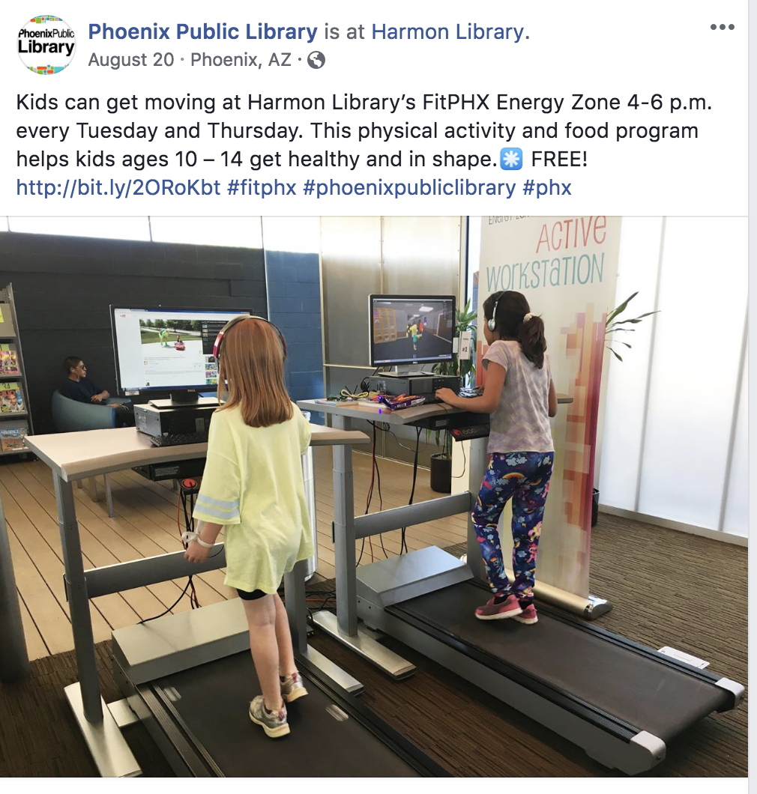




Slide 22


Slide 23


Slide 24


Slide 25
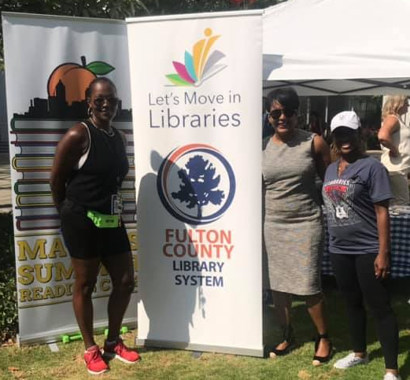
Who’s ready to get started?
Book available for order from Libraries Unlimited
Welcome Day-Spring 2020
Atlanta Mayor Keisha Lance Bottoms (center) with public librarians at Summer at the Library kickoff, May 2019
LetsMoveInLibraries.org

