Slide 1
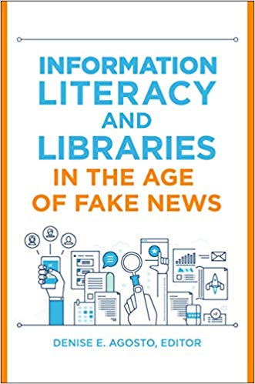
Information Literacy & Libraries in the Age of Fake News Denise E. Agosto, Ph.D. Drexel University
Based on the book!
Niche Academy
November 15, 2019

Slide 2
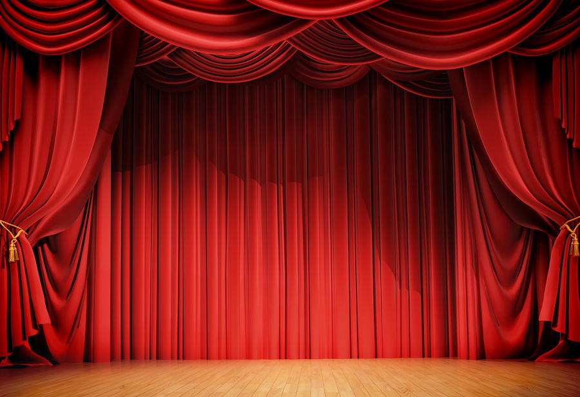
Setting the Stage
What is fake news?
Why does it matter?
Why do people believe it?
Why is it relevant to library services?

Slide 3
Pulitzer Prize-winning Politifact.com named fake news its 2016 “lie of the year:”
“Fake news: Hillary Clinton is running a child sex ring out of a pizza shop.
Fake news: Democrats want to impose Islamic law in Florida.
Fake news: Thousands of people at a Donald Trump rally in Manhattan chanted, ‘We hate Muslims, we hate blacks, we want our great country back.’
None of those stories – and there are so many more like them – is remotely true.” (Holan 2016)

Slide 4
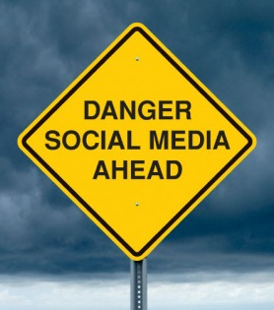
What is fake news?
False or misleading stories that are “masterfully manipulated to look like credible journalistic reports [and] are easily spread online to large audiences willing to believe the fictions and spread the word” (Holan 2016).

Slide 5
Fake news is big business.
$
$
Motivating factors include profit, ideology, and/or mischief
Fake news writers and distributors can make thousands of dollars per month from advertising revenue (Ohlheiser 2016).
No oversight agency in the U.S.

Slide 6
Why now? Why libraries?
The most recent surge of fake news correlates with a rise in widespread public reliance on online information.
Librarians have the opportunity and the responsibility for teaching users how to determine if information is accurate, reliable, and worthy of being shared.

Slide 7
Today’s Complex Information Environment
Internet/WWW = led to changes in how information is vetted and distributed
User-produced information versus information written by professional writers, researchers, news reporters, and academics

Slide 8
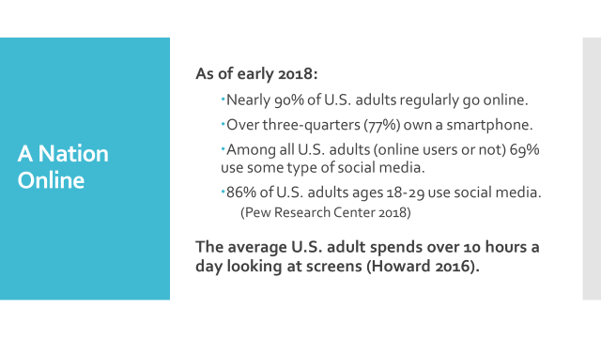

Slide 9
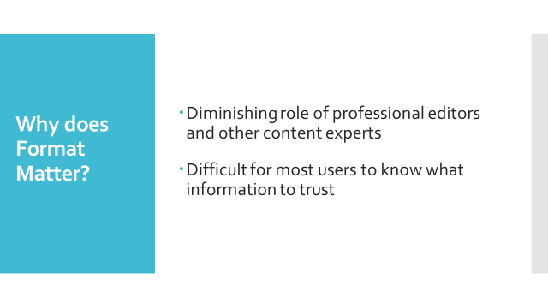

Slide 10
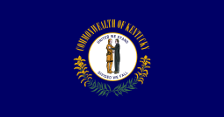
Not so fast!
Simple definitions obscure important nuances:
intentions (intentional/unintentional)
motivations (profit, ideology, parody, satire, humor, bias/prejudice/hate)
belief (degree to which the sender believes that the content is true, accurate, beneficial, etc.)
Problems with the term itself:
troublesome partisan associations (Ah, Kentucky!)
dismissiveness

Slide 11
Verstraete, M., Bambauer, D. E., & Bambauer, J. R. (2017). Identifying and countering fake news, University of Arizona, https://andyblackassociates.co.uk/wp-content/uploads/2015/06/fakenewsfinal.pdf.

Slide 12
Beyond Fake News: Misinformation/Disinformation
Misinformation = information that is incomplete, uncertain, vague, or ambiguous (Cooke 2018) – usually doesn’t include the concept of intentionally misleading or influencing others
Disinformation = intentionally disseminated, known to be false either by the originators or others who pass it on; but some theorists also include false information passed on via uninformed “benevolence” (Cooke 2018)

Slide 13
--Misinformation/disinformation not only “prohibits collective knowledge and understanding,” it can “do harm by deliberately and persistently perpetuating racist and culturally insensitive images and messages.” -- Users should “consider the underlying power structures that shape the information, and the acquisition of agency that can come with the acquisition of quality information.”
Nicole Cooke, Critical Literacy as an Approach to Combating Cultural Misinformation/Disinformation on the Internet, Information Literacy and Libraries in the Age of Fake News, Libraries Unlimited, 2018.

Slide 14
The Real Issue: User Confusion
Wineburg & McGrew, 2016:
Widespread confusion among middle school, high school, and college students
Conflation of news and advertising content
Little understanding of how biased perspectives affect news and other information
Widespread confusion in knowing what information to trust crosses age, educational, income, geographic, and other demographic variables.

Slide 15
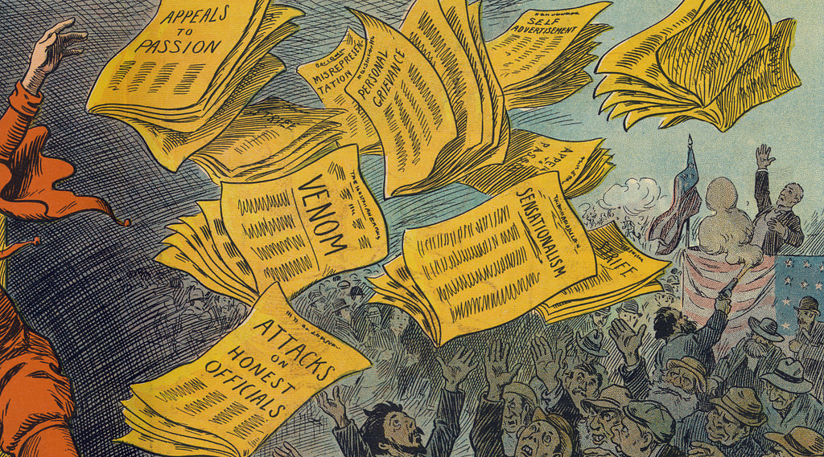
Fake news isn’t new.
It can be traced back at least a century to the era of yellow journalism.
https://www.flickr.com/photos/publicdomainreview/33030479845
(For a detailed history of fake news, see: “From Yellow Journalism to Tabloids to Clickbait: The Origins of Fake News in the United States,” Sharon McQueen, in Information Literacy and Libraries in the Age of Fake News, 2018.)

Slide 16
The Event that Got All of Us Talking about Fake News (Yeah, that’s the one: November 8, 2016.)
An estimated 14% of U.S. adults relied on social media as their most important source of news about the 2016 U.S. Presidential election. (Allcott and Gentzkow 2017)
That’s more than 30 million potential voters in an election in which about 137 million votes in total were cast. (United States Election Project 2016)

Slide 17
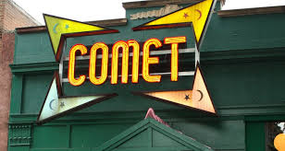
Why do people believe fake news?

Slide 18
Lack of understanding of how online information is created
Lack of understanding of how to evaluate information sources
Emotionally-charged content tends to be more compelling than facts or statistics (Sharot 2017)
Confirmation bias--the human tendency to believe information that agrees with or confirms a person’s beliefs or biases (Nickerson 1998)

Slide 19
Example: Pizzagate
November 2016: InfoWars and conspiracy theorist Alex Jones posts “PizzaGate is Real.”
November – December 2016: “PizzaGate is Real” garners nearly half a million views and 1.5 million tweets (Robb 2017).
December 2016: Edgar Maddison Welch drives from North Carolina to Washington to liberate enslaved children from the basement of the Comet Ping Pong Pizza Parlor, armed with an AR-15 semiautomatic rifle, a .38 handgun, and a folding knife. There is no basement.
March 2017: Alex Jones apologizes and retracts “PizzaGate is Real” video.
October 2019: PizzaGate lives on on Twitter.

Slide 20
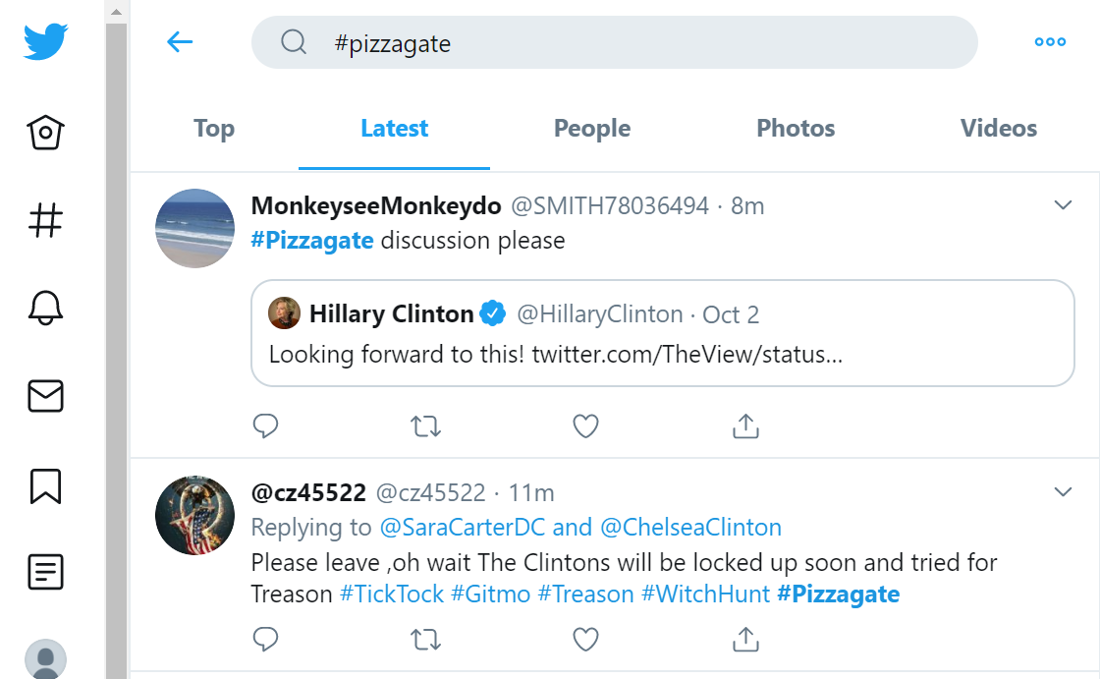

Slide 21
Reasons for Believing
May not have heard the story was retracted
Confirmation bias--the tendency to believe information that agrees with or confirms a person’s beliefs or biases (Nickerson 1998)
Transfer of trust (Pentina, Zhang and Basmanova 2013) – stories/information/opinions shared by trusted friends or family members
People tend to find emotional content much more compelling than facts or statistics. (Sharot 2017)

Slide 22
What roles can librarians play?
Librarians as information experts
Teach users how information is created, vetted (or not), and shared online
Teach critical information evaluation: to “view authority with an attitude of informed skepticism and an openness to new perspectives, additional voices, and changes in schools of thought” (PALNI 2017)
Teach digital information literacy skills

Slide 23
“Now and going forward we have many difficult issues to deal with for teaching people how to identify, evaluate, and apply [information evaluation techniques] - including dealing with attempts to rewrite history; interpret reality; ignore diversity, equity and inclusion; and shatter our standards and applications for authority and credibility.”
Julie Todoro, Foreword, Information Literacy and Libraries in the Age of Fake News, Libraries Unlimited, 2018.

Slide 24
ACRL Framework for Information Literacy (ACRL 2016)
Highlights the importance of understanding:
1) information authority varies with context
2) the many different processes through which information is created
3) information in itself has value
4) research is an inquiry-driven process
5) scholarship should be thought of as conversation and discussion
6) the process of searching for information involves strategic exploration (ACRL 2016)

Slide 25
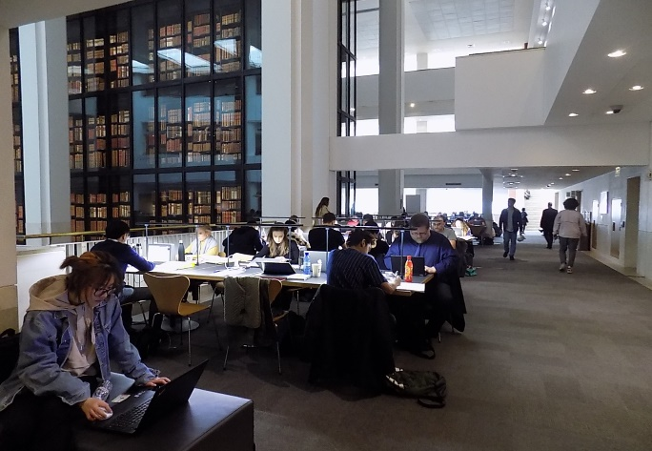
Active Library Programming
In-house hands-on lab sessions
Outreach-based hand-on lab sessions
Discussion groups
Lectures led by community experts

Slide 26
Passive Library Programming
Printed and electronic guides and evaluation tools
Printed bookmarks and single-sheets
Recorded online sessions
---------
For more detailed active and passive programming ideas, see:
Spratt, Hannah and Denise E. Agosto. 2017. “Fighting Fake News: Because We all Deserve the Truth.” Young Adult Library Services 15, no, 4: 17-21.

Slide 27
Conclusion: Librarians as Information Educators
Libraries of all types – public, academic, special, government, and school – are fundamentally educational organizations.
Librarians should play the role of information educator, empowering users not just to access information but to understand which information to trust and share.

Slide 28
References
Agosto, Denise E. 2018. Information Literacy and Libraries in the Age of Fake News. Santa Barbara, CA: Libraries Unlimited.
Allcott, Hunt, and Matthew Gentzkow. "Social Media and Fake News in the 2016 Election." Journal of Economic Perspectives 31, no. 2 (2017): 211-36. https://web.stanford.edu/~gentzkow/research/fakenews.pdf.
Farhi, Paul. 24 March 2017. “Conspiracy Theorist Alex Jones Apologizes for Role in Fake 'Pizzagate' Story.” Washington Post, http://www.chicagotribune.com/news/nationworld/ct-alex-jones-pizzagate-apology-20170324-story.html.
Holan, Angie Drobnic. 2016. "2016 Lie of the Year: Fake news." Politifact, http://www.politifact.com/truth-o-meter/article/2016/dec/13/2016-lie-year-fake-news/.
Howard, J. July 29, 2016. Americans devote more than 10 hours a day to screen time, and growing. http://www.cnn.com/2016/06/30/health/americans-screen-time-nielsen/.

Slide 29
Mitchell, A., Gottfried, J., Barthel, M., & Shearer, E. July 7, 2016. Pathways to news. Pew Research Center, http://www.journalism.org/2016/07/07/pathways-to-news/.
Nickerson, R. S. 1998. Confirmation Bias: A Ubiquitous Phenomenon in Many Guises. Review of General Psychology 2, no. 2: 737-759.
Ohlheiser, Abby. 18 November 2016. This is how Facebook’s Fake-News Writers make Money. Washington Post, https://www.washingtonpost.com/news/the-intersect/wp/2016/11/18/this-is-how-the-internets-fake-news-writers-make-money/?utm_term=.43c3d046a1e5.
PALNI. 6 March 2017. Framework for higher education. http://libguides.palni.edu/c.php?g=185459&p=1224981.
Pentina, I., Zhang, L., & Basmanova, O. 2013. Antecedents and consequences of trust in a social media brand: A cross-cultural study of Twitter. Computers in Human Behavior, 29(4), 1546-1555.
Pew Research Center. 5 February 2018. “Internet/Broadband Factsheet.” http://www.pewinternet.org/fact-sheet/internet-broadband/.

Slide 30
Robb, Amanda. 16 November 2017. “Anatomy of a Fake News Scandal.” Rolling Stone. https://www.rollingstone.com/politics/news/pizzagate-anatomy-of-a-fake-news-scandal-w511904.
Sharot, Tali. The Influential Mind: What the Brain Reveals about Our Power to Change Others. New York: Henry Holt and Company, 2017.
United States Election Project. 2016. http://www.electproject.org/2016g.
Verstraete, M., Bambauer, D. E., & Bambauer, J. R. 2017. Identifying and countering fake news. , University of Arizona
Wineburg, Sam, Sarah McGrew, Joel Breakstone, and Teresa Ortega. "Evaluating Information: The Cornerstone of Civic Online Reasoning." Stanford Digital Repository (22 Nov 2016). Stanford History Education Group, https://sheg.stanford.edu/upload/V3LessonPlans/Executive%20Summary%2011.21.16.pdf.

