Slide 1
Harnessing the Power of Google
Online Webinar for Niche Academy
October 17, 2018
Christopher C. Brown
Reference Librarian
University of Denver Libraries
christopher.brown@du.edu

Slide 2
Overview of the Three Googles
Overlapping at Times
GW
GS
GB
Note: this chart does not represent the actual Google architecture. It shows that different features are foregrounded in different environments.

Slide 3
Google Web: How to leverage it for academic purposes
Primary source materials (government documents, international materials, technical reports, company policies, etc.)
Locating these with site-specific searching (domain searching; TLD searching)
Examples:
site:gov.ng domestic staffing
site:state.gov country reports human rights
site:undp.org development indicators climate change
site:state.co.us marijuana regulation filetype:pdf
site:gob.mx water statistics filetype:pdf

Slide 4
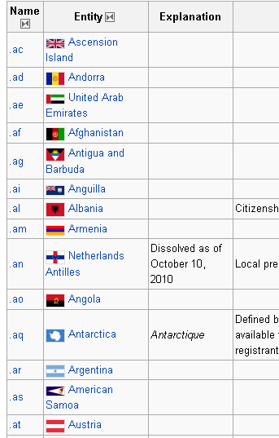
TLDs: Top-Level Domains
Google Web is most effectively searched when you can restrict searching to a top-level domain (like .edu, .gov, .jp)
To discover all the TLDs for countries, type TLD in a Google search box.

Slide 5
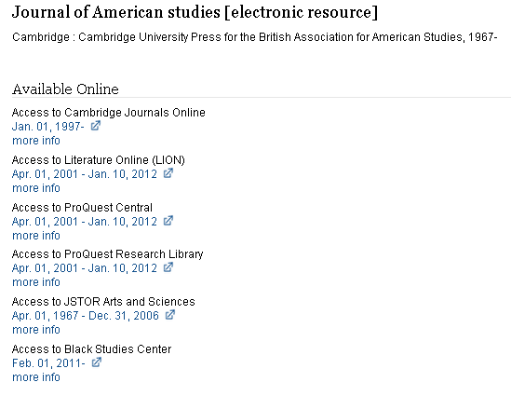
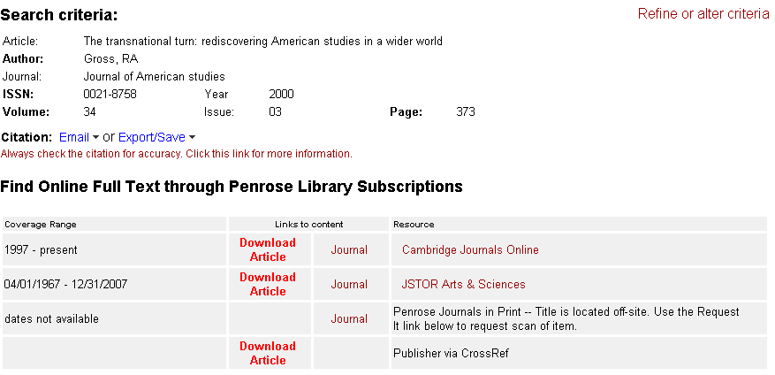
Google Scholar Content
GS
Publisher-supplied indexing and full text content
Library-supplied journal holdings. Every online journal subscription from every publisher and aggregator

Slide 6
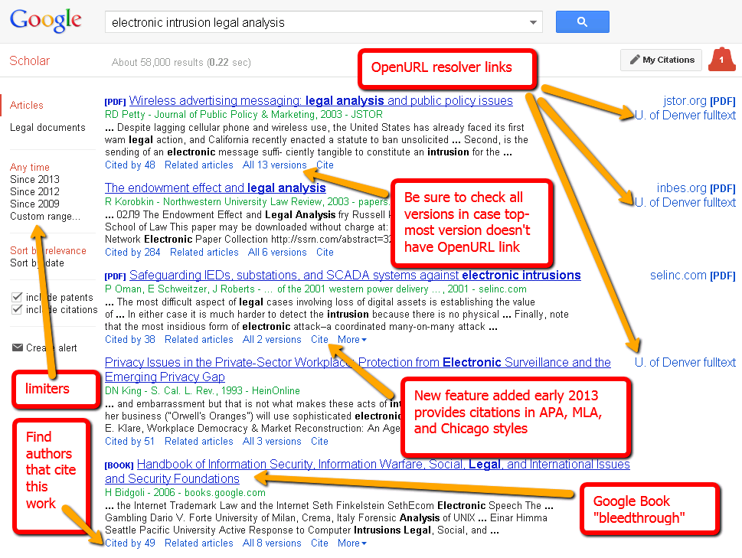
Features of Google Scholar

Slide 7
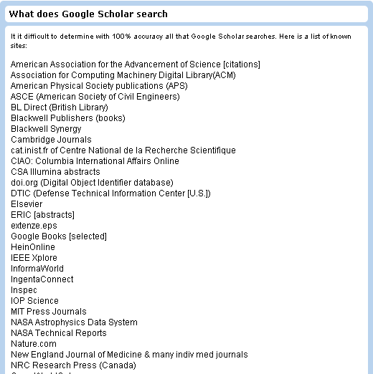
What’s in Google Scholar?
Google isn’t saying – so they leave it up to us to figure it out.
http://libguides.du.edu/content.php?pid=86031&sid=639860

Slide 8
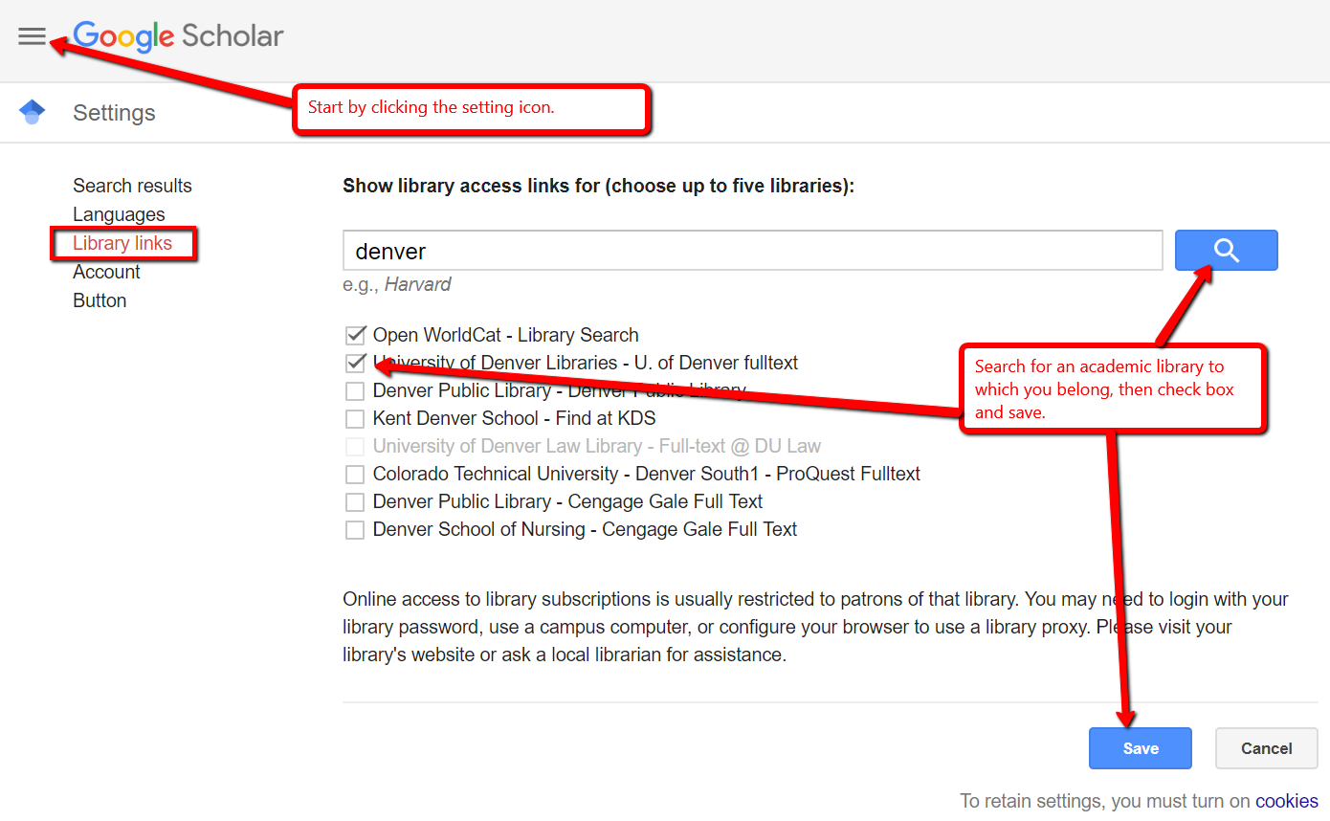
Google Scholar Settings

Slide 9
Google Books: Background
Google Scholar is a metadata and full text search project
Where do books come from?
  Partner Program – publishers and authors make their works more discoverable
  Library Project

Slide 10
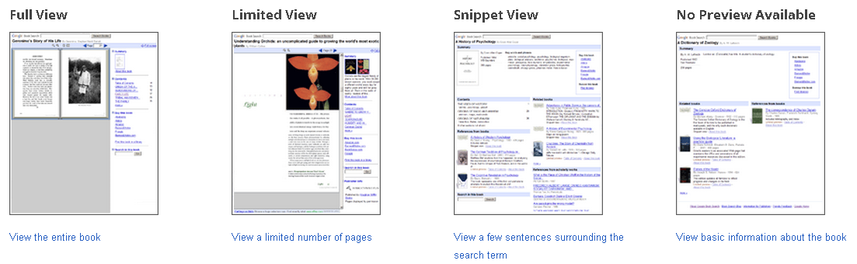
Google Books Views
Full View – if in public domain may be able to download PDF
Limited Preview – publisher has given permission for preview of up to 20% or work
Snippet View – shows a few snippets that match search terms
No Preview – only basic information; sometimes not able to search full text
From:http://books.google.com/intl/en/googlebooks/library/

Slide 11
Google Books and HathiTrust
http://books.google.com/intl/en/googlebooks/about/history.html
http://www.hathitrust.org/partnership
GB
HT
There are materials that are in GB that are not in HT, and vice versa

Slide 12
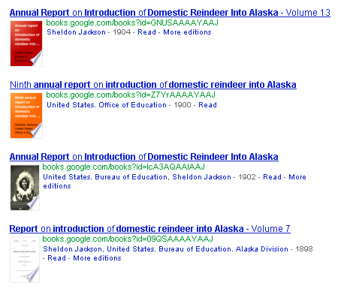
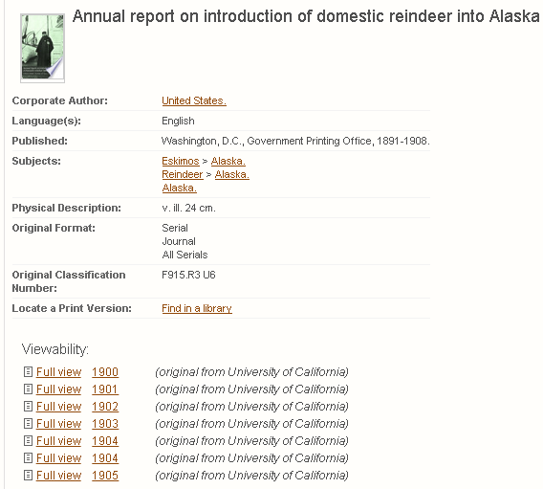
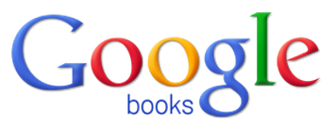

Sometimes Easier to use HT than GB
Annual Report on Introduction of Domestic Reindeer Into Alaska

Slide 13
Feature Differences
 | Google Web | Google Scholar | Google Books
Metadata | Very little useable metadata | Extensive metadata provided by publishers | Extensive metadata provided by OCLC
Citations | No ability to cite resources | Citations can be displayed (APA, MLA, Chicago) and exported | Export citations only in selected formats
Links | Links to Web content | Links to subscribed library content | Links to library holdings and bookstore sales
Date Limits | Date limits for compliant Web pages | Facets for date limits | Limit by century or custom date range

Slide 14
The Three Googles: Summary
GW
GS
Academic, scholarly journal articles
Primary source materials
Discovery + Fulfillment
Discovery + Fulfillment
GB
Full text of books
Discovery Only

Slide 15
The Information Access Anomaly
 | Book (average) | Journal Article (average) | Google (Scholar/Books)
Typical Length - full text (FT) | 200 pages x 400 = 80,000 words | 15 pages x 400 = 6,000 words
Surrogate Record (SR) | 50-100 words (75 ave.) | 300-500 words (400 ave. ¹)
SR to FT ratio | 1 to 10,666 | 1 to 15 | 1 to 1
¹ http://www.writersservices.com/wps/p_word_count.htm

Slide 16
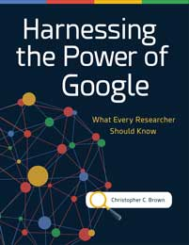
Recommended Reading
Brown, Christopher C. Harnessing the power of Google: What every researcher should know. ABC-CLIO, 2017.
Discount Code from ABC-Clio: Q41820
20% discount valid through end of 2018

Slide 17
Questions?
Contact Chris Brown:
Christopher.Brown@du.edu

