Slide 1

Guiding Family Media Use: Every Family & Community is Different
This project was made possible in part by the Institute of Museum and Library Services
IMLS grant #LG-96-17-0220-17.
Notes:
N: The ‘Guiding Family Media Use’ training helps professionals consider different family contexts for media use. The training uses examples from our interviews with parents to consider ways that ‘every family and community is different’, and how these differences impact on media uses in the home.

Slide 2

Overview
Different Family Contexts – examples from interviews with parents
Three frameworks for understanding family media use
Notes:
R: The goal is to consider how to support families in culturally relevant ways. First, the training presents data that show how differences in family, and contextual factors such as socioeconomic status, ethnicity, (dis)ability, location, parents’ work schedules, and religious beliefs or values impact family decisions connected with media use.
Second, the training introduces three frameworks that describe family media use. Thinking through these frameworks can help professionals better understand and guide families in their decisions about their media use.

Slide 3
Every community,
every family,
and every child
is different.
Notes:
N: The message on this screen is probably not new to anyone! However, we often hear one-size-fits-all solutions about topics like screen time. In an increasingly media-saturated world, parents seek solutions to challenges they face. The reality, however, is that every community, family, and child is different.
(30 sec)

Slide 4
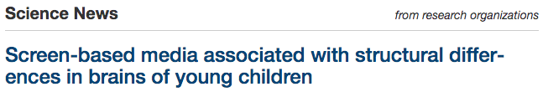
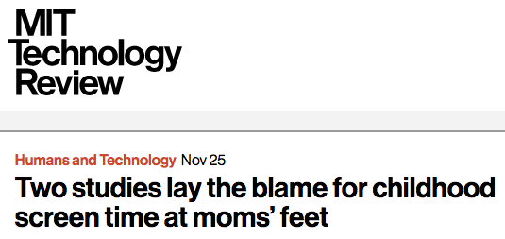


“One-Size-Fits-All” Messaging*
Notes:
R: One-size-fits-all messages and recommendations do not work for many families, like the (now defunct and revised) 1999 American Academy of Pediatrics oft-cited ‘2x2’ rule. The rule stated that children under age two should have no access to screens, and for children over age two, screen time should be limited to 1-2 hours per day. You might think about messages from news media, like those shown here, and how these messages might alienate some parents & caregivers.

Slide 5
In Their Own Words
Notes:
N: This next section, entitled “In Their Own Words,” contains 3 slides from the research data demonstrating different family contexts which depict some of the challenging realities faced by everyday American families in relation to screen media use. These excerpts illustrate how different contexts impact parental decision-making surrounding family media use.

Slide 6

In Their Own Words
Parent Quote #1
“We are definitely strict when it comes to the boys just because it's hard being Hispanic too, you know? ... The stereotypes and stuff. So the last thing I want are my children to be violent or gang-related, or anything like that, because that's kind of why I feel like I'm way stricter when it comes to screen time and television.”
--Melissa, Latinx mother of 5 boys ages 7, 6, 4, 3, and 1; urban community
Notes:
R: this quote is from Latinx mom with 5 boys under age 8. We chose this quote to highlight the role ethnicity and gender play in parents’ decision-making.
[read quote]

Slide 7
Parent Quote #2
“Do you know what the effort is just to get them to brush their teeth every time? To get them to stay off their screens and go do something else? I spend my whole day just hovering [over] them, so that is a pipe dream. I know there are parents like, ‘Just take them away.’ I guess I could. I pick my battles….other parents say like, ‘Oh, we only let them have it at this time,’ but I try to steer clear of those conversations because I feel so guilty.”
--Nora, White mother of twin neurodivergent boys age 12, and a 14 year-old boy, very rural location
Notes:
N: This second quote indicates how disability and location impact decisions about screen media use. [read quote]

Slide 8
Parent Quote #3
“The Bible is our standard...that's how we make decisions on what they should be watching and shouldn't be watching. That's the number one thing.” *
--Rhoda, White mother, two sons 8 and 6; urban community
Notes:
R: Finally, this quote indicates the role religion (including values and ethics) plays in decision-making about family media use [read quote]

Slide 9

Frameworks for Understanding Family Media Use
Photo via:
https://blog.wisconsinearlychildhood.org/2018/07/26/3-essential-steps-to-helping-your-family-become-sensible-digital-users/. Used under Wisconsin Early Childhood Association.
Notes:
N: Now we’ll turn our attention to the core of this training: these are 3 frameworks from researchers for helping to guide and understand family media use. As we introduce each framework you might consider how one’s personal biases shape perceptions of media use, and ways these frameworks might help to create more open-ended and individualized guidance tools. On our website, you’ll find two handouts to accompany this section of the presentation: the first is a “Quick Reference Guide” which summarizes the frameworks for understanding family media use, and the second contains 5 (real life) parent quotes from the data to practice applying the three frameworks.

Slide 10
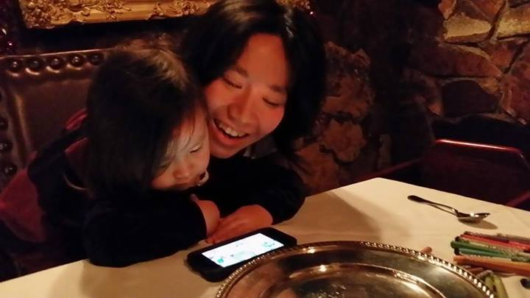
Framework #1
Joint Media Engagement
Joan Ganz Cooney Center
Photo via: https://littleelit.com/2014/01/01/4185/.Used under Little Elit: Young Children, New Media & Libraries.
People using media together interactively
Multiple persons engaging with any form of media (e.g. technology), including traditional media like books or magazines
Modes: viewing, playing, searching, reading, contributing and creating!
Supports learning and literacy by providing resources for making sense and making meaning of situations
Digital Resource Link: http://joanganzcooneycenter.org/wp-content/uploads/2011/12/jgc_coviewing_desktop.pdf
Notes:
R: The expression “joint media engagement” comes from the organization responsible for founding Sesame Street, the Joan Ganz Cooney Center. It refers to spontaneous and designed experiences of people using media together. Joint media engagement broadens the notion of “co-viewing,” as it can happen anywhere and at any time when there are multiple people interacting together and engaging with any form of media. Modes of Joint Media Engagement include viewing, playing, searching, reading, contributing, and creating, with either digital or traditional media. Joint Media Engagement can support learning by providing resources for making sense and making meaning of particular situations.

Slide 11
Framework #1
Joint Media Engagement
Joan Ganz Cooney Center
Photo via: https://littleelit.com/2014/01/01/4185/.Used under Little Elit: Young Children, New Media & Libraries.
Examples of what it looks like:
Two children watching a YouTube video together
A caregiver asks a child which app they want to play with
Children playing Minecraft together (face-to-face and/or online)
Children and a babysitter are taking photos of their neighborhood
Video chatting with friends or family
Children pretending to be characters from a videogame or singing a song from a television show *
Digital Resource Link: http://joanganzcooneycenter.org/wp-content/uploads/2011/12/jgc_coviewing_desktop.pdf
Notes:
R: Here are some examples of different ways children might experience joint media engagement. I’m sure you have other examples. As we are talking through all of these frameworks, please feel free to share ideas from your own professional practice in the chat box.

Slide 12
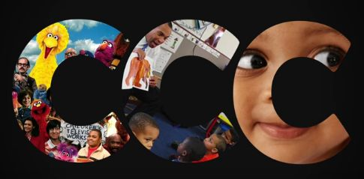
Framework #2
3C’s: Child, Context, Content
Lisa Guernsey
Easy-to-remember and practical
A simple formula for addressing complex questions re: digital media use
  Child = brings own needs interests to media use
  Context = what is happening around the viewing or playing
  Content = information portrayed on the screen
Digital Resource Link: https://www.tapclickread.org/wp-content/uploads/2016/05/2016.06.26_NA_TCR_3Cs.pdf
Photo via: https://ctecs2110.wordpress.com/2016/03/24/the-3-cs-of-screen-time-with-children-content-context-and-child/. Used under “Children and Technology.” Carmen, 2016.
Notes:
N: Author and NYTimes Education contributor Lisa Guernsey created the 3 C’s framework. This framework offers librarians and other professionals an easy-to-remember, practical model for addressing complex questions involving digital media use, parenting, and youth. Every CHILD comes to media or technology with their own needs and interests that can be either fostered or squelched, depending on how media are used. The CONTEXT, or what is happening around the viewing or playing, as well as the extent to which screen time dominates a child's daily routines can also make a difference. According to a growing number of studies on toddlers, preschoolers and elementary school children, the CONTENT, or information portrayed on screen, impacts whether a child learns from what they see.

Slide 13
Framework #2
3C’s: Child, Context, Content
Lisa Guernsey
Parent/Caregiver: Do you have any recommendations for kids’ apps and games?
Librarian: It depends (thinks to themselves: “child, context, content”). Let me ask you some questions.
CHILD: How old is your child? What are their interests? Do they have any special physical or learning needs? What language do you want to use?
CONTEXT: Will they be playing with friends or by themselves? Where and with whom will they use the media? Are there any particular times of the day or week the apps will be used?
CONTENT: Are you looking for a game, story app, creative production app, learning app?
Digital Resource Link: https://www.tapclickread.org/wp-content/uploads/2016/05/2016.06.26_NA_TCR_3Cs.pdf
Photo via: https://ctecs2110.wordpress.com/2016/03/24/the-3-cs-of-screen-time-with-children-content-context-and-child/. Used under “Children and Technology.” Carmen, 2016.
Notes:
N: Let’s imagine for a moment that you’re approached by a parent/caregiver asking for recommendations re: kids’ apps and games. Now that you have the 3C’s at your disposal, you can confidently address the patron inquiry starting with the first C, Child...questions related to the child that you might want to ask are (read from slides)...

Slide 14
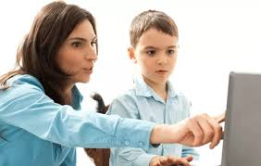
Framework #3
Genres of Digital Parenting
Sonia Livingstone & Alecia Blum-Ross
Embrace Balance Resist
Children are allowed to play games on phones when waiting in line.
Children are allowed to watch certain channels, playlists, or shows on YouTube.
Children are not allowed to be on screens at dinner time.
Photo via: https://www.digitalcenter.org/columns/parenting-digital-age/. Used from USC Center for the Digital Future. Jeffrey Cole, 2019.
Digital Resource Link: https://blogs.lse.ac.uk/parenting4digitalfuture/2018/11/07/parenting-for-a-digital-future-the-book/
Notes:
R: This framework is based on extensive research with families by Livingstone, a Professor in Media and Communications at the London School of Economics, and Blum-Ross, the Global Public Policy Lead for Children and Families at Google/YouTube. The framework identifies three “genres of digital parenting”—embrace, balance, or resist—at different times depending on context. Parents might embrace, balance & resist in different contexts and in relation to different media. Think about how parenting with media changes according to the delivery medium, age of consumer, in various spaces, or even situations like weather, while traveling, or on vacation. This framework provides a potentially useful way of thinking and empowering parents & caregivers and librarians & other professionals as they approach navigating screens in their lives.

Slide 15
Conclusions & Additional Resources
Context is important in families’ decision-making regarding media use.
The three family media use frameworks can help professionals understand and support families’ media use in culturally relevant ways.
Notes:
N: In conclusion, contextual factors such as race, ethnicity, socioeconomic status, geographic location, (dis)ability, parents work schedules, and religious beliefs/values, etc. shape family decision-making in regard to media use. These 3 media use framework can assist professionals in not only understanding, but also supporting families as they navigate screens and digital media in their daily lives.

