Slide 1

Navigating Screens: Advising Parents about Child Media Use
Project team: June Abbas (University of Oklahoma), Denise Agosto (Drexel University), (Gabrielle Salib, Drexel University), Nathan Wheeler (University of Wisconsin-Madison), Rebekah Willett (University of Wisconsin-Madison)
This project was made possible in part by the Institute of Museum and Library Services, IMLS grant#LG-96-17-0220-17.
Notes:
Welcome to the Flipping the script: changing the narrative about children and media professional training session. This training session was developed by the Navigating Screens Research project team. This project was made possible in part by the Institute of Museum and Library Services.

Slide 2

A Bit of Background:
The Navigating Screens Project
The Navigating Screens tutorials are based on a three-year national research project funded by the Institute of Museum & Library Services (IMLS). Navigating Screens researchers conducted interviews with 51 parents and 24 professionals (librarians, teachers, pediatricians, school administrators, and others) in three U.S. states.
The tutorials will be available via Niche Academy: https://my.nicheacademy.com/navigatingscreens
---------------------------------------------------------------------------------------------------------------
All "Navigating Screens" training materials are licensed for free sharing, redistribution, and adaptation under CC BY 4.0.
Notes:
[Read slide aloud.]
This professional training is based on the navigating screens research project which collected and analyzed interviews with 51 parents and 24 professionals including librarians teachers pediatricians and school administrators in three US states. The interviews focused on learning about different ways that parents mediate advice about screens.

Slide 3
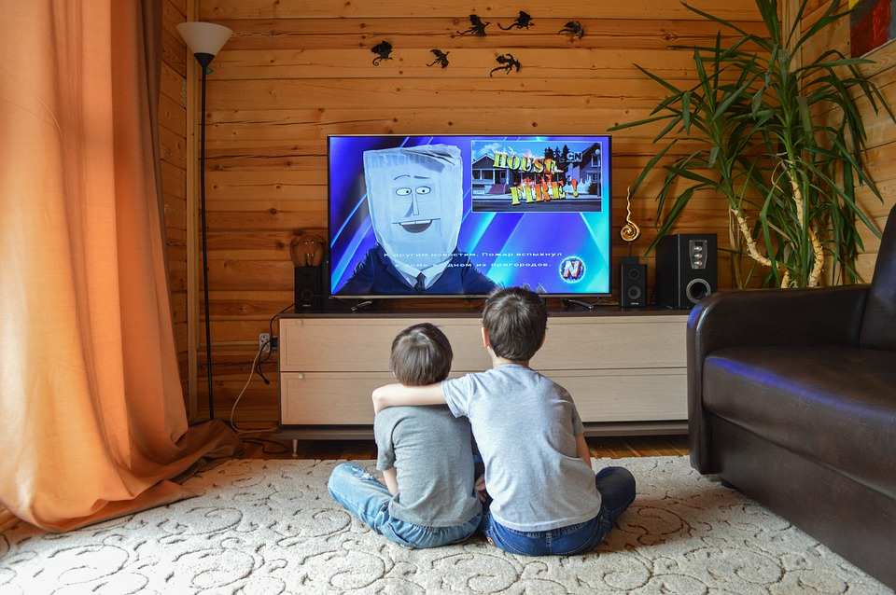
Tutorial 1: Flipping the Script:
Changing the Narrative
About Children & Media
https://pixabay.com/photos/tv-kids-cartoons-movie-toys-5017870/
Notes:
Welcome to the Flipping the script: changing the narrative about children and media professional training session. This training session was developed by the Navigating Screens Research project team. This project was made possible in part by the Institute of Museum and Library Services.

Slide 4

Flipping the Script: Role and Purpose
“Flipping the Script: Changing the Narrative about Children & Media” provides an overview of:
Some of the ways in which U.S. parents view children’s relationships to digital media.
Common generalizations about children and digital media.
Ideas for equipping librarians and other community professionals to support a balanced perspective when helping parents manage and guide children’s media use.
Notes:
[Read slide aloud.]

Slide 5
Why is this topic important?
The Navigating Screens researchers found that many parents talked about media in negative ways and pictured their children as at risk of various negative effects of media, rarely discussing positive aspects of children’s media use.
This tutorial aims to support librarians as they work to make conversations around children and media more balanced and more nuanced.

Slide 6
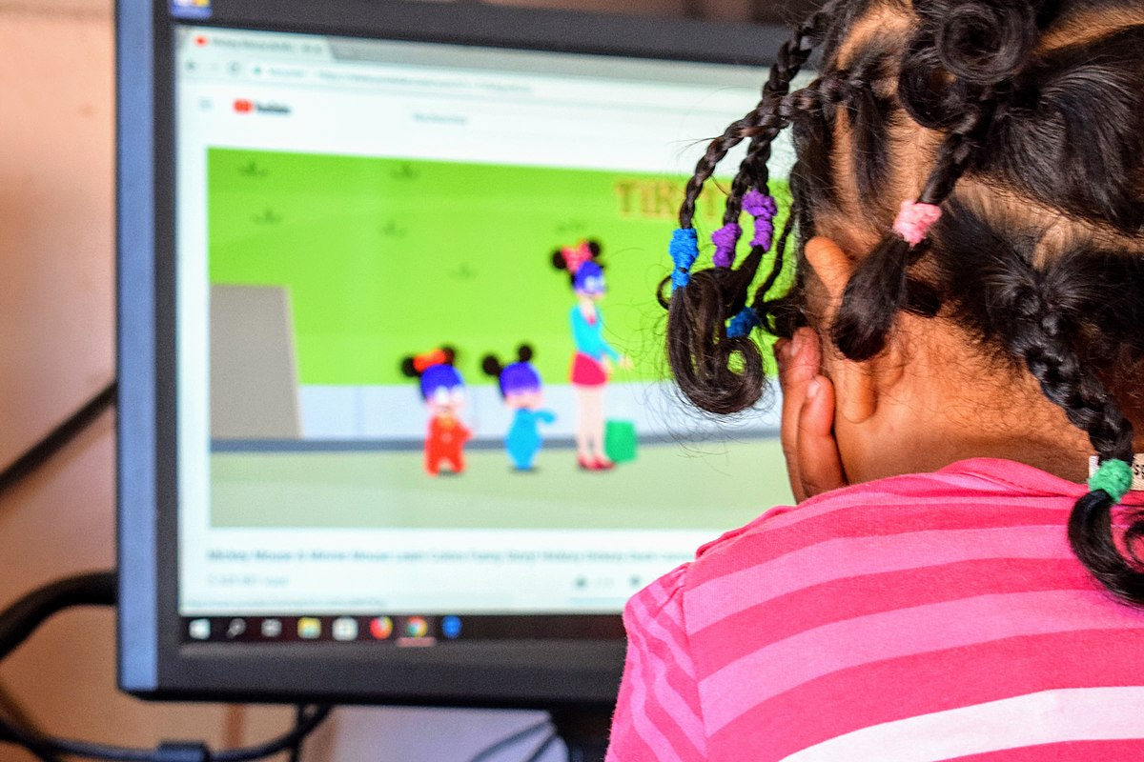
Key Definitions
Media: is used in this tutorial to mean any digital or print resource (e.g. tv shows, videos, apps, or books).
Parents: parents, guardians, and other adults with significant childcare responsibilities. The term “parents” is used as shorthand for “parents and other caregivers” to refer to the full range of adult caregivers in families.
“Child Playing Alone with the Computer,” by Hragaby, https://commons.wikimedia.org/wiki/File:Child_and_connected_computer.jpg, licensed for free sharing CC BY 4.0.
Notes:
Within the context of this training, we use the terms “media,” “media use,” and “parents” in ways that might be somewhat different than you’re used to. Here, when we say “media”, we’re talking about both paper media and digital media.
However, the emphasis in these trainings is on digital media as we work to expand librarians’ well-established authority in recommending books and reading toward making recommendations about digital media use, as an equally core focus of library work.
We use the term “media use” here to refer to the use of any digital or paper media for information, entertainment, socialization, education, or any other purpose. This training focuses on digital media, also called “screen media.” However, we try to avoid the term “screen media,”, as it is largely associated with negative aspects of media use. Our goal in this training is to make conversations about children and media more balanced, encompassing both positive and negative aspects of use.
In addition, we want to stress that we use the term “parents” here is used as shorthand for the wide range of adults with significant childcare duties in families, including parents, grandparents, guardians, and other adults with regularly recurring childcare duties. The importance of recognizing family diversity is covered in more detail in professional training #3, entitled: “Guiding Family Media Use: Every Family and Community is Different.” [You can find training #3 on the Navigating Screens website (https://navigatingscreens.wordpress.com/).]

Slide 7

Common Concerns
from Parents
Children’s exposure to inappropriate content
Parental difficulty in monitoring children’s use
Stranger danger
Time-wasting and taking time away from other activities
Negative effects of excessive screen use: on social skills development, on vision, and on children’s behaviors
Notes:
In working with parents for the Navigating Screens research project, the research team identified several common concerns that parents across socioeconomic and geographic divisions tended to share. The most commonly voiced concerns included: worries about children’s exposure to inappropriate content online, parental difficulties in monitoring children’s use of media, fears of children encountering dangerous strangers online, worries about media use as wasting children’s time and taking up time that would otherwise be spent engaging in more meaningful activities, and worries about negative effects of excessive screen media use in particular on children’s social skills development, on their vision, and on their behaviors at home, at school, and in other places within their communities.

Slide 8

Parental Concerns:
Another Example from the Interviews
“You know, the scamming, the bringing in any viruses is a big one. We limit our searches. We do have firewalls up, and such. That's one. The other is predators. That's my huge [concern]...predators. That's why we're not [on] there yet. And then, their time they're devoting to it is another thing we have issues with sometimes. Because they are in the middle of something, and they don't want to just shut down there, and they've got to.”
--MacKenzie, mother, son age 10, suburban
Notes:
You can see another example of these common concerns about children and media in this quote. [Allow audience to read the quote to themselves].
Here MacKenzie expresses multiple common parental concerns, including worries about media use taking up time that would otherwise be spent engaging in more meaningful activities and negative effects on children’s daily behaviors, as well as repeating the stranger danger narrative we heard from Callum on the previous slide.
Next we’ll spend some time discussing these common parental concerns. The purpose of this discussion is to help you interpret parents’ concerns in order to effectively address them and to be prepared to provide suitable guidance and resources.
To start the discussion, what are your reactions to this quote from MacKenzie? [Pause to give the audience a few minutes to consider the question. Then ask for volunteers to discuss their responses.]

Slide 9
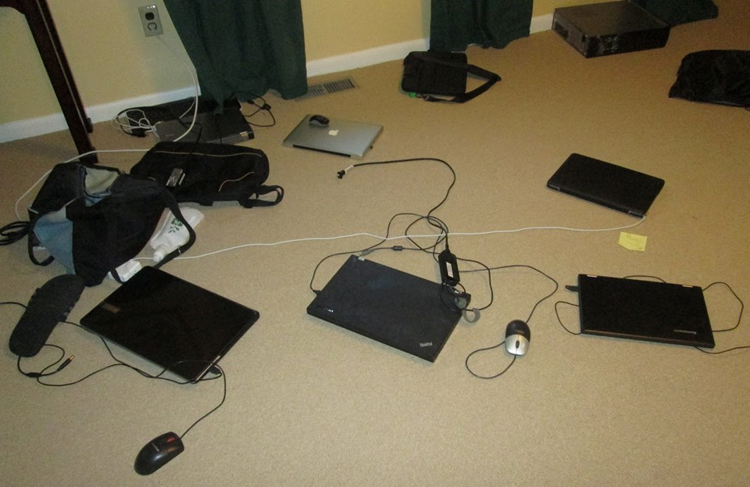
Another Example from the Research:
What Parents Say about Children’s Media Use
“David Brooks wrote about this in the New York Times about two years ago. We are losing the ability just to sit and be with another human being…. So my son will wanna go over to that person's house and play, and they'll play for like three, four hours, this one, stupid game. But there's no interaction. There's no ability to empathize.”
--Tyler, father, African American, urban,
“Abandoned Laptops at a Sleepover,” by Denise Agosto. Used with permission.
Notes:
Returning to what we learned from the research interviews for the Navigating Screens project, here’s another quote that expresses a commonly-held view about the effects of media on children. [Pause to give audience time to read the quote.]
Here we see two additional common parental concerns, worries that time spent online means reduced human interaction and the degradation of children’s social skills and interest.
Now let’s consider these questions for a couple of minutes:
1. To what extent do you agree or disagree with this quote from Tyler?
2. What might you tell Tyler if he came to you in the library and asked for advice on how to keep his son from going to his friend’s house to play video games?
[Give the audience a few minutes to consider the questions. Then ask for volunteers to discuss their responses.]
Although we often hear that the explosion of new media in daily life is leading to the breakdown of meaningful social interaction in society, this is an overly-simplistic view of a much more complicated, nuanced relationship between children and media (and adults and media, too).
For example, although it’s easy to dismiss video game playing as antisocial, most young people who play video games online are communicating with others as they play. Socialization is a fundamental part of children’s draw to gaming - whether it’s a group of children playing the same game together in a room, or children’s located miles away from each other playing together online. As librarians, we must remember not to promote sweeping generalizations such as “The Internet means we’re losing out on human connections” and encourage parents to consider more thoughtfully messages such as these. We’ll address additional generalizations about children and media later in this training.

Slide 10

Common Generalization #1
CHILDREN ARE IRRESPONSIBLE AND VULNERABLE.
A more balanced perspective: Children are still growing and developing mentally and emotionally, and most children are eager to learn. Adults should avoid thinking of children as irresponsible and vulnerable and instead focus on helping them to identify and understand risks while empowering them to build their own identities and make their own decisions.
Notes:
Many of these parental concerns stem from popular generalizations about children and media.
The next five slides present some of the most prevalent of these generalizations and offer more balanced ways to think about children’s relationships to media.
The first of the common generalizations about children and media that we will discuss today is the commonly-held adult belief that children are irresponsible and vulnerable, and therefore they need to be kept off of the internet and social media. We can help parents understand that children are still growing and developing mentally and emotionally, and that most children are eager to learn responsible behaviors.
Parents should favor education over restriction, focusing on helping their children to identify and understand the potential risks of media use while empowering them to build their own identities and to make their own smart decisions about media use.
In the long run, arming children with a balanced understanding of the risks and benefits of media use will enable them to become more productive participants in the vast world of online social interactions.

Slide 11
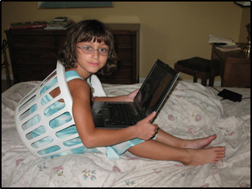
Common Generalization #2
CHILDREN SHOULD USE DIGITAL MEDIA FOR LEARNING. LEISURE USE IS A WASTE OF TIME.
A more balanced perspective: Much of children’s learning takes place during play. Children should have many outlets for entertainment and relaxation.
“Child with Laptop,” by Denise Agosto. Used with permission.
Notes:
The second common generalization suggests that children should use digital media for learning purposes only and that leisure use, such as online gaming or online social interaction, is a waste of time. We can help parents realize that it’s not just learning that provides valuable cognitive and social benefits to children. Having fun does, too!
Resources available on our Additional Resources Handout.
[To learn more about the value of leisure use of media, see: Living and Learning with New Media: Summary of Findings from the Digital Youth Project, by Mizuko Ito et al. MIT Press, 2009., https://www.macfound.org/press/grantee-publications/living-and-learning-with-new-media-summary-of-findings-from-the-digital-youth-project/]

Slide 12
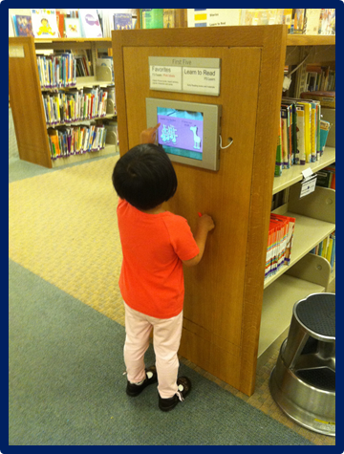
Common Generalization #3
THE INTERNET IS A DANGEROUS PLACE FOR CHILDREN.
A more balanced perspective: The internet and social media can be used to introduce children to different viewpoints and diverse audiences. Rather than trying to protect children by keeping them off of the internet and social media, adults should teach them to become educated, discerning digital citizens.
"Girl with Library Ipad," by Gretchen Caserott: https://www.flickr.com/photos/hams-caserotti/6181613202/. Used with permission.
Notes:
Next, there is the commonly-held view that the internet is a wild and dangerous place for children. It’s true that there are all kinds of people using these tools, but that can be seen as a positive, too, opening up children to new, diverse ideas and perspectives. Again, rather than trying to protect children by keeping them off of the internet, parents, librarians, and other adults should work to teach children how to use these tools safely and wisely.

Slide 13
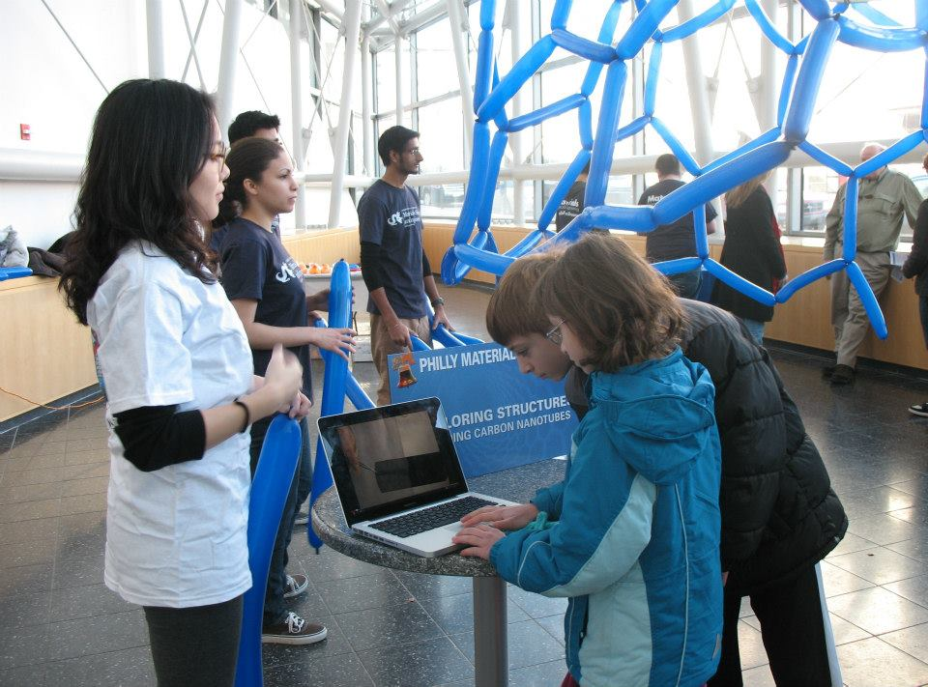
Common Generalization #4
MEDIA ARE TOO POWERFUL FOR CHILDREN TO RESIST.
A more balanced perspective: The powerful draw of media will be there for the rest of children’s lives. Children must learn how to balance media use with other important life activities. Teaching balance – rather than enforcing harsh use restrictions – will likely benefit children more in the longer term.
“Children at Technology Exposition,” by Denise Agosto. Used with permission.
Notes:
Another common generalization is that the draw of media is so strong that children can’t resist it...even when they should.
Librarians can discuss the many benefits of media use, such as explaining that many types of media provide effective platforms for enhancing children’s formal and informal learning.
Parents should also be reminded that the powerful draw of media will also be there for the rest of children’s lives, and they must start learning now how to balance media use with other important life activities. Teaching balance – rather than enforcing harsh restrictions – will likely benefit children more in the longer term.

Slide 14
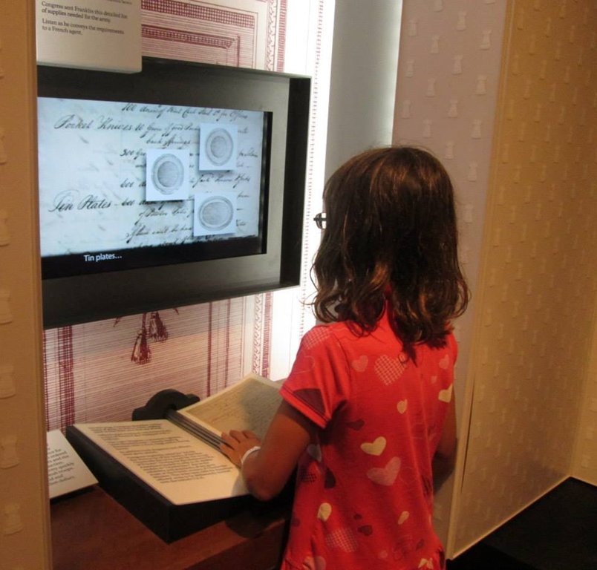
Common Generalization #5
ALL CHILDREN ARE MEDIA ENTHUSIASTS AND EXPERTS.
A more balanced perspective: Just as with any other generation, children’s levels of technology interest and skills vary widely. We must be careful not to stereotype an entire generation.
“Girl with Computer at Museum,” by Denise Agosto, Used with permission.
Notes:
Lastly, many adults believe in the common myth of children as “digital natives,” which suggests that because today’s children were born into a highly-networked world they are all media and technology enthusiasts and experts.
More than a decade of research in a range of disciplines has shown that this stereotype is just that -- a stereotype. Children’s levels of media and technology interests and skills vary widely, from those who are avid fans to those with only limited interest. Stereotyping an entire generation leaves those with less media interest and skills at a disadvantage in both formal and informal learning environments.
[To learn more about the myth of children as digital natives, see: Busting the Myths of the Digital Native, by Hilary Scharton, EdTech Digest, https://edtechdigest.com/2018/10/22/busting-the-myths-of-the-digital-native/.]

Slide 15

American Academy of Pediatrics (AAP) Guidelines -- A Bit of History
Prior to 2010, AAP recommended no screen time before age 2, and limiting children’s screen time after age 2 to 1 hour per day.
2010 AAP Guidelines
The 2x2 model (no more than 2 hours of screen time per day after age 2)
Notes:
Next, we will examine the most commonly shared professional recommendations related to children and media use.
We’ll consider how these guidelines reflect some of the common parental concerns and generalizations of children and media that we’ve been discussing today.
We’ll also consider how useful or constraining they are for parents seeking to guide their children’s media use and for professionals engaged in media advocacy with families.

Slide 16

The American Academy of Pediatrics (AAP) 2016 Guidelines
The 2016 Revision of the AAP Guidelines suggests:
More nuanced consideration of screen time (e.g. video-chatting is fine; some types of media use are more valuable than others).
Joint media use (selecting apps together; co-viewing tv & videos).
The use of a Family Media Use Plan (a tool for creating individualized plans for each child in a household).
Notes:
Moving on to 2016, the AAP released another revision of the guidelines. The 2016 update erased the one-size-fits-all, two hour per day screen time limit and offered a more nuanced set of guidelines. Consider the more nuanced recommendations on the screen.
Specifically, it offered the following screen media use recommendations:
For children younger than 18 months, avoid the use of screen media other than video-chatting.
Parents of children 18 to 24 months of age who want to introduce digital media should choose high-quality programming and watch it with their children to help them understand what they're seeing. (This is called “co-viewing.”)
For children ages 2 to 5 years, limit screen use to 1 hour per day of high-quality programs. Parents should co-view media with children to help them understand what they are seeing and how to apply it to the world around them.
For children ages 6 and older, place consistent limits on the time spent using media, and the types of media used, and make sure that media use does not take the place of adequate sleep, physical activity, and other behaviors essential to good health.
Families should designate media-free times together, such as dinner or driving, as well as media-free locations in the home, such as children’s bedrooms.
Parents should hold ongoing communications with their children about online citizenship and safety, including learning how to treat others with respect both online and offline.
Families should create a Family Media Use Plan. The Family Media Use Plan should take into account the particular health, education, and entertainment needs of each child as well as the whole family. It should include screen-free zones in the home; designated screen-free times; device use curfews; a personalized family framework for choosing and diversifying media selections; guidelines for balancing online and offline time; topics relating to media manners digital citizenship, and online safety; and schedules for sleep and exercise for each child.

Slide 17
The American Academy of Pediatrics (AAP) Guidelines: The 2x2 Rule Lives On
Advantages
It’s easy to remember.
It needs little explanation.
Disadvantages
One-size-fits-all media rules assume all media use is equally beneficial or unfavorable to children’s health.
Simplistic rules ignore the fact that different parents have different resources and different amount of available time.
Notes:
Take some time to think about the newer guidelines. Consider these questions in regard to the newer guidelines:
Pause here for a few minutes to consider these questions and discuss with the larger group.

Slide 18

Questions to Consider
1. As librarians, how can we “flip the script” for each of these media generalizations and concerns, helping parents think about children and media in more balanced ways? 2. How can we help parents understand that one-size-fits-all solutions don’t work, and that there is no one “best way” to guide children’s media use? 3. How can we best support parents in their efforts to guide their children’s media use?
Notes:
To conclude, let’s bring the discussion back to our professional practice one final time. We want to encourage you to put into practice some of what you’ve learned today.
Take a few minutes to come up with one step you plan to take within the next week to build on the ideas that you’ve learned from today’s training and one step you plan to take in the longer term as you work to make media advocacy a more central role of your work with families.
These “steps” might be changing how you discuss children’s media use with parents, creating new active or passive library programs for parents or families, seeking out resources you can share with parents, teaching colleagues about some of generalizations we examined today, etc.
[You should now pause here to give the group time to think and discuss. ]
Thank you for taking part in this training!

