Slide 1

VALCHOICE AND NICHE ACADEMY
5 Essential Tools for a Successful Money Smart Week
In support of ALA and The Federal Reserve Bank, ValChoice produced an exclusive content series for libraries of all sizes. It covers one of the gaping holes in financial literacy among Americans -- understanding and buying insurance.
February 19, 2020

Slide 2








AGENDA
Money Smart Week is Right Around the Corner April 4 - 11
Money Smart Week is all about empowering your community with the skills to make better-informed personal finance decisions
The problem: buying insurance is difficult, confusing and expensive
The solution: financial literacy / insurance education
Five essential tools for Money Smart Week and financial literacy
Demonstration – How to access the content and tools

Slide 3

THE PROBLEM FACED BY CONSUMERS
Why is buying insurance so difficult and confusing?
Must buy but don’t understand
10x price range
Large claims often not paid
No transparency
Online purchases result poorly insured shoppers
Choosing the wrong insurance is financially catastrophic

Slide 4


THE SOLUTION IS FINANCIAL LITERACY
ValChoice Provides Insurance Content That’s Unique and Easy to Understand
No Support Required
What’s Provided
The content can be customized to each city and patron making it more valuable and relevant
Over nearly a decade, ValChoice studied more than 25,000 companies and delivers those findings free of charge to the consumer
Great Benefit to Adult Patrons
Training Options
Everyone from the age of 16 on up needs this kind of education to help them be more informed consumers capable of making better buying decisions
Libraries can choose to deliver the content either via web self service, staff-led events or both

Slide 5


VALCHOICE
#1 Independent Insurance Company Ratings and Analytics
The Carfax for Insurance according to Forbes Magazine

Slide 6

FIVE ESSENTIAL TOOLS FOR SMART MONEY WEEK
1 Calculators – Price info tailored to your location
2 Company ratings – On price, value and service
3 Educational videos – Understanding items 1 & 2
4 Worksheets – For individualizing info
5 Book – Injured Money

Slide 7
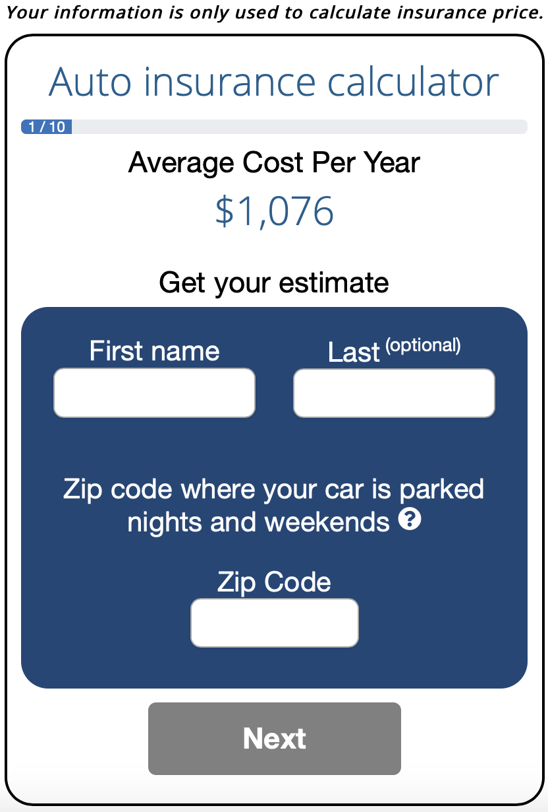
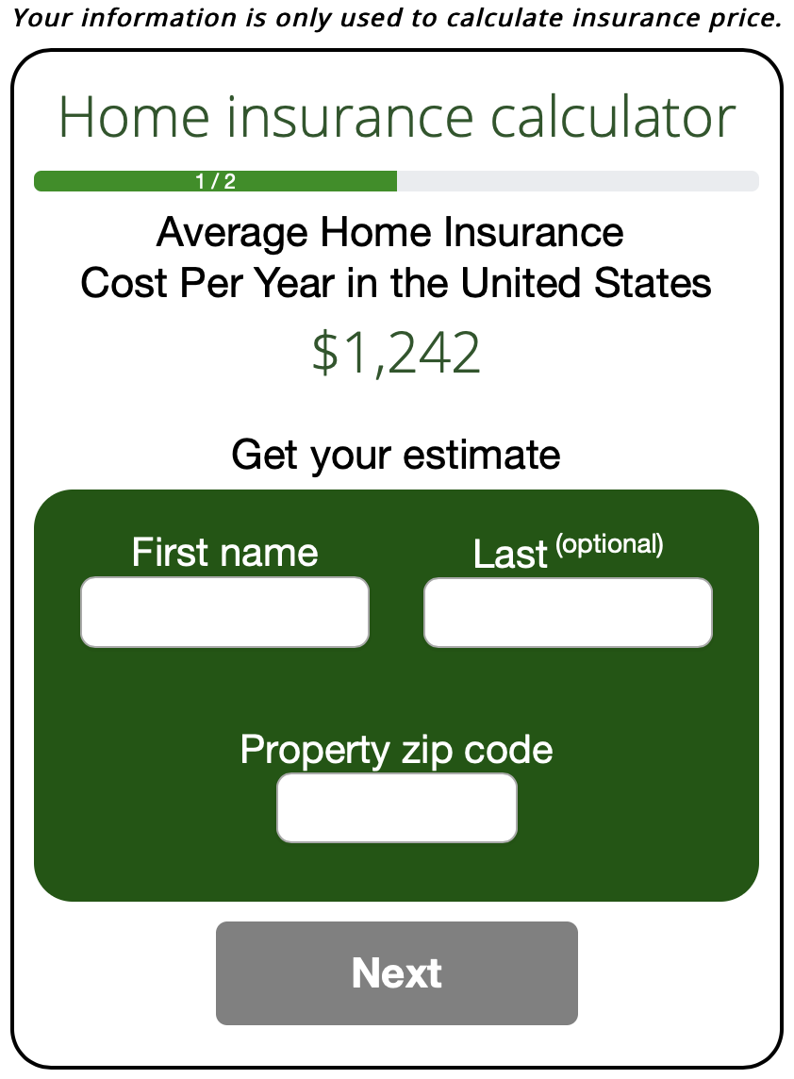


INSURANCE COST CALCULATORS
Find Out What You Should Pay to Get the Most Value from Insurance Coverage
Empowering and informing consumers
Insurance shopping websites don’t provide consumers with the complete picture. ValChoice delivers more information and helps consumers understand what they should pay to get the most value from their insurance dollars when they need it most – when they file a claim.
Completely customizable results that accurately reflect individual location and needs
Thousands of data points and insurance regulatory filings inform the intelligent reports

Slide 8
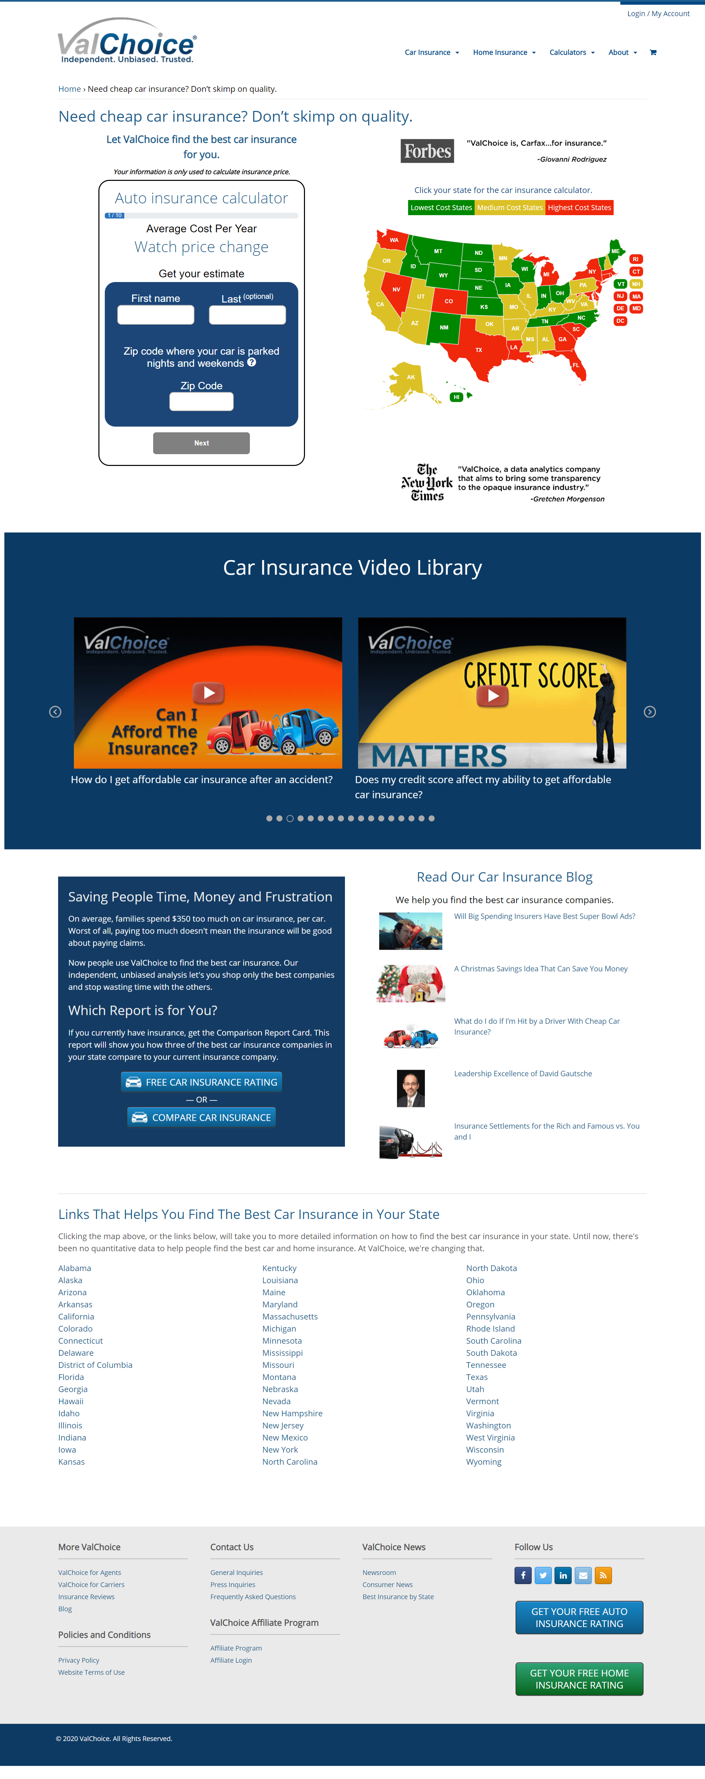
THE VALCHOICE CAR INSURANCE CALCULATOR
Bringing price and claims transparency to buying coverage for automobiles
Find a fair price without pressure to buy
Take control of the coverage and cost through literacy
Select insurance companies based on quality and value

Slide 9
THE VALCHOICE CAR INSURANCE CALCULATOR
Bringing price and claims transparency to buying coverage for automobiles
State versions updated as laws and regulations change
Pricing changes with the market
Updates require no support from your organization
No software required on your systems

Slide 10
THE VALCHOICE CAR INSURANCE CALCULATOR
Bringing price and claims transparency to buying coverage for automobiles
Customized by location
Educate users on what:
    They need
    They can influence
    Fair
Debunk myths
Much additional info on web page

Slide 11
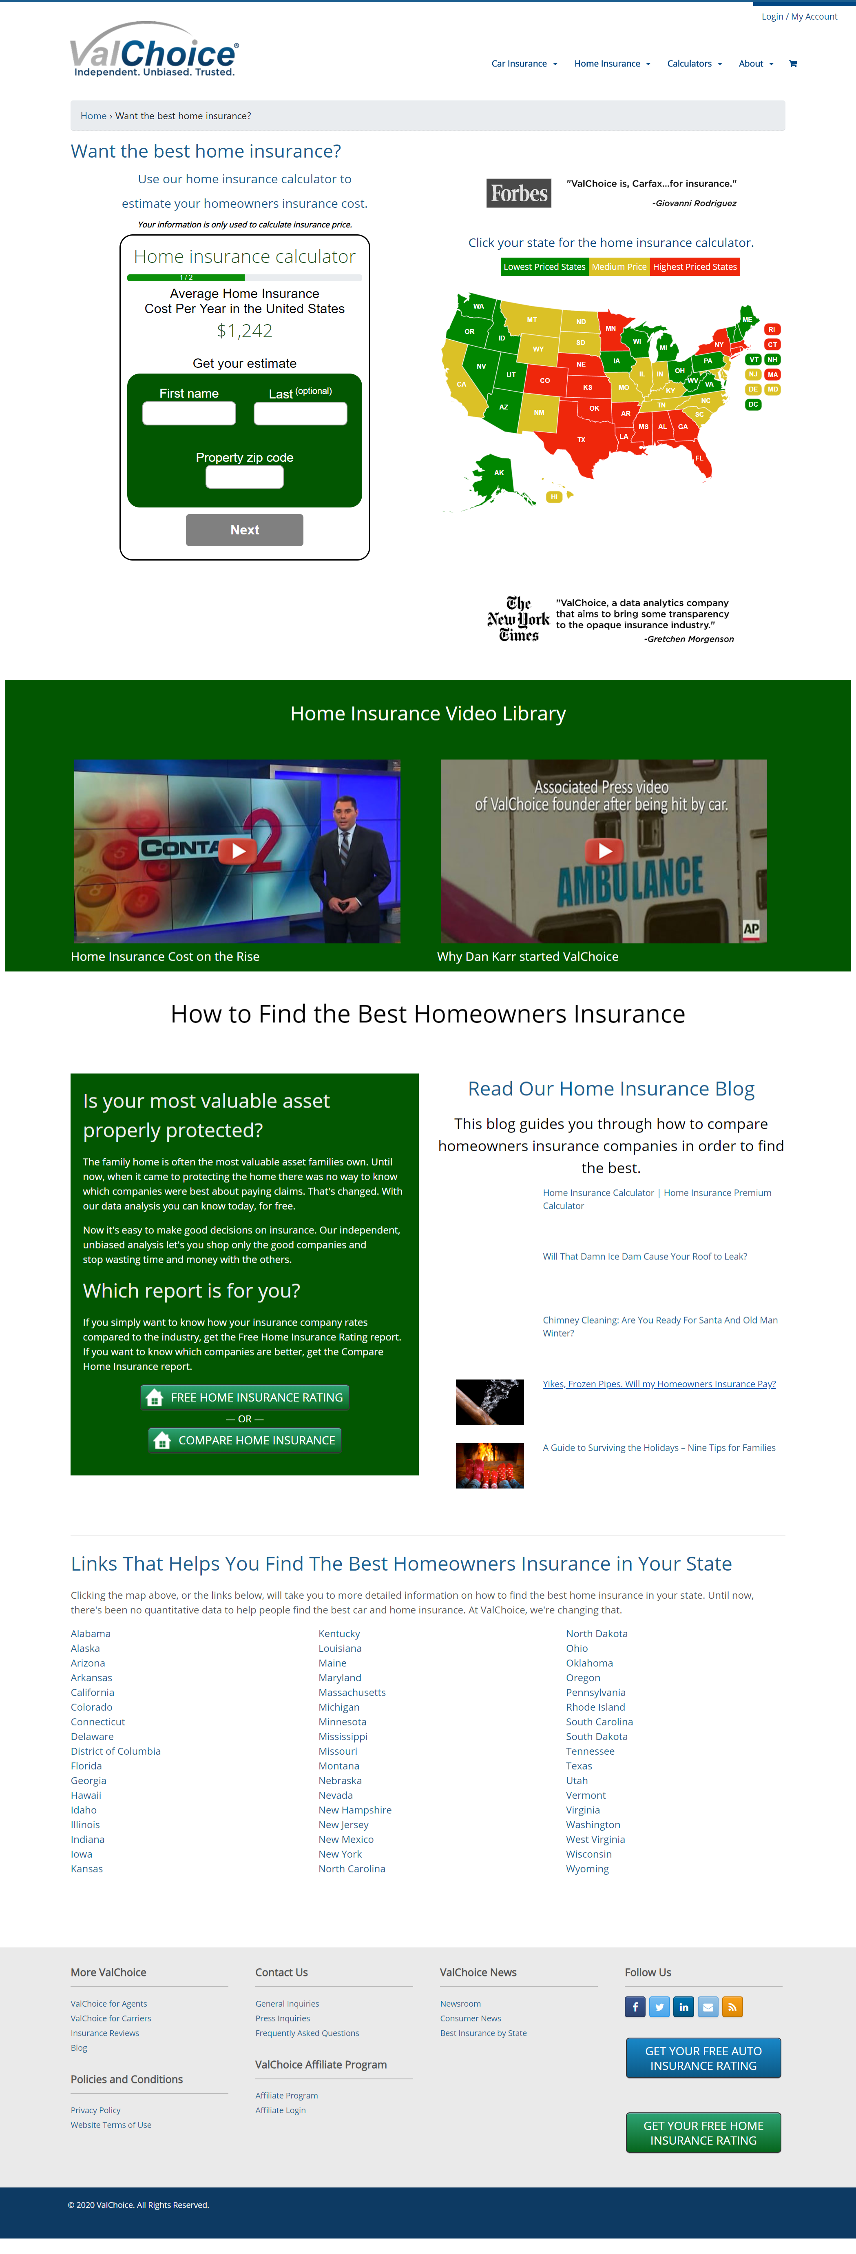
THE VALCHOICE HOME INSURANCE CALCULATOR
Bringing price and claims transparency to buying coverage for consumers most valuable asset
Find a fair price without pressure to buy
Take control of the coverage and cost through literacy
Select insurance companies based on quality and value

Slide 12
THE VALCHOICE HOME INSURANCE CALCULATOR
Bringing price and claims transparency to buying coverage for consumers most valuable asset
Updated as prices increase in each state
Updates require no support from your organization
No software required on your systems

Slide 13
THE VALCHOICE HOME INSURANCE CALCULATOR
Bringing price and claims transparency to buying coverage for consumers most valuable asset
All info custom, by location
Understand inputs
Debunk myths
Educate users on what’s
  They need
  They can influence
  Fair
Much additional information on page

Slide 14


INSURANCE COMPANY RATINGS
An Independent Measure of Quality and Value
Insurance that doesn’t pay claims is not insurance!
ValChoice measures insurance companies based on three important criteria – price, protection (quality) and service. No other company provides this important independent analysis for consumers
Single company reports are provided to your patrons free of charge
More comprehensive multi-company comparison reports are available from agents on the website

Slide 15




EXAMPLE: ROCKFORD MUTUAL VS. COMPETITION
ValChoice Compares Carriers on Three Important Criteria – Price, Protection and Service
Company / Value | Rockford Mutual | State Farm | Geico | Progressive
Overall | 100 / 100 | 47/ 100 | 50 / 100 | 40 / 100
Price | 74 / 100 | 48 / 100 | 67 /100 | 40 / 100
Protection | 100 / 100 | 50 / 100 | 34 / 100 | 42 / 100
Service |  |  |  | 
Financial Strength | A- (Excellent) | A++ (Superior) | A++ (Superior) | A+ (Superior)
Years in Business | 124 | 98 | 84 | 83

Slide 16

VALCHOICE INSURANCE COMPANY REPORTS
Bringing price and claims transparency to the insurance industry
ValChoice is the only company to
  Use data collected by state insurance departments
  Use data vetted by state insurance departments
Mathematical model of industry by insurance type
No user surveys or web reviews
25,000 companies analyzed

Slide 17



EDUCATIONAL VIDEOS
Hands-on Learning with No Train the Trainer Required
16 - 24 Years Old
25 - 54 Years Old
55 and Older
21 frequently asked questions
Seven top tips
Series of six videos
25-minute total run time
25 frequently asked questions
11 top tips
Series of seven videos
30-minute total run time
28 frequently asked questions
12 top tips
Series of seven videos
30-minute total run time

Slide 18

CAR & HOME INSURANCE CHECK-UPS
Free ratings
How good is your insurance company?
Does your insurer delay & deny claims?
Who are the best companies?

Slide 19
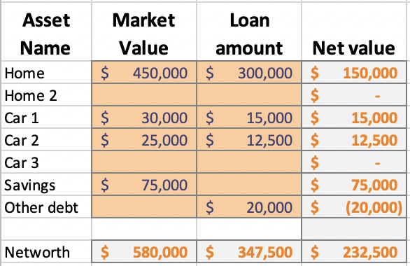
WORKSHEETS
Individualized, hands-on learning
Figure out exactly what you need
  Liability insurance coverage
  Deductible amount
Coordinated with calculators
  Pages (screens) in the web app
  Guides individualized decisions

Slide 20

INJURED MONEY BOOK
“This book is the complete guide for dealing with insurance companies, and the people who work for them. I had read a few "file your own claim" type books, but this is the only one that accurately prepares you for what is going to happen at each step in the process. It also provides a clear explanation of how to handle the situation. This is like a Bible and a Dummies guide rolled into one book. As icing on the cake, it is actually interesting to read.
“Statistically speaking, most of us will never be in a serious car accident in our lives. However, we buy insurance anyway. Injured Money should be part of your insurance purchase, so order a copy now. If you or a loved one are in a serious accident, car or otherwise, you will need to have this book at hand.”
“A very informative book that everyone who has insurance should read.”

Slide 21
PRICING
Calculators – No charge. Register to get links for your location
Ratings – No charge.
Educational Videos – First year free, until 4/4/20.
Worksheets – Included as part of video subscription.
Book – Link to web apps and use above items and get signed book, free.

Slide 22

HOW TO ORDER
https://www.valchoice.com/product/money-smart/

Slide 23


Ordering
STEP #1: ORDERING
Select your state
Click “REGISTER NOW”

Slide 24
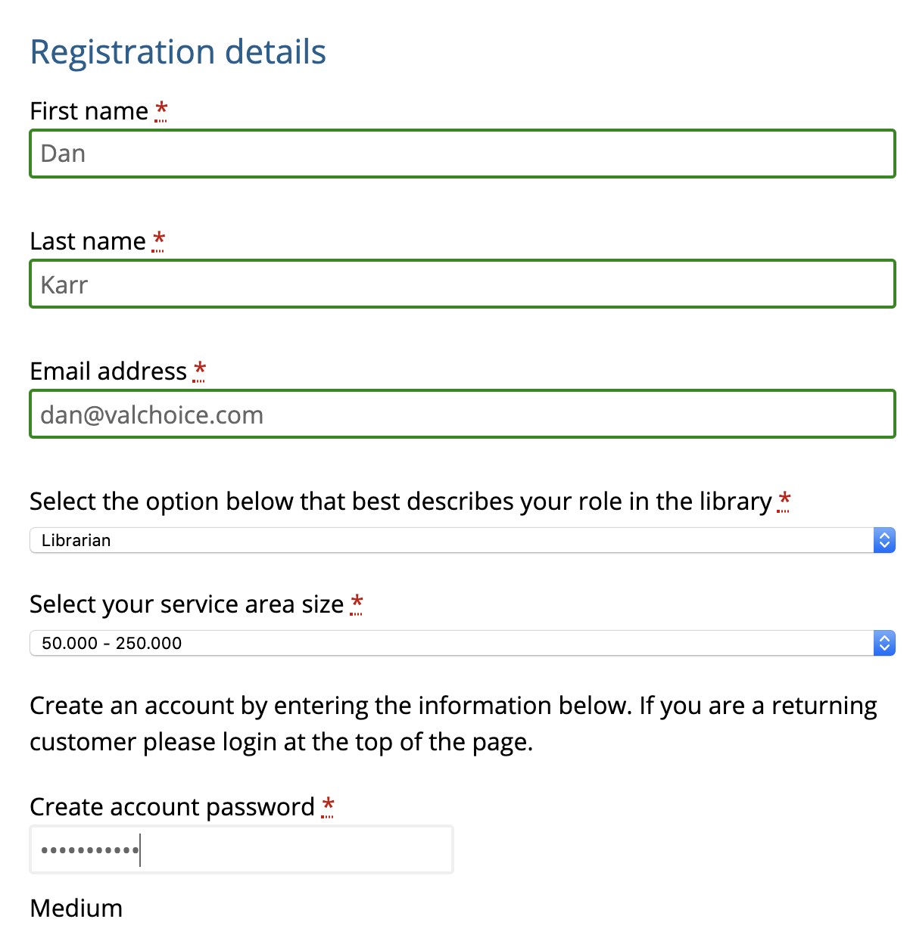
STEP #2: ORDERING
Fill in name
Email
Title
Service area size

Slide 25
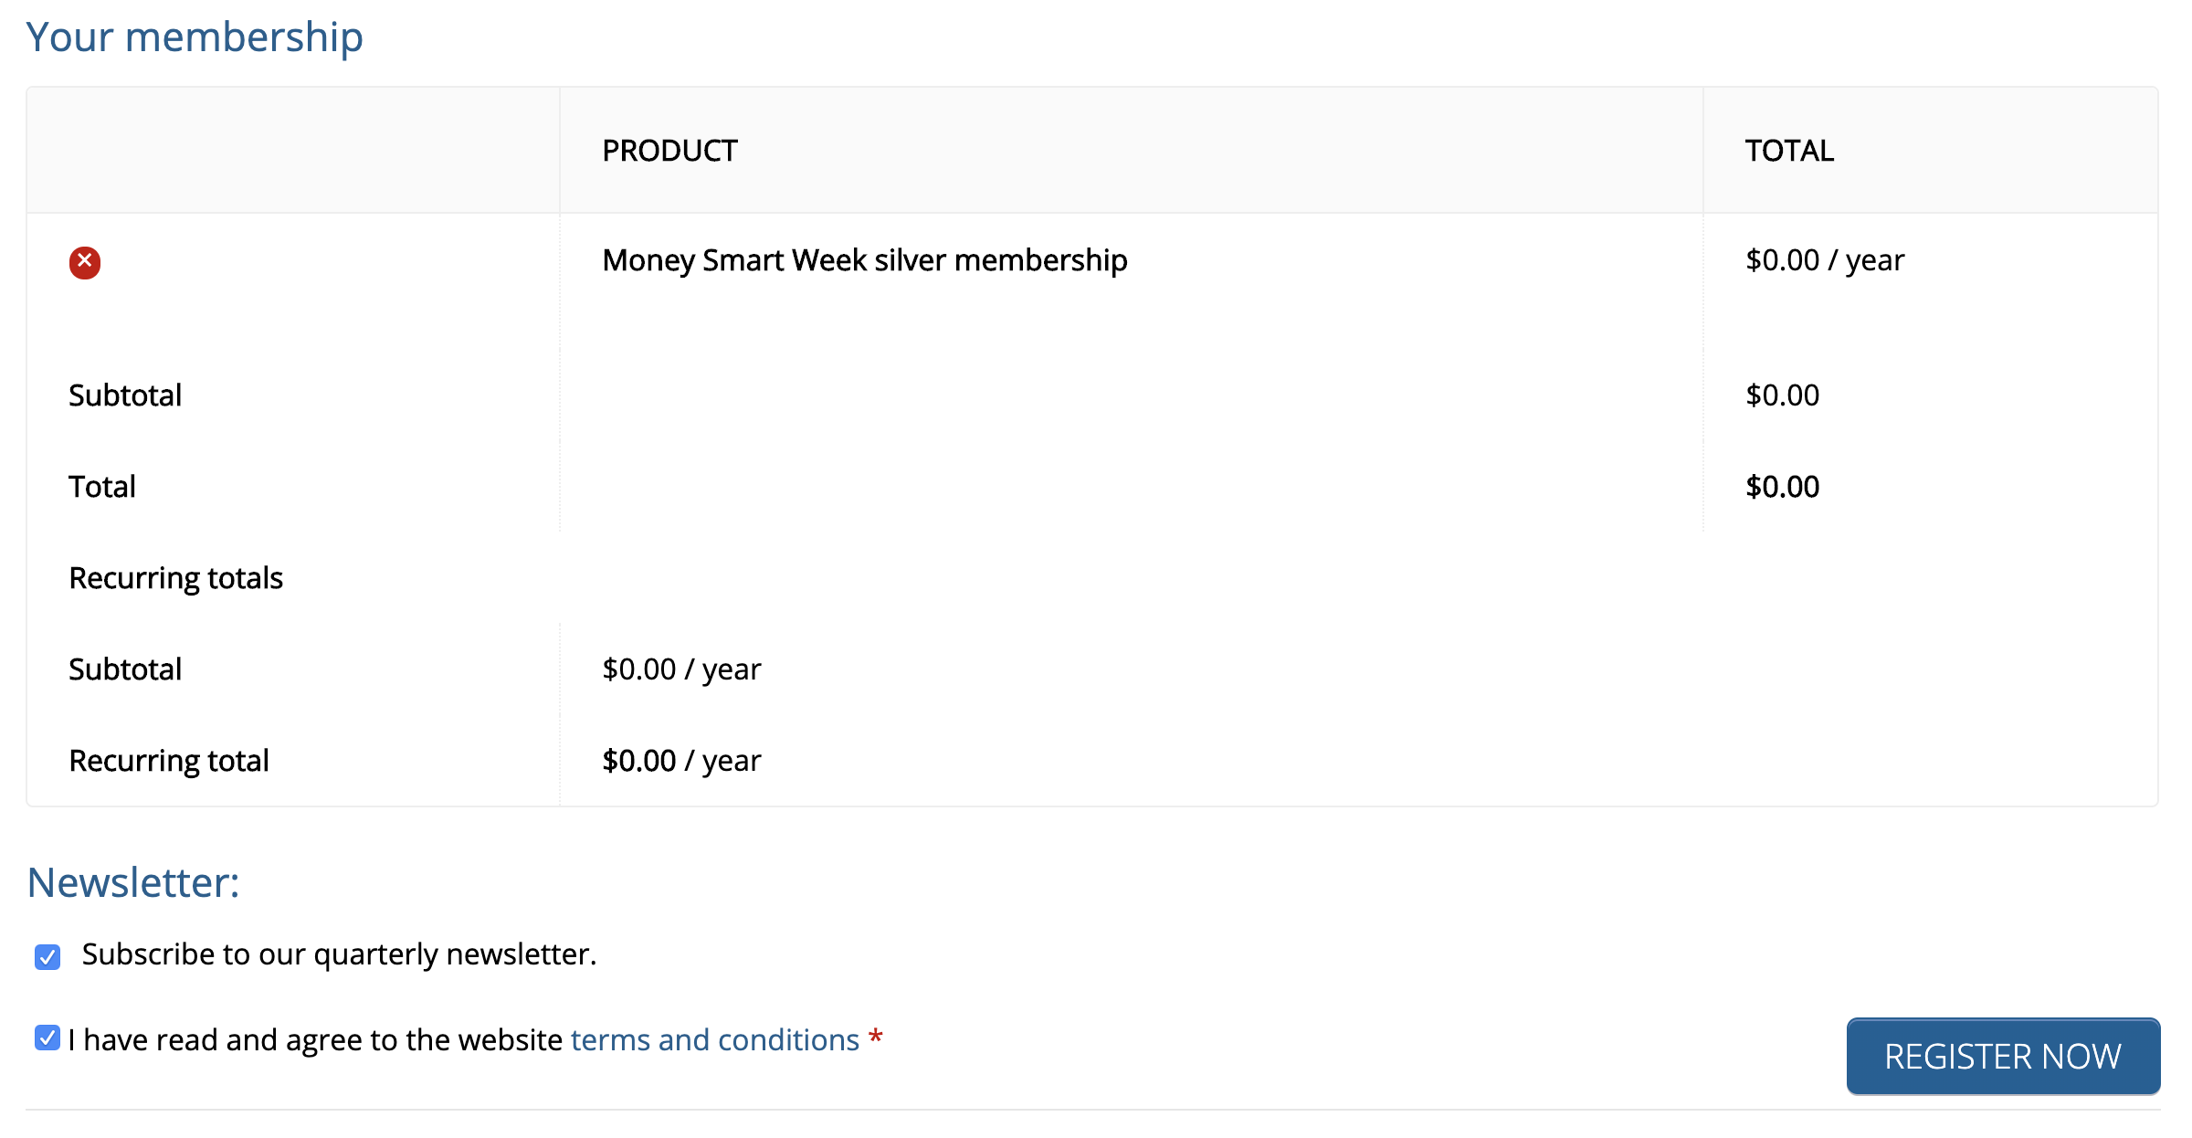
STEP #3: ORDERING
No charge order
No recurring charge
Accept terms
Click ”REGISTER NOW”

Slide 26

STEP #4: ORDERING
Click ”GET CONTENT”

Slide 27
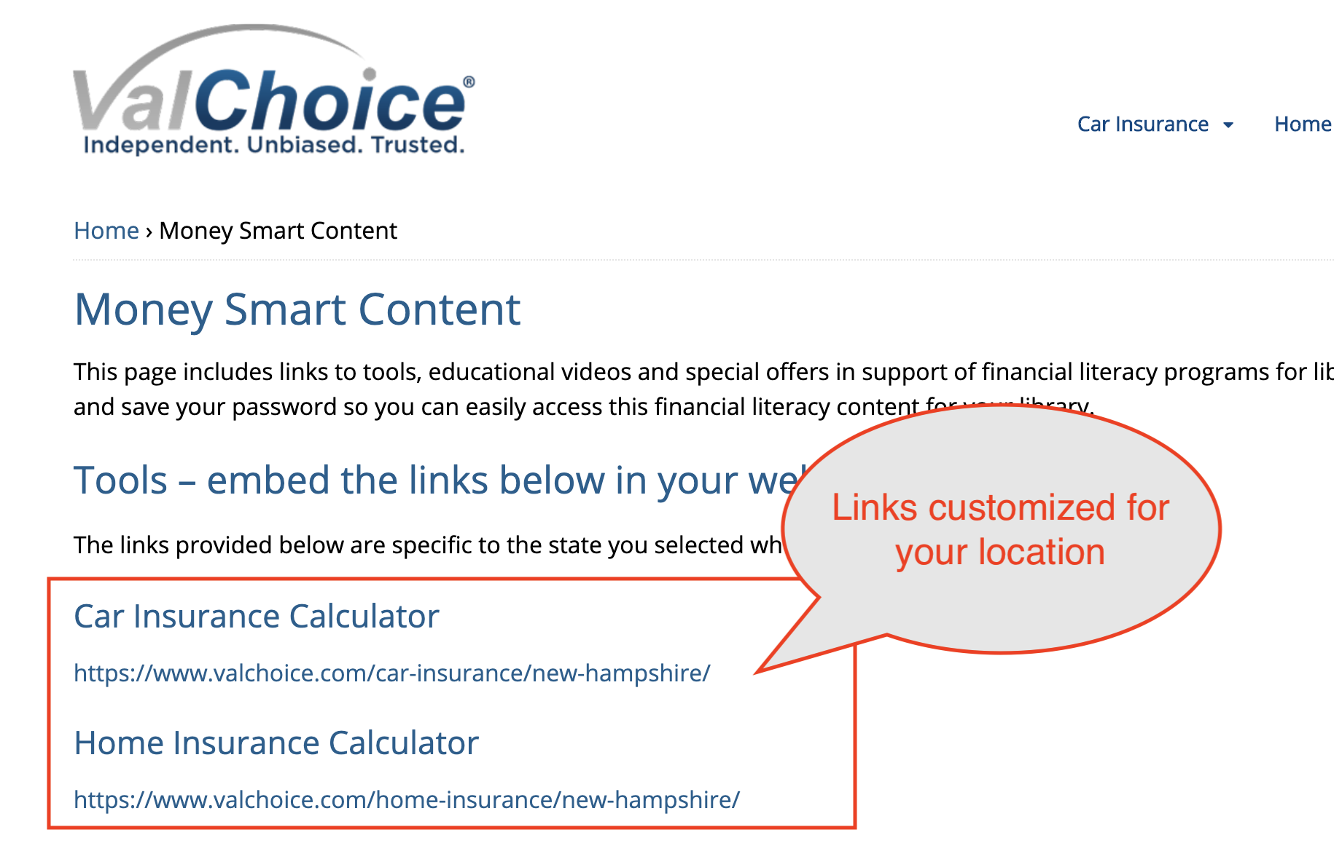

STEP #5: ORDERING
Copy your links for pasting into your library’s website

Slide 28
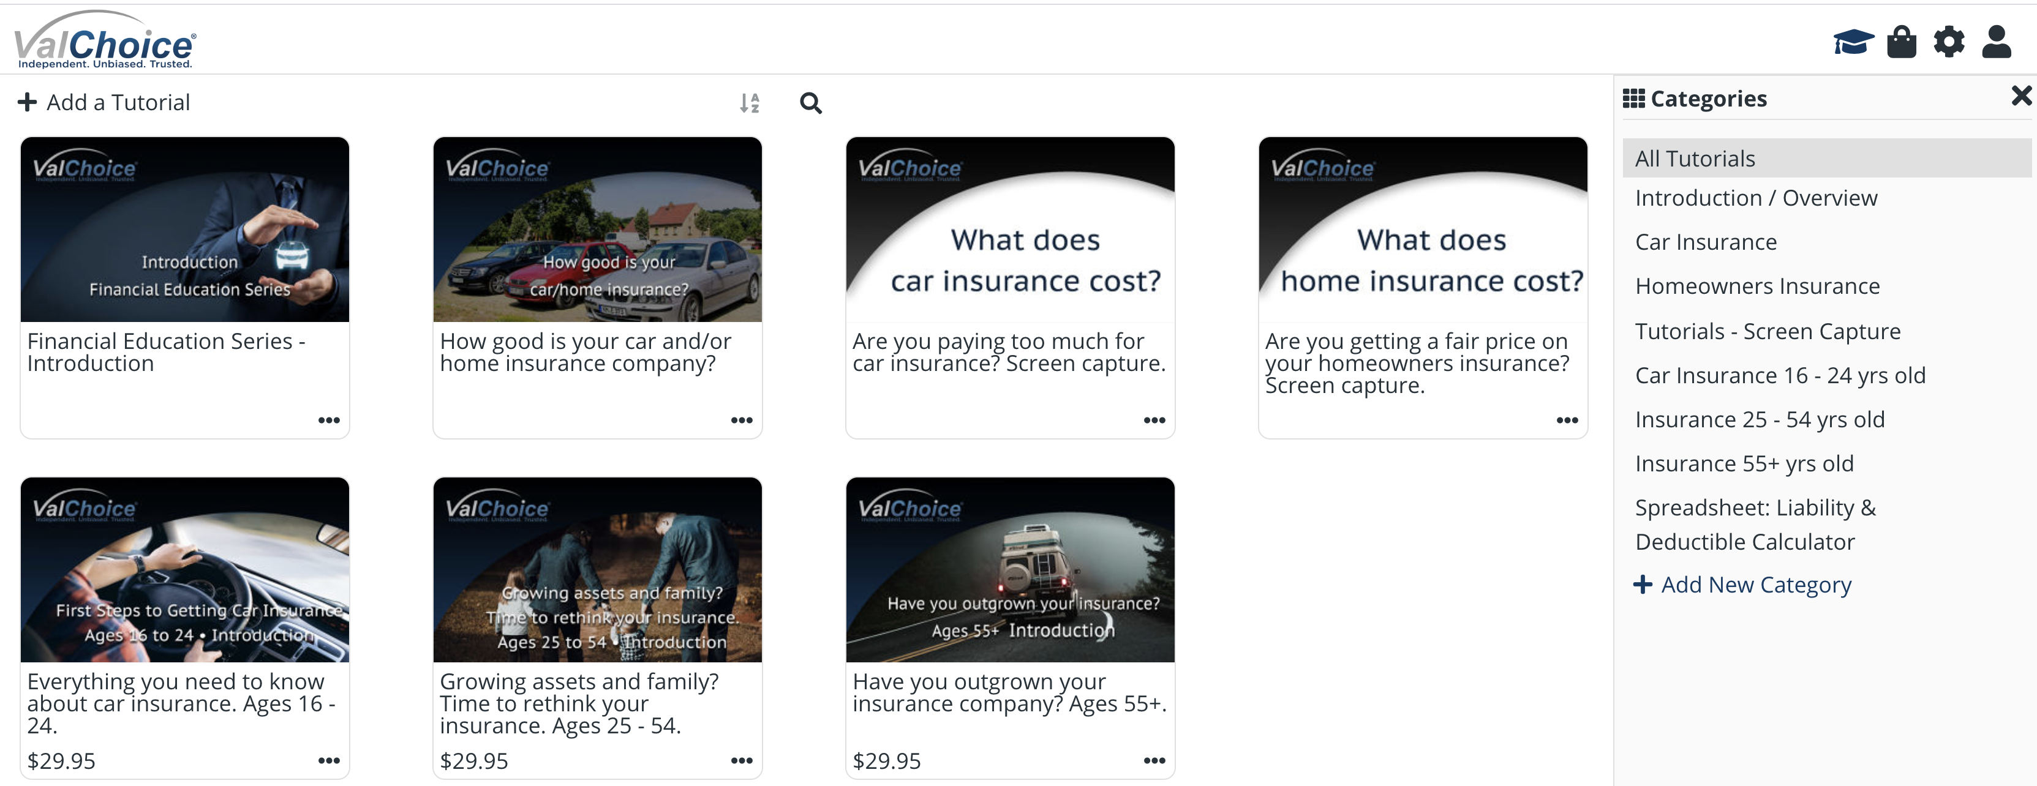
ACCESSING VIDEOS
https://my.nicheacademy.com/valchoiceacademy

Slide 29
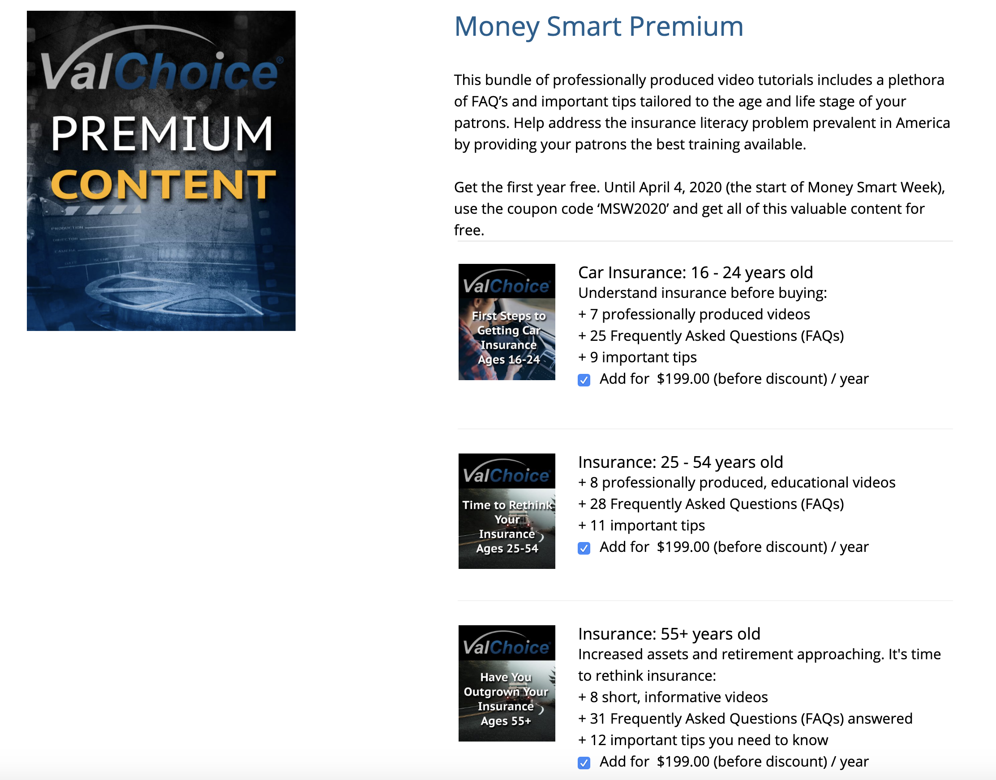
PREMIUM CONTENT
https://www.valchoice.com/product/money-smart-premium/
First year free with coupon MSW2020
Discount: three video series for the price of two

Slide 30
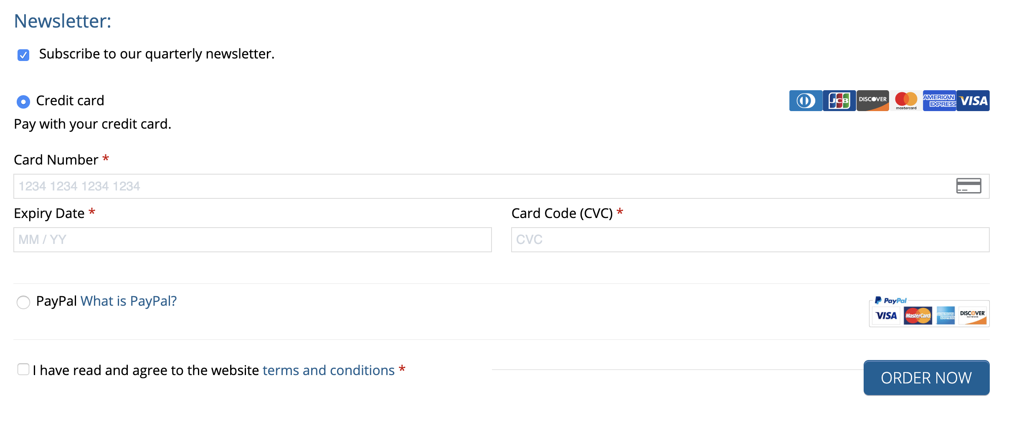
PREMIUM CONTENT
Enter CC#
No charge this year
Click “ORDER NOW”
Can cancel before one-year is up

Slide 31
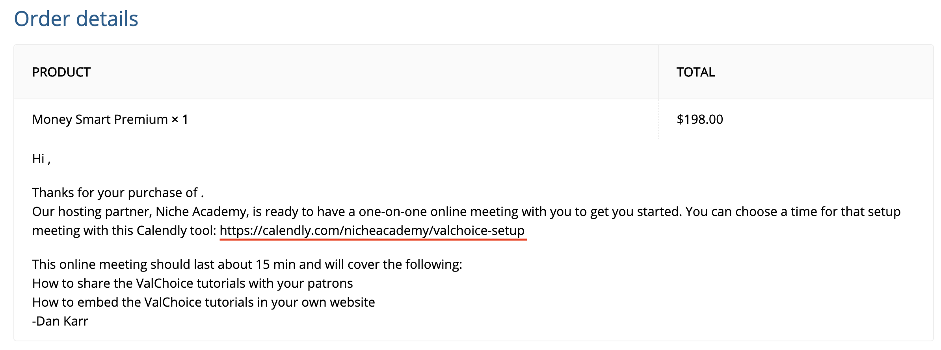
ACCESSING PREMIUM CONTENT

Slide 32
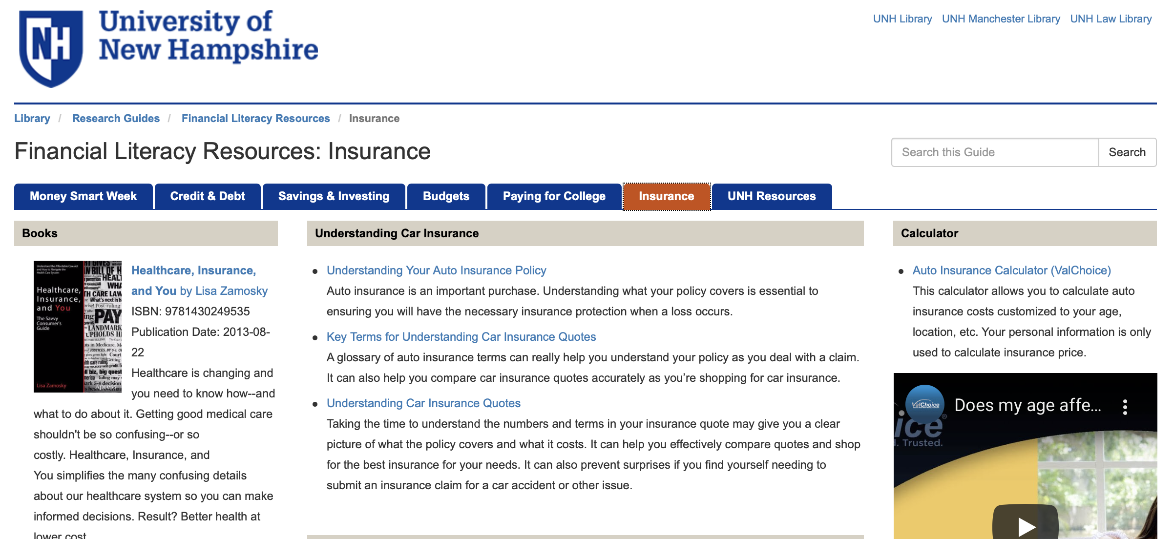
PLACING THE CONTENT

Slide 33
How To Contact Us
ValChoice
Bedford, NH
03110
info@valchoice.com
www.valchoice.com
Come see us at PLA, Nashville. Booth 550
About ValChoice
ValChoice® is the only company to provide consumers, agents and advisors with information on which home and auto insurance companies offer the best price, protection and service. The company’s advanced analytics platform collects and analyzes over 1.5 million financial and complaint data points and delivers the results in an easy-to-use service that Forbes Magazine describe as "Carfax for insurance." Using ValChoice, consumers are finally able to shop for insurance based on value rather than making decisions blindly based on price or advertising campaigns.

