Slide 1
Dismantling Institutional Racism in your Library:
From Theory to Practice
Tobin Miller Shearer

Slide 2
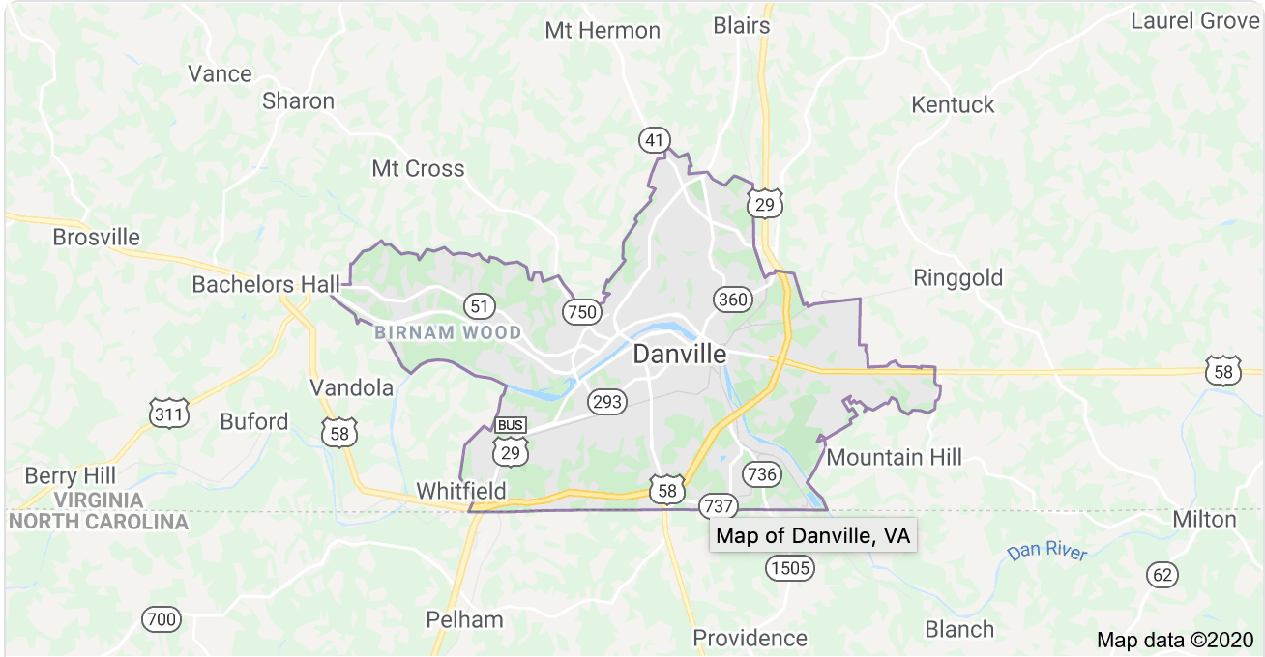

Slide 3
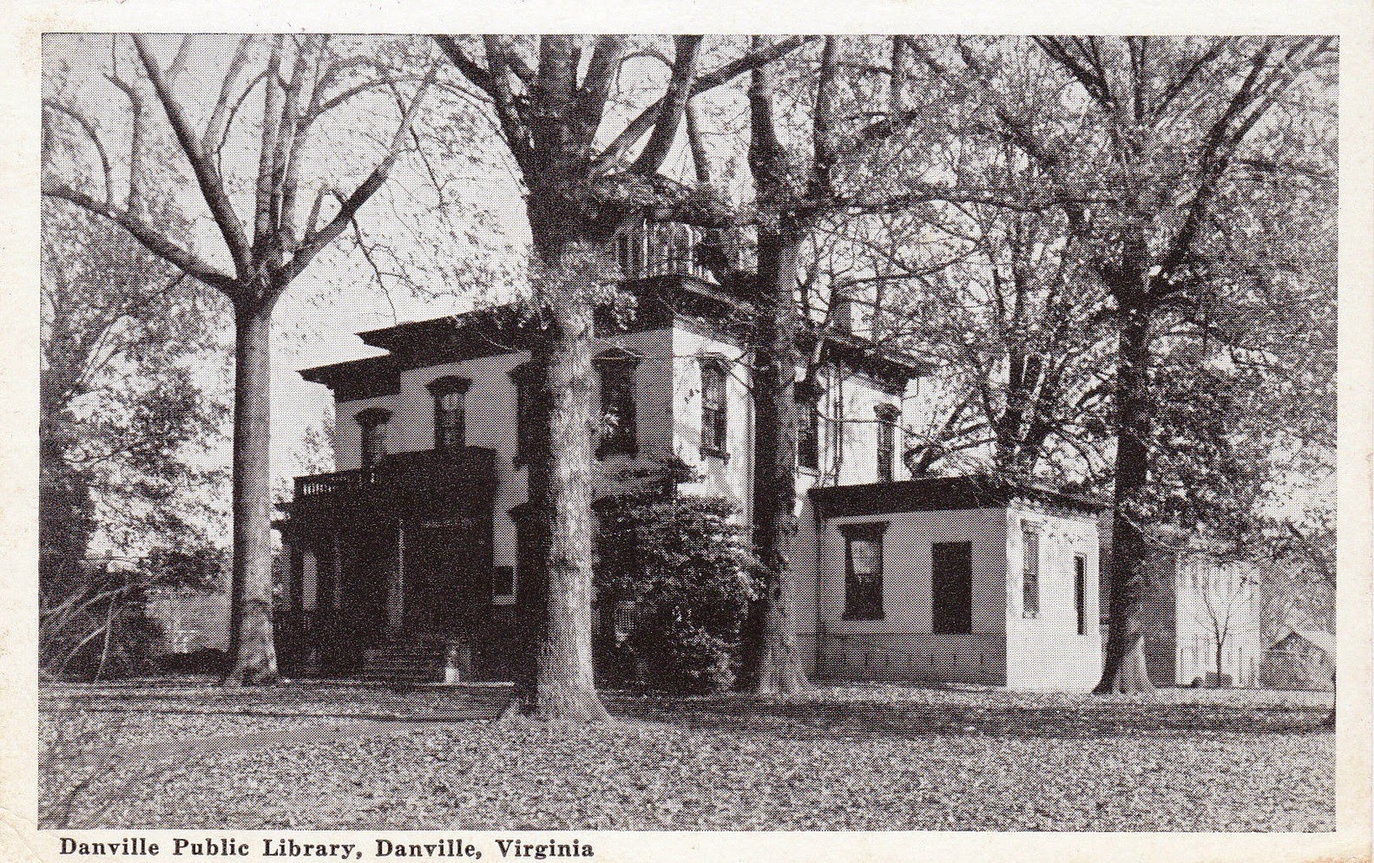

Slide 4
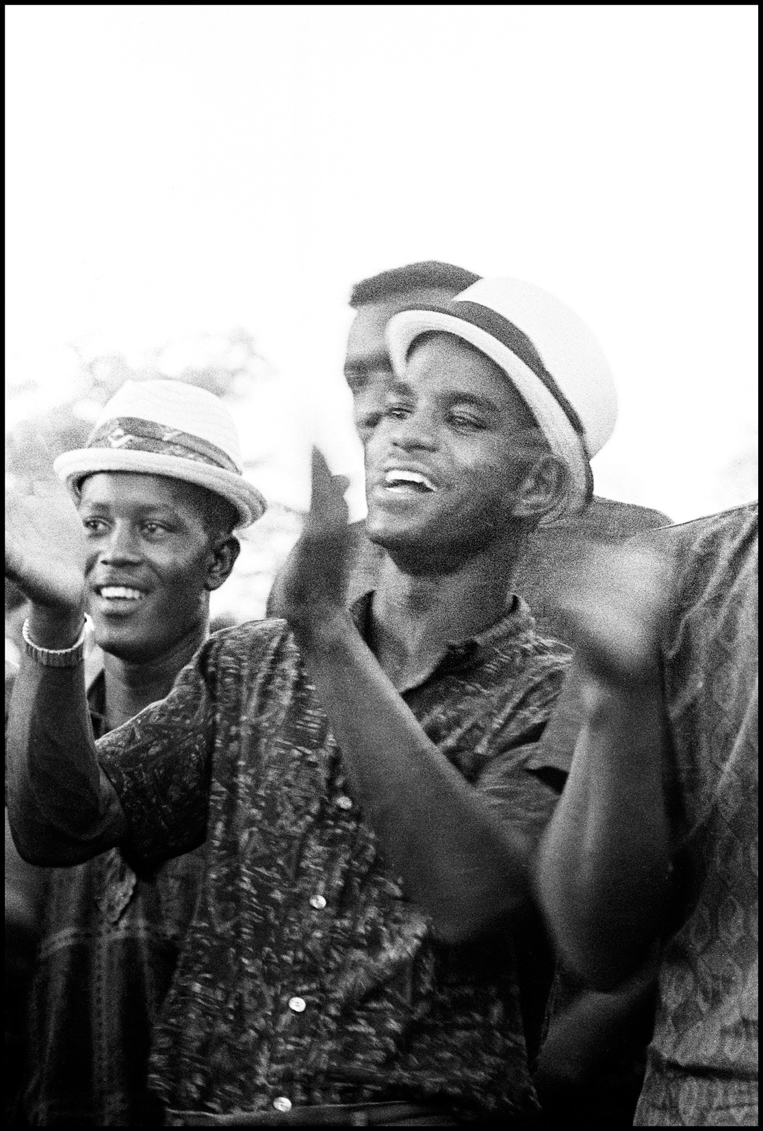

Slide 5
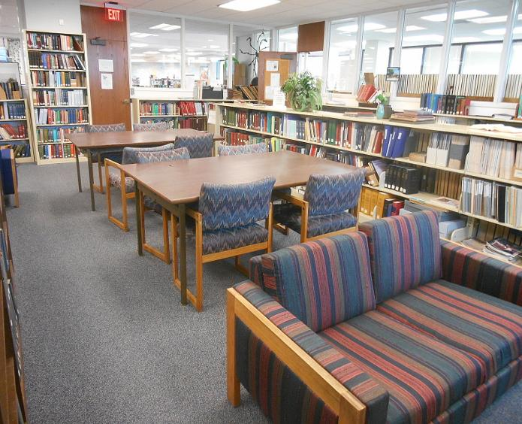

Slide 6
Can libraries dismantle institutional racism without demonstrations directed at them?

Slide 7
dismantle institutional racism effectively and efficiently
research-based and field-tested methods
prepare yourself ultimately to be a resource to help bring about change

Slide 8
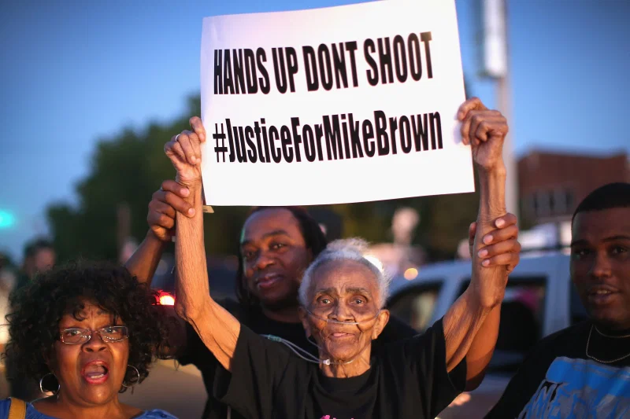

Slide 9
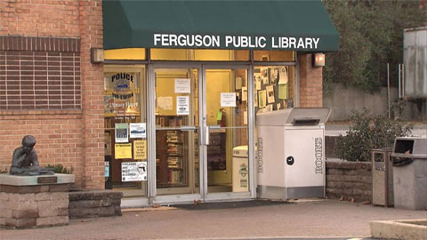

Slide 11


Slide 12
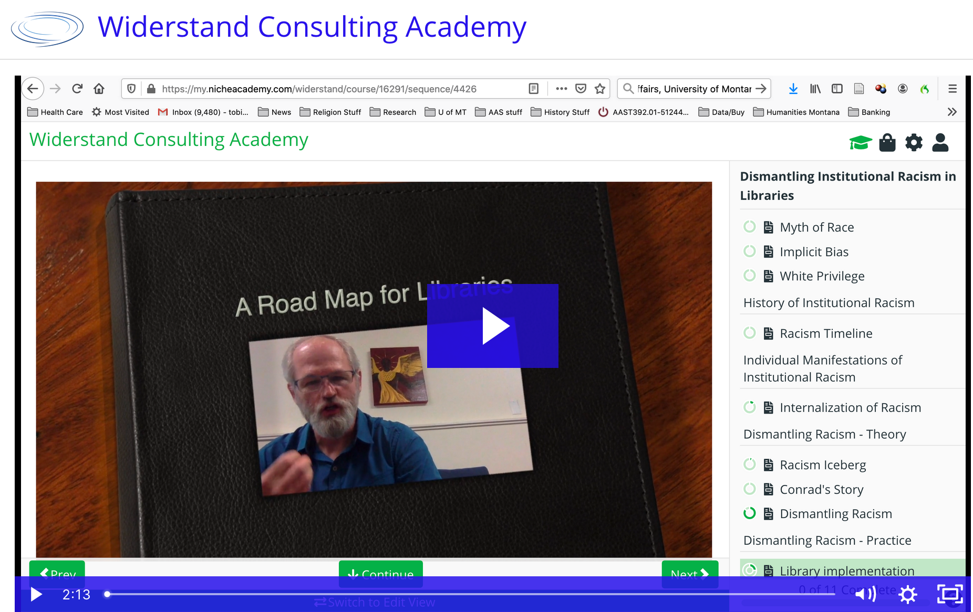

Slide 13
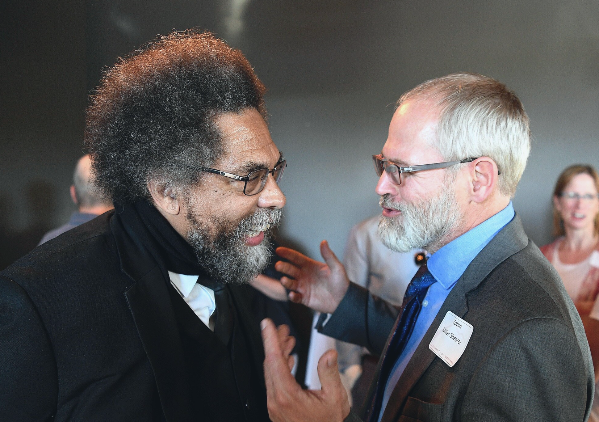

Slide 14
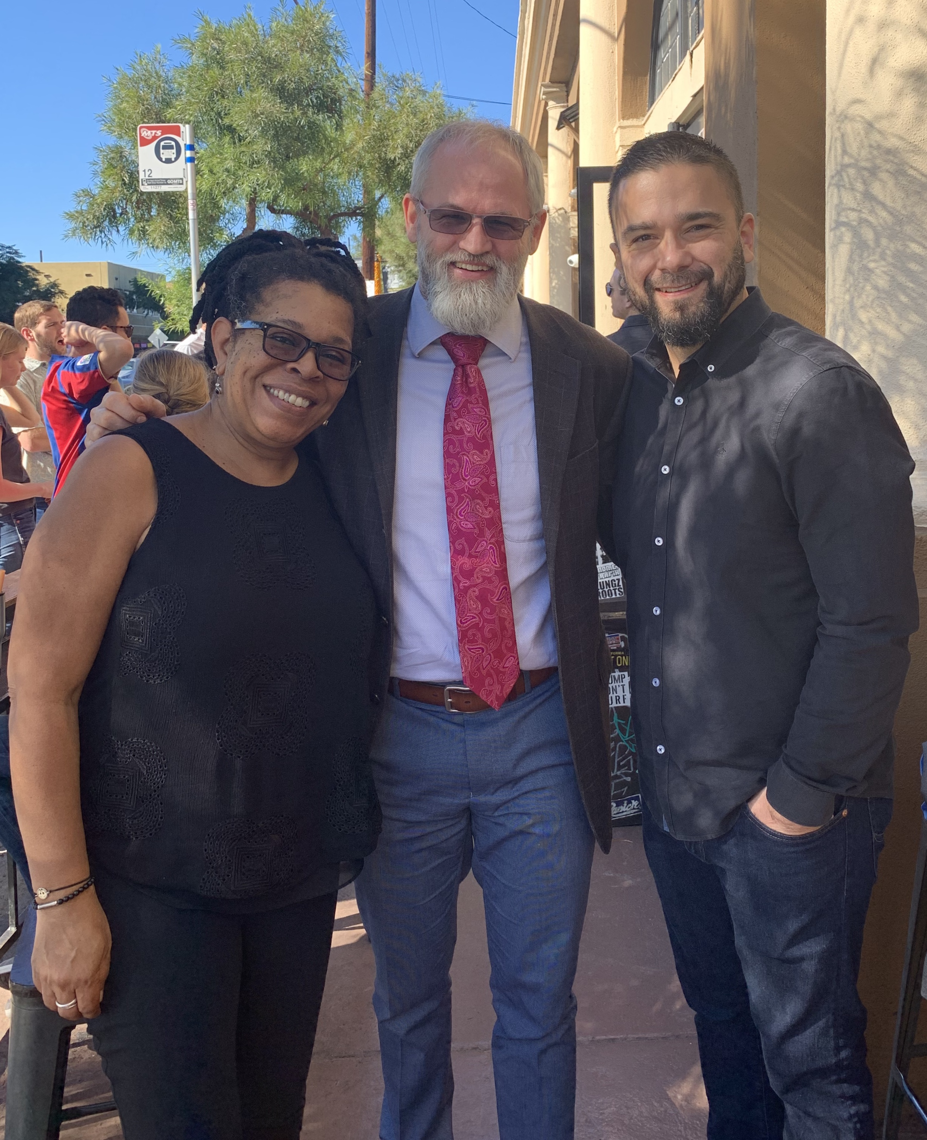

Slide 15

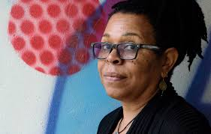

Slide 16


Slide 17

Public
Individual
Collective
Private

Slide 18
Public
Police
Abuse
Physical
Violence
Church Segregation
Educational Segregation
Lynching
Verbal
Attacks
Dis-enfranchisement
Housing Segregation
Public Facility Segregation
Murder
Paternalistic
Programs
Legislative Policy
Official
Statements
Sentencing
Disparity
Individual
Collective
Murder
Torture
Physical
Violence
Micro-aggressions
Jokes, slurs, comments
Policy Discrimination
Budget Mis-appropriation
Verbal
Attacks
Relational
Segregation
Hiring Discrimination
Murder
Kidnapping
Private

Slide 19
Public
Police
Abuse
Physical
Violence
Church Segregation
Educational Segregation
Lynching
Verbal
Attacks
Dis-enfranchisement
Housing Segregation
Public Facility Segregation
Murder
Paternalistic
Programs
Legislative Policy
Official
Statements
Sentencing
Disparity
Individual
Collective
Murder
Torture
Physical
Violence
Micro-aggressions
Jokes, slurs, comments
Policy Discrimination
Budget Mis-appropriation
Verbal
Attacks
Relational
Segregation
Hiring Discrimination
Murder
Kidnapping
Private

Slide 20
Public
Police
Abuse
Physical
Violence
Church Segregation
Educational Segregation
Lynching
Verbal
Attacks
Dis-enfranchisement
Housing Segregation
Public Facility Segregation
Murder
Paternalistic
Programs
Legislative Policy
Official
Statements
Sentencing
Disparity
Individual
Collective
Murder
Torture
Physical
Violence
Micro-aggressions
Jokes, slurs, comments
Policy Discrimination
Budget Mis-appropriation
Verbal
Attacks
Relational
Segregation
Hiring Discrimination
Murder
Kidnapping
Private

Slide 21
Public
Public
Witness
Personal Accompaniment
Confrontational
Acts
Official
Declarations
Economic
Actions
Development
Work ($)
Political
Action
Corporate
Engagement
Social
Services
Individual
Collective
Educational
Initiatives
Ritual
Acts
Covert
Actions
Institutional
Transformation
Relational
Acts
Research
Personal
Preparation
Private

Slide 22
Public
Public
Police
Abuse
Public
Witness
Public
Witness
Physical
Violence
Church Segregation
Educational Segregation
Personal Accompaniment
Personal Accompaniment
Confrontational
Acts
Confrontational
Acts
Lynching
Official
Declarations
Official
Declarations
Economic
Actions
Economic
Actions
Verbal
Attacks
Dis-enfranchisement
Housing Segregation
Public Facility Segregation
Development
Work ($)
Development
Work ($)
Murder
Paternalistic
Programs
Legislative Policy
Official
Statements
Sentencing
Disparity
Social
Services
Political
Action
Social
Services
Political
Action
Corporate
Engagement
Corporate
Engagement
Collective
Individual
Collective
Individual
Murder
Educational
Initiatives
Educational
Initiatives
Torture
Ritual
Acts
Physical
Violence
Micro-aggressions
Ritual
Acts
Jokes, slurs, comments
Policy Discrimination
Budget Mis-appropriation
Covert
Actions
Covert
Actions
Institutional
Transformation
Relational
Segregation
Institutional
Transformation
Verbal
Attacks
Relational
Acts
Relational
Acts
Research
Hiring Discrimination
Research
Murder
Kidnapping
Personal
Preparation
Personal
Preparation
Private
Private

Slide 23
Public
Public
Police
Abuse
Public
Witness
Public
Witness
Physical
Violence
Church Segregation
Educational Segregation
Personal Accompaniment
Personal Accompaniment
Confrontational
Acts
Confrontational
Acts
Lynching
Official
Declarations
Official
Declarations
Economic
Actions
Economic
Actions
Verbal
Attacks
Dis-enfranchisement
Housing Segregation
Public Facility Segregation
Development
Work ($)
Development
Work ($)
Murder
Paternalistic
Programs
Legislative Policy
Official
Statements
Sentencing
Disparity
Social
Services
Political
Action
Social
Services
Political
Action
Corporate
Engagement
Corporate
Engagement
Collective
Individual
Collective
Individual
Murder
Educational
Initiatives
Educational
Initiatives
Torture
Ritual
Acts
Physical
Violence
Micro-aggressions
Ritual
Acts
Jokes, slurs, comments
Policy Discrimination
Budget Mis-appropriation
Covert
Actions
Covert
Actions
Institutional
Transformation
Relational
Segregation
Institutional
Transformation
Verbal
Attacks
Relational
Acts
Relational
Acts
Research
Hiring Discrimination
Research
Murder
Kidnapping
Personal
Preparation
Personal
Preparation
Private
Private

Slide 24
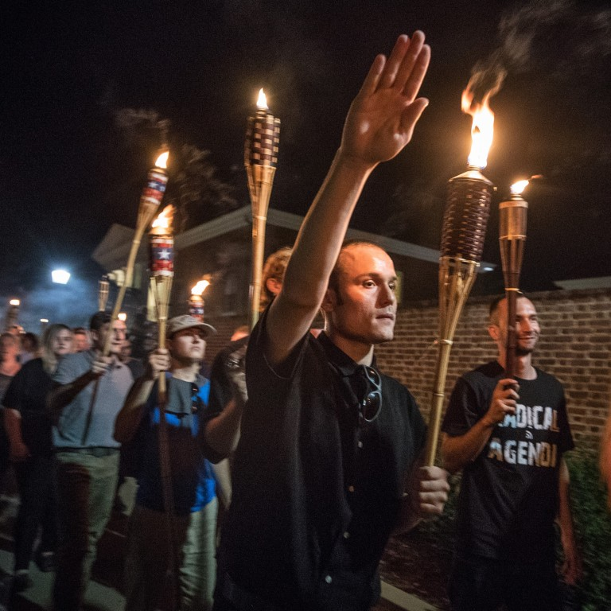

Slide 25
Dismantling Racism

Slide 26
For our Seven Principles For Starting to Dismantle Institutional Racism In Libraries and First Three Steps Handout, point your browser to:
www.widerstandconsulting.org/free-resources

Slide 27
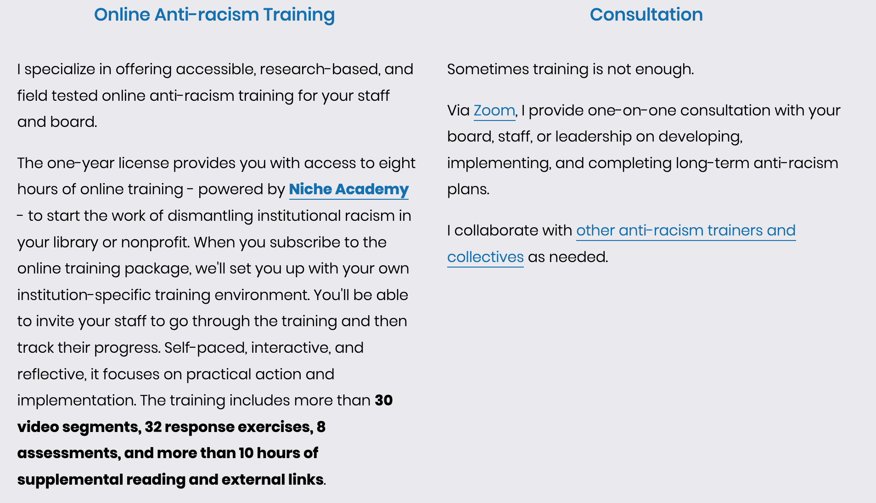
$100 off Discount code
Good through 7/17/2020:
LIBRARY2020
www.widerstandconsulting.org.

