Slide 1

Adding Value to Libraries, Archives and Museums
Joseph Matthews
Notes:
Today we are going to explore ways in which cultural institutions such as libraries, archives, museums and galleries have added value in the life of their customers. As we go along I hope that you will share any comments or questions that you might have so that you will have found our time together an experience in which you have gained value.

Slide 2
Every successful organization has found a way to create value for its customers that competitors have not been able to achieve.
Value is (or should be) at the core of organizational purpose.
The notion of creating or adding value has been called a “value proposition.”
Notes:
We are going to spend the next hour discussing value and the importance of value for any organization but especially for our cultural institutions. Every time someone considers whether to visit (physically or virtually) your library, museum, gallery or archive they make a judgment about the value tradeoff – will I gain more value from the visit than the “costs” of time, effort, transportation, and so forth involved in making that visit. Unfortunately value is something we do not learn about in library school but it is implicit in everything that you do in your professional career. We each should be asking ourselves everyday, “how can I add more value in the life of each and every customer that visits my organization?”

Slide 3
What is a Value Proposition?
A promise of value delivered to a customer
Explains how a service solves customer’s problems
Delivers specific benefits
Explains why the customer would use the library and note the competition (differentiation)
Notes:
What is a Value Proposition?
Chat

Slide 4
Adding Value
Ranganathan’s Five Laws
Robert Taylor – Value-Added Processes in Information Systems
TEDS Framework – Taylor, Eisenberg, Dirks & Scholl
Tefko Saracevic & Paul Kantor – Taxonomy of value
Others – Joanne Marshall, Jose-Marie Griffiths, Don King, Alison Keyes, Carol Tenopir, Megan Oakleaf
Notes:
How Cultural Institutions historically added value? If you think about it for a moment, Ranganathan’s Five Laws are all about value. Robert Taylor, long-time Dean at Syracuse University wrote a wonderful book about value. And several folks at the University of Washington have extended Taylor’s Adding Value Framework with their TEDS Framework. Tefko and Paul at Rutgers University had several projects in which they developed a Value Taxonomy. And others have also contributed to the value discussion.

Slide 5
Who Creates Value?
The library does not create value, but rather the customer creates value through the use of collections and services.

Slide 6
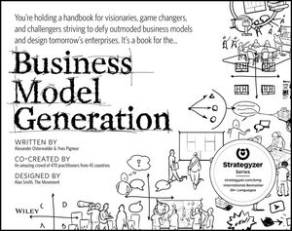
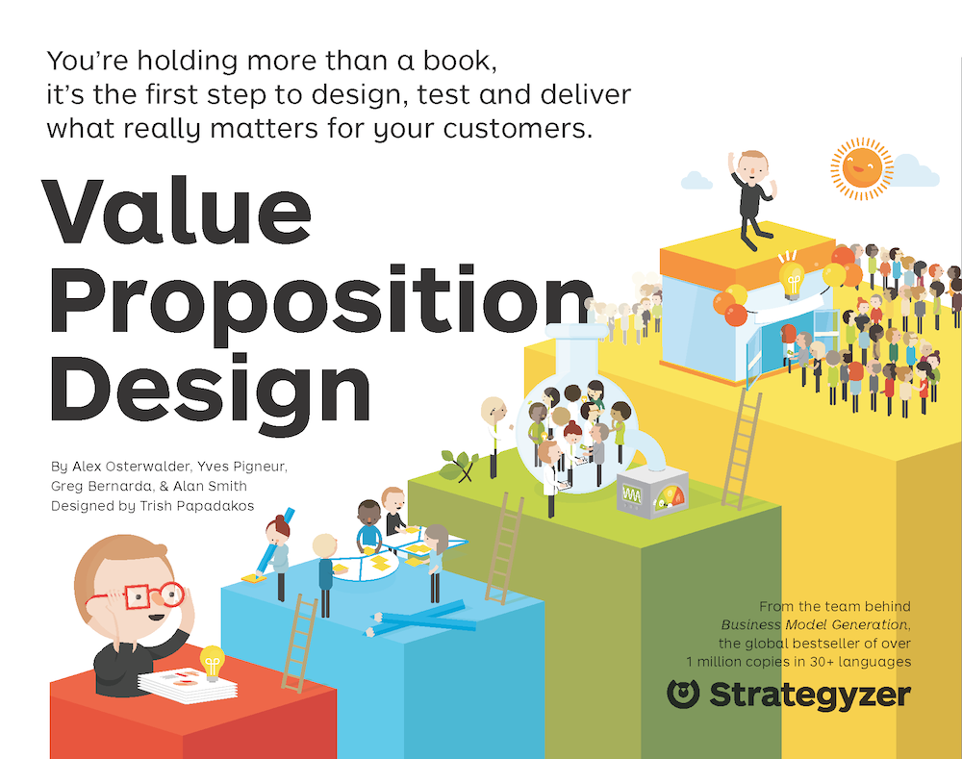
Notes:
The two books most responsible for helping people clearly understand the concept of value, adding value and the value proposition are
Business Model Generation
And Value Proposition Design
While I won’t be discussing these two books in much detail, they really should be read by everyone interested in the topic of adding value.

Slide 7
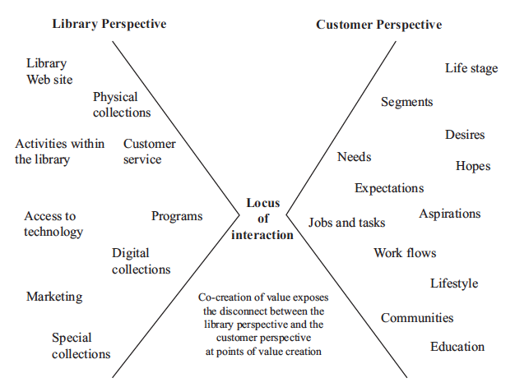
Notes:
As mentioned before, the value is co-created in someone’s life when the products, services and collections intersect with one individual who has very specific needs.
The library has organized its physical spaces to provide access to services, space and its collections – hopefully in ways that make sense to the people who are in the building. A library’s Web site is also hopefully organized so the individual can find the resource they need to help fill a specific need.
The customer comes to the library with a set of experiences, expectations, and needs.
Historically libraries have tried to understand their customer by segmenting their customers based on demographic and education criteria in the case of public libraries and by educational attainment in an academic setting – undergraduates, grad students, faculty and so forth.
More recently there has been an increasing emphasis on trying to understand the Jobs-to-be-done when they come to the library (physically or virtually). One possible strategy would be to organize library services, spaces and collections around the concept of minimizing the challenges in attempting to complete a Job-to-be-done.

Slide 8
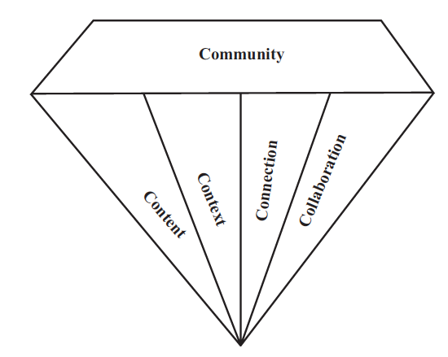
The Adding Value Diamond
Notes:
The 5 Cs

Slide 9
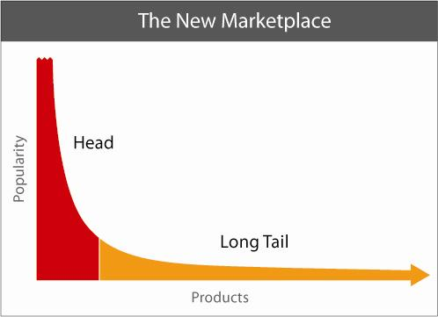
Content
Notes:
Chris Anderson, Wired editor
The Head – the bigger publishers
And going down the curve – small press publishers, university press, self-published eBooks
Blogs, Web sites
Somewhere in the long tail are library Websites that provide access to library digitized content

Slide 10
Content - Digitization
Library of Congress American Memory Project
Project Gutenberg
British Library
National Library of Australia Trove
Internet Archive
International Dunhuang Project
Google Books
Notes:
Lot’s of digitized content
Google Books – over 30 million so far

Slide 11
Content - Digitization
French National of Library Gallica
HathiTrust
Other National Libraries
Lots of university & public libraries
Museums, archives & galleries
What about your library, museum, archive or gallery?
Notes:
And still more content
What about your library, museum, archive or gallery? Have you digitized your local history and/or special collections?

Slide 12
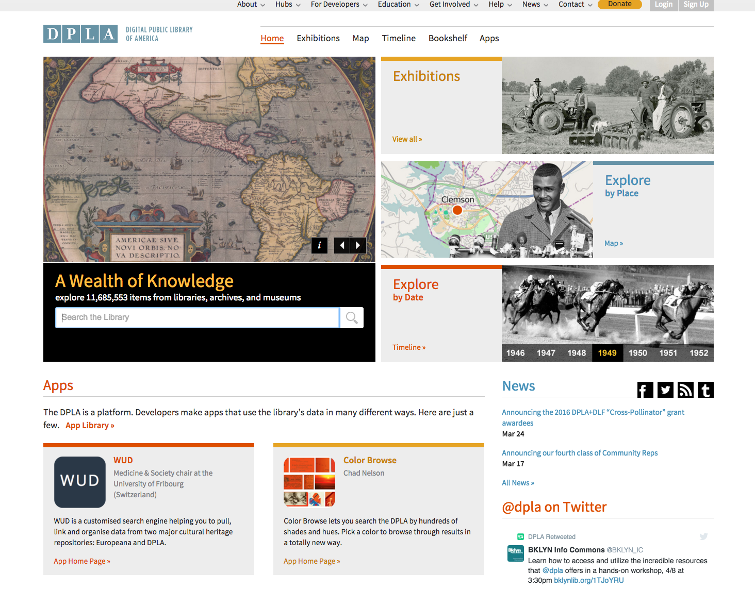
Notes:
Digital Public Library of America
Most of the content is maintained by the “owning institution” and DPLA simply provides links to all this content. Over 30 million items
About 50 hubs for the importing of data about collections
Implication: user is expected to navigate lots of different user interfaces as they move from one site to the next

Slide 13
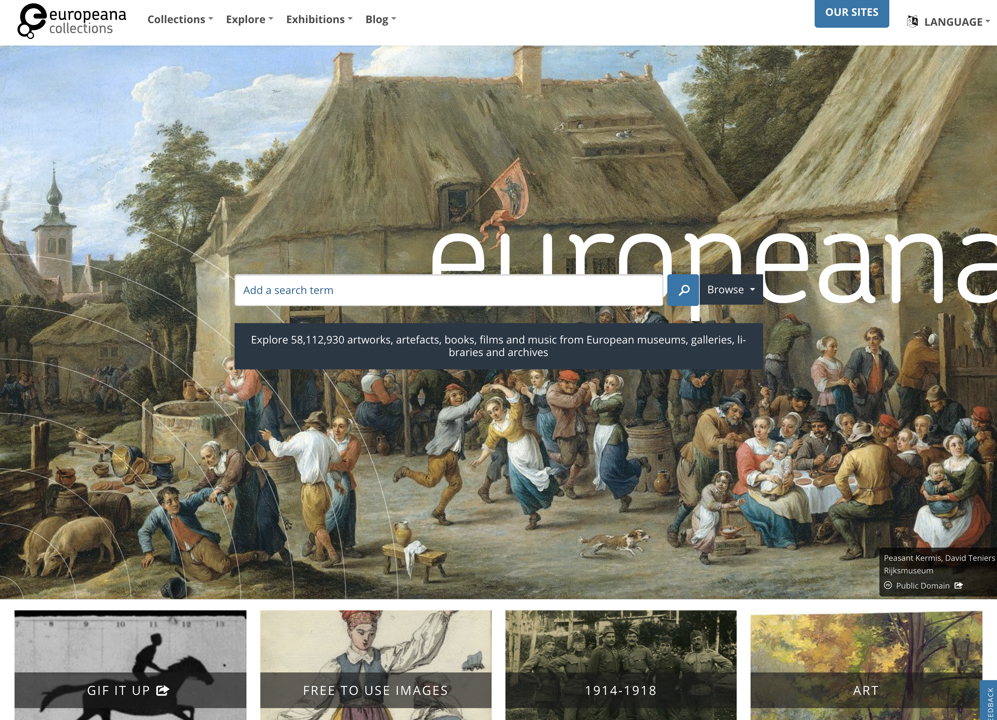
Notes:
Europeana is the European equivalent of DPLA although they have much more content
Notice the content exceeds 58 million items!!

Slide 14




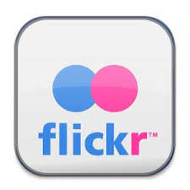

User-Contributed Content
Notes:
Lot’s of user generated content as these examples illustrate
Over 100 million bloggers

Slide 15
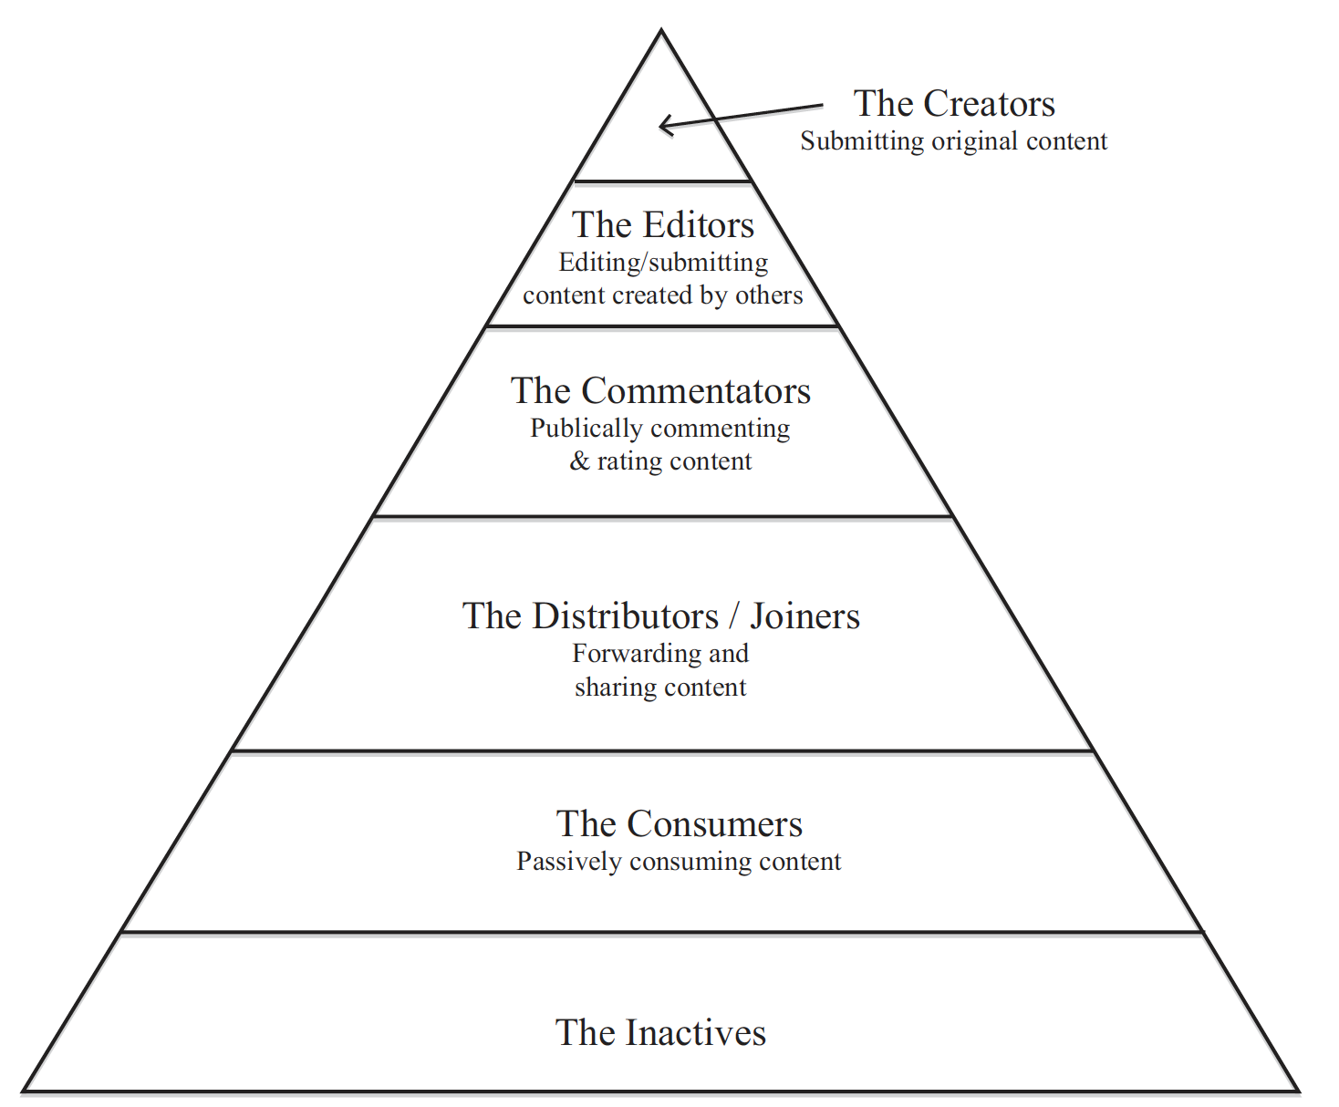
User-Contributed Content
Notes:
Less than 1/4th of people are Creators
1/3rd are Commentators/Critics
Half are Joiners
And about 3/4ths are Consumers
Younger people are more active than their older counterparts

Slide 16
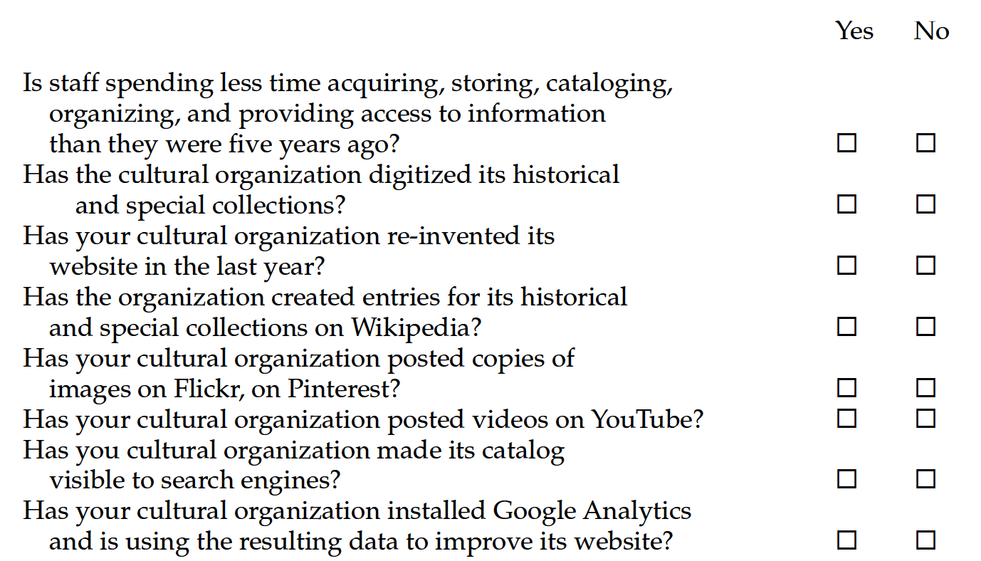
Tips for Adding Value to Content
Notes:
So how is your organizations doing?

Slide 17
Content is something we connect to emotionally, converse about or learn from . . .
But content without context is useless.
Daniel Eizans

Slide 18
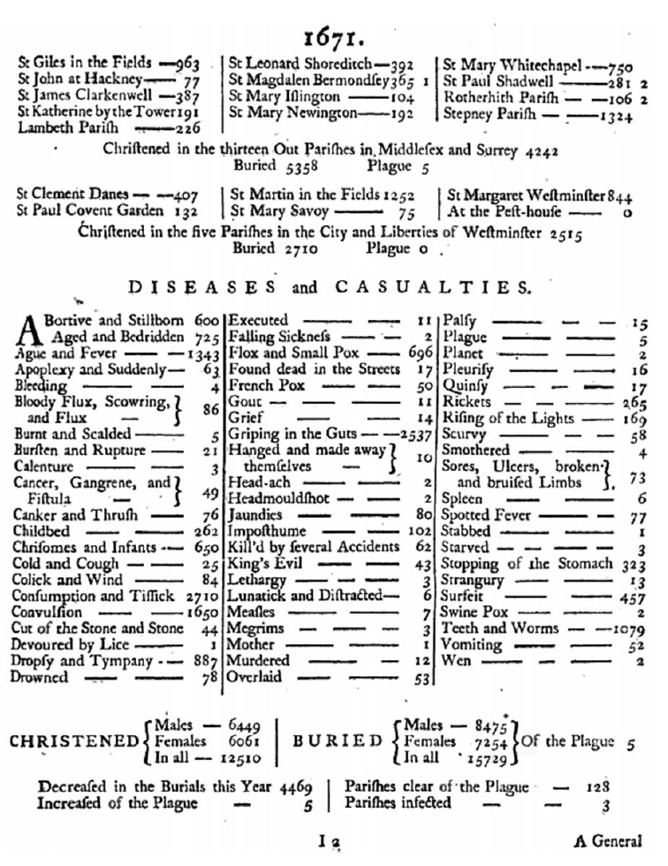
A Bill of Mortality
Notes:
During he middle ages, lots of different plagues and other diseases
In England during the 1600’s the government published leaflets called Bills of Mortality each month for various cities and towns

Slide 19
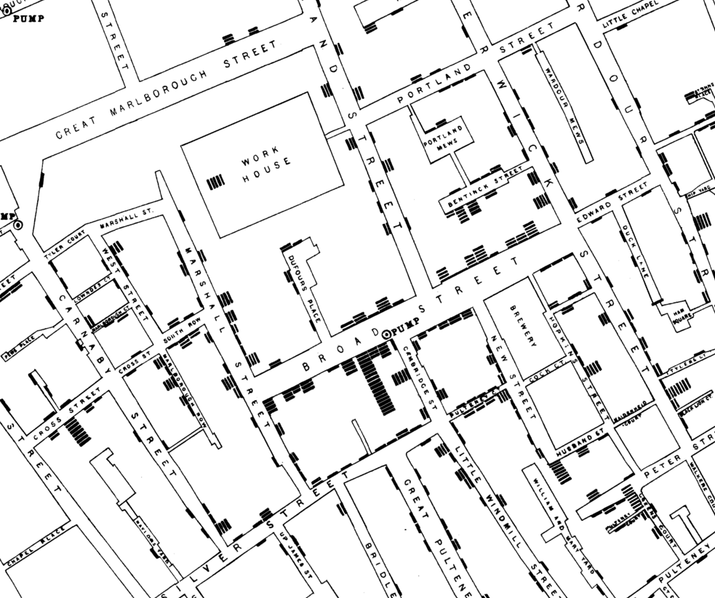
Context
Notes:
John Snow – mapped the data contained in the Bills of Mortality for London and positied that the water pump circled above might be the cause of the spread of cholera.
In short, Snow provided context

Slide 20
Ways to Add Context
Location
Category
Alphabetical
Hierarchy
Icons
Time
Links
Notes:
After reviewing the literature I discovered there are a number of ways to add context – review the icons
Alphabetical – library catalog –
My favorite definition of a catalog - “a place where bibliographic entries get lost alphabetically”

Slide 21
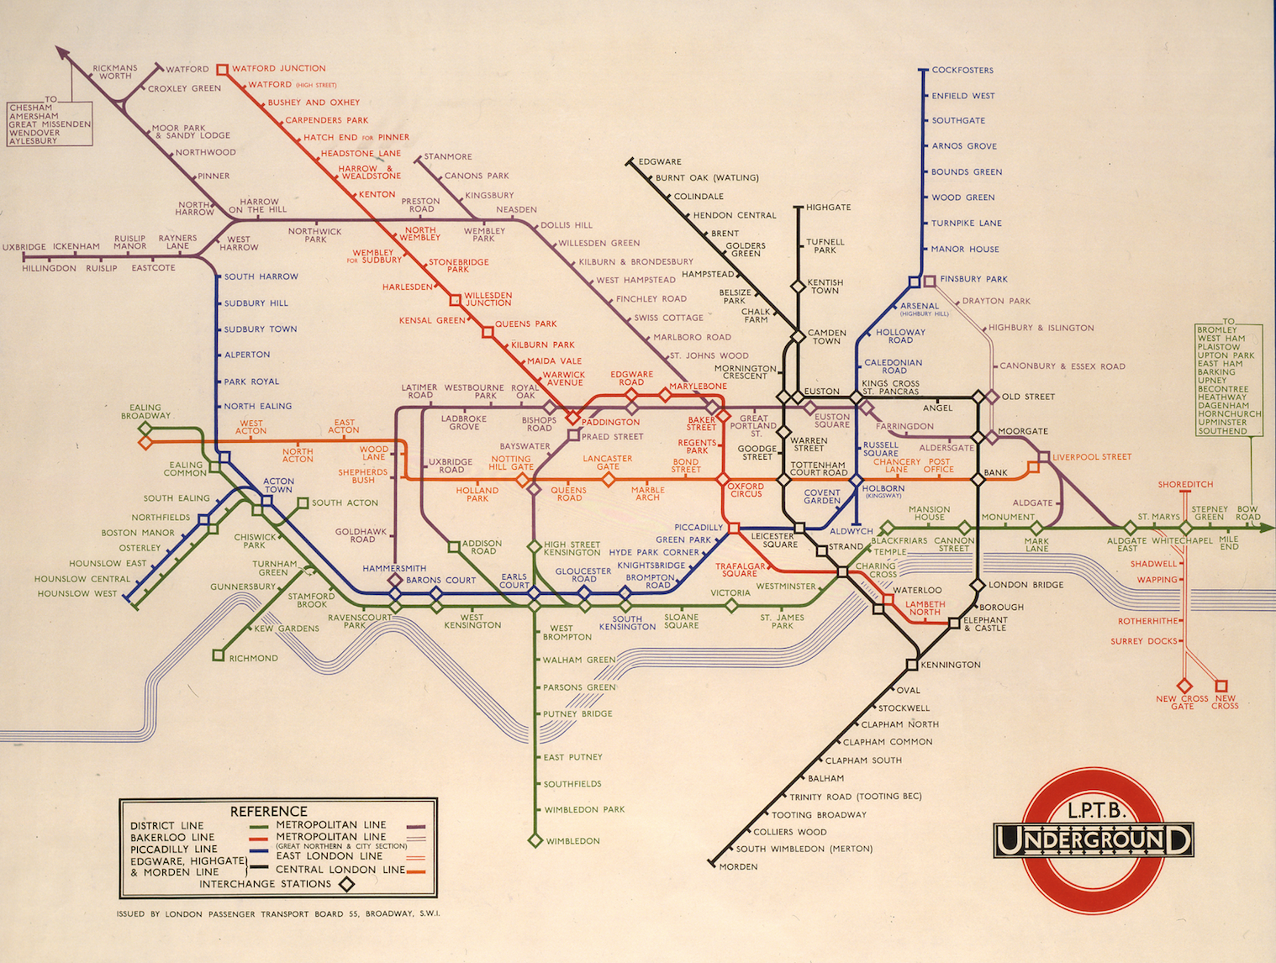
Notes:
Henry C. Beck – great example of using location 1931 London underground
Location is all about navigation, orientation, discovery, and understanding

Slide 22
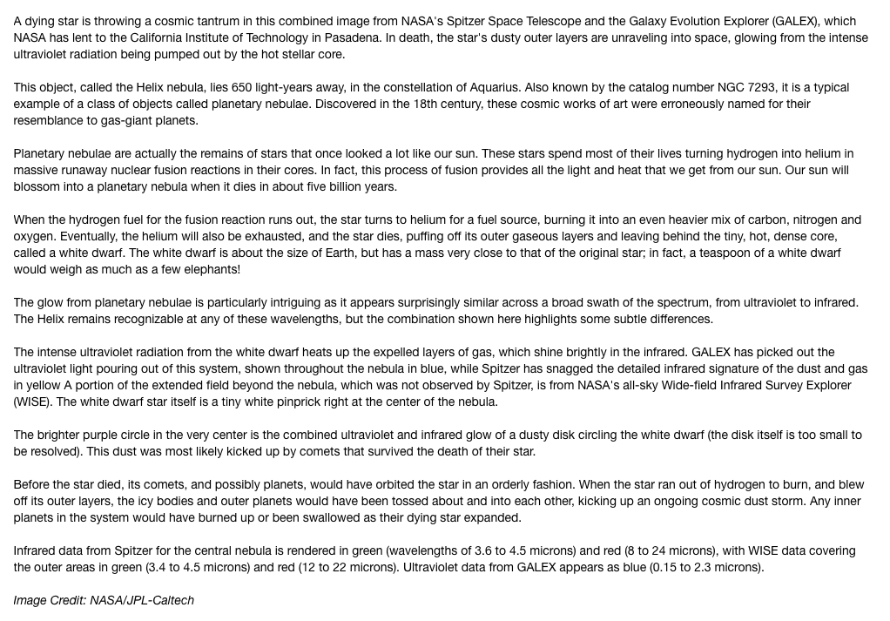

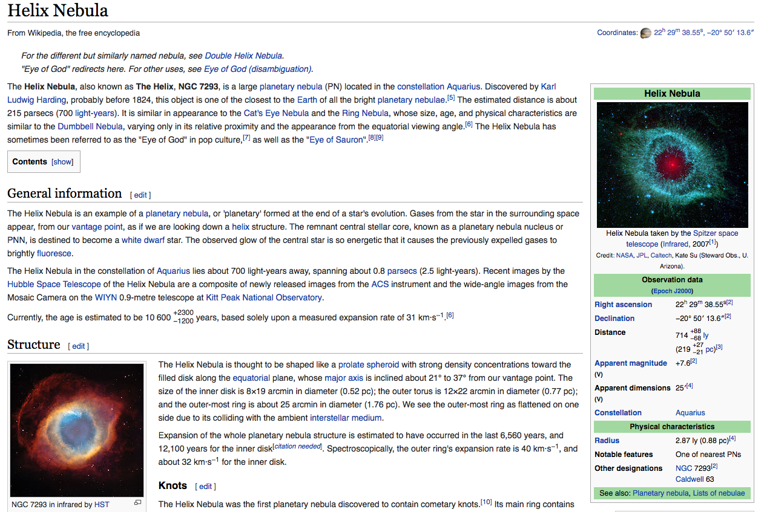
Notes:
Another important way to provide context is to provide navigation links to related content
JPL versus Wikipedia
Links – Eugene Garfield – Science Citation Index
Google - PageRank

Slide 23
Context
Semantic Web
Random
Reviews
Tags
Curation
Annotation
Notes:
Random – David Weinberger Everything is Miscellaneous
Tags – folksonomies vs taxonomies The Bibliotheek Harlem Osst in the Netherlands – book returns
BIBFRAME – Libraries developing Knowledge Graphs
Popular form of curation are the blogs that people write – curation is about providing filtering, validation, synthesis, customization and presentation

Slide 24
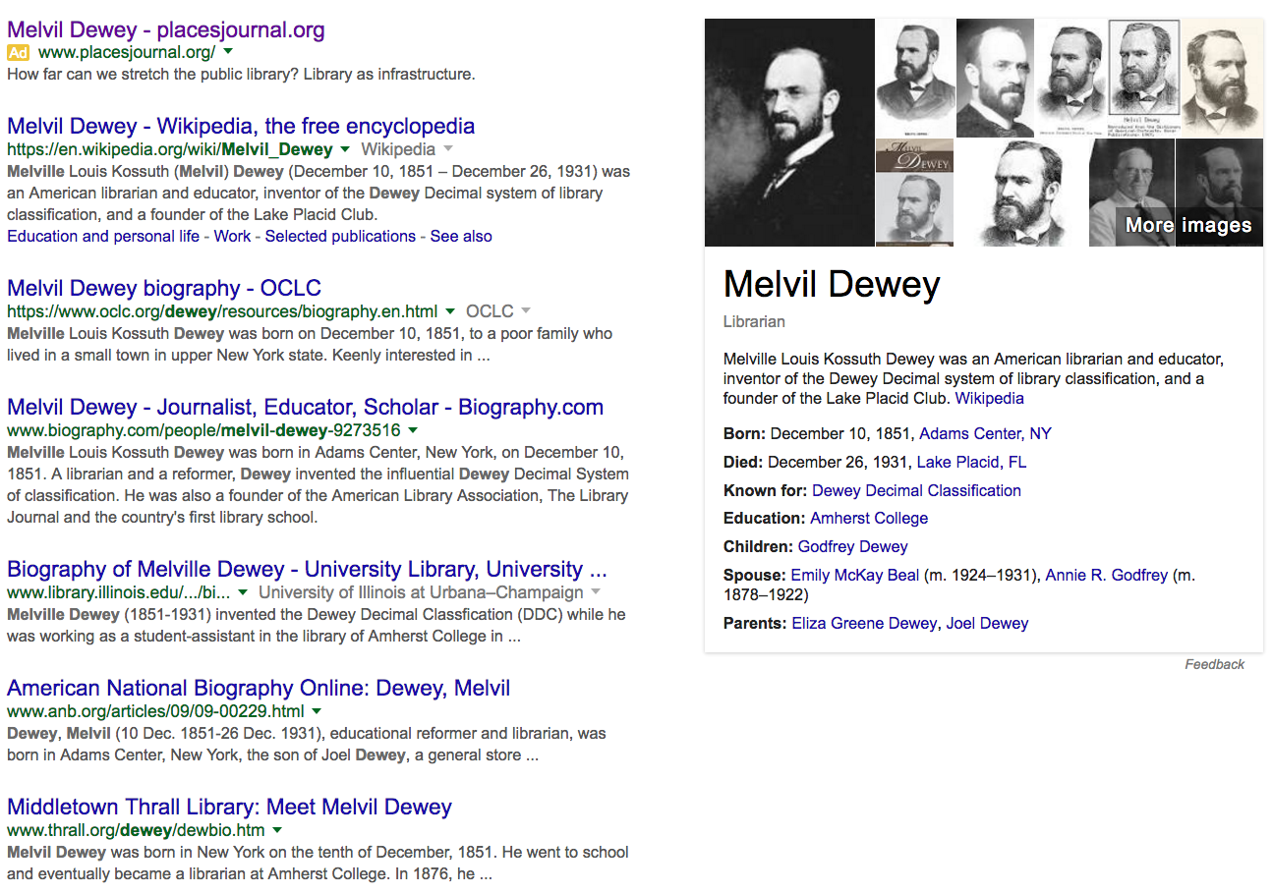
Google’s Knowledge Graph
Notes:
This is an example of using the links embedded in the Semantic Web

Slide 25
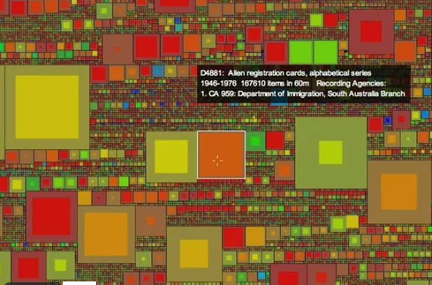
Displaying Content
Michael Whitelaw – Generous Interface
Notes:
Michael Whielaw down in Australia has developed a “generous interface” – here are the contents of the National Archives of Australa – each square represents a different collection
Mouse over provides some information as do the size and colors of the squares

Slide 26
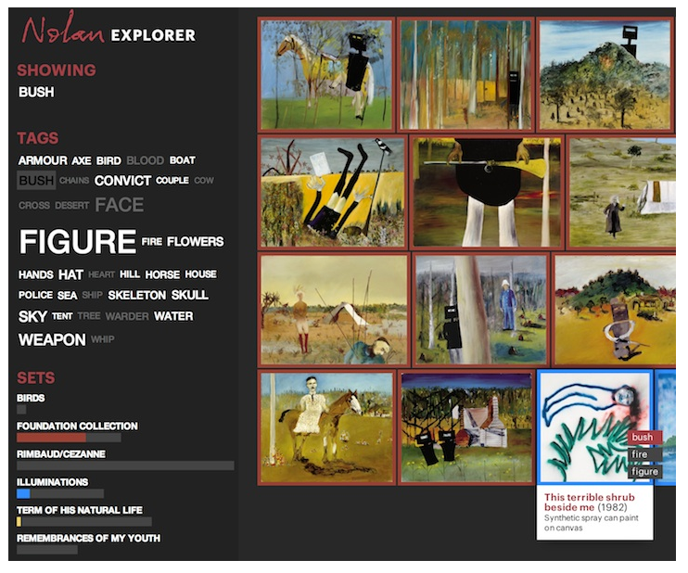
Displaying Content
Nolan Art Gallery - Canberra
Notes:
Whilelaw’s interface for the Nolan Art Gallery – Canberra, Australia

Slide 27
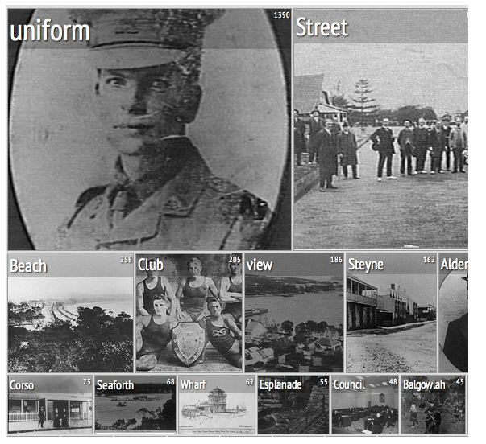
Displaying Content
Manly Images – Suburb of Melbourne
Notes:
Another example

Slide 28
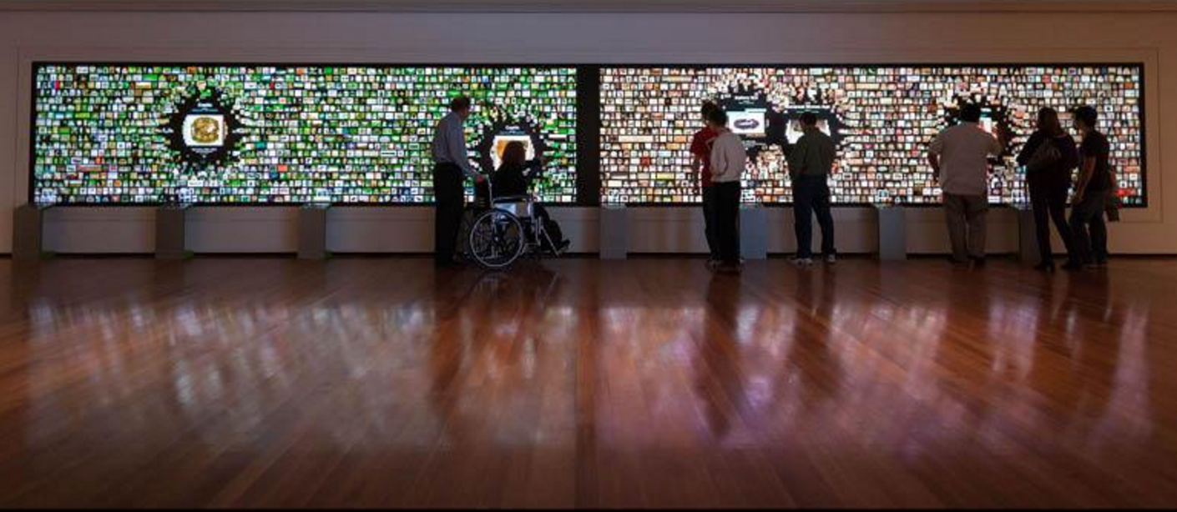
Displaying Content
Cleveland Museum of Art
Notes:
Cleveland Museum of Art – The Collection Wall An image for every item in the collection, explore, organize a custom visit to the galleries, download content to your iPad

Slide 29
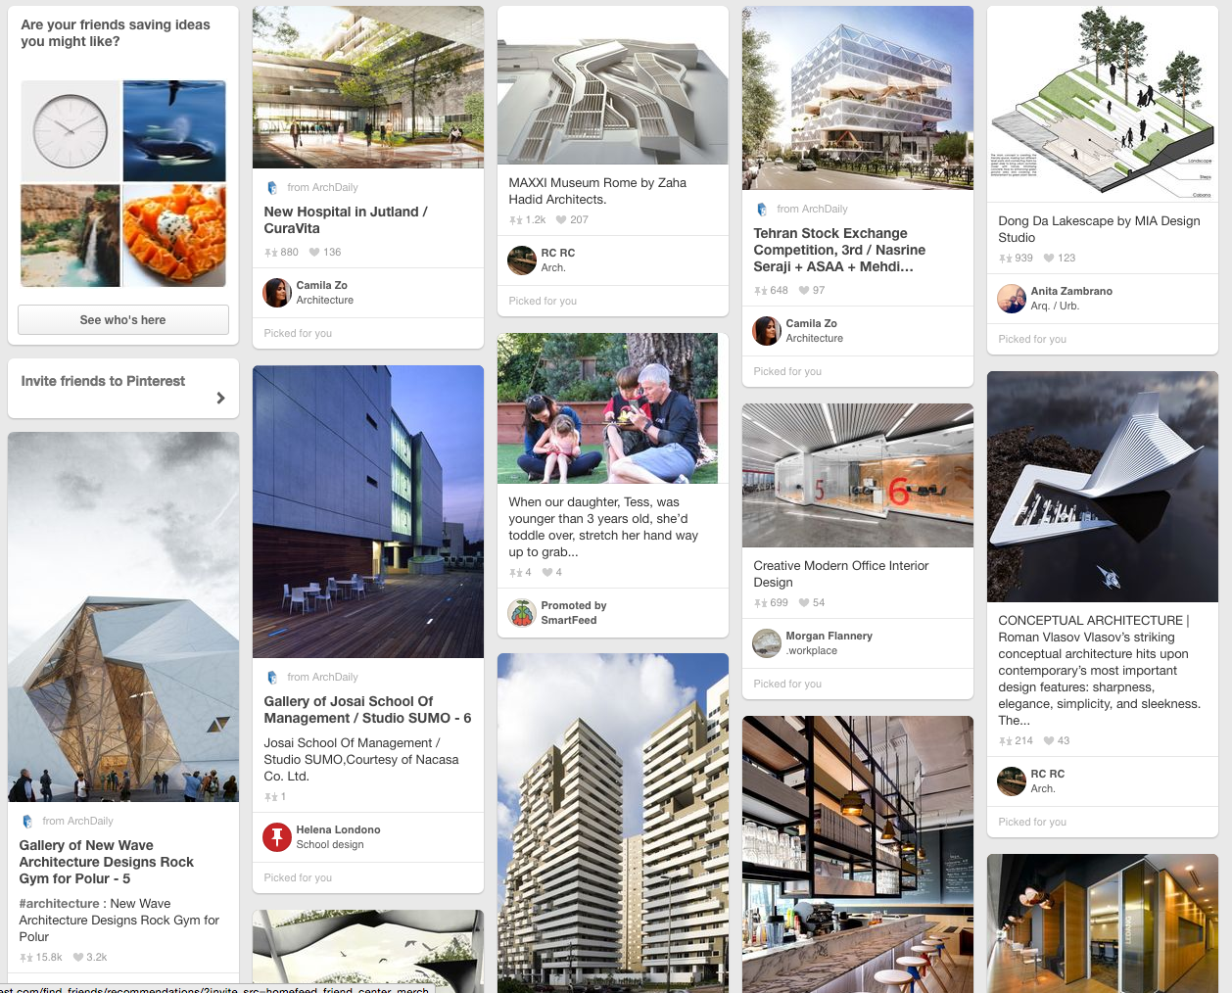
Displaying Content
Pinterest
Notes:
Pinterest – 100 million users, over 750 million boards, over 30 billion individual pins

Slide 30
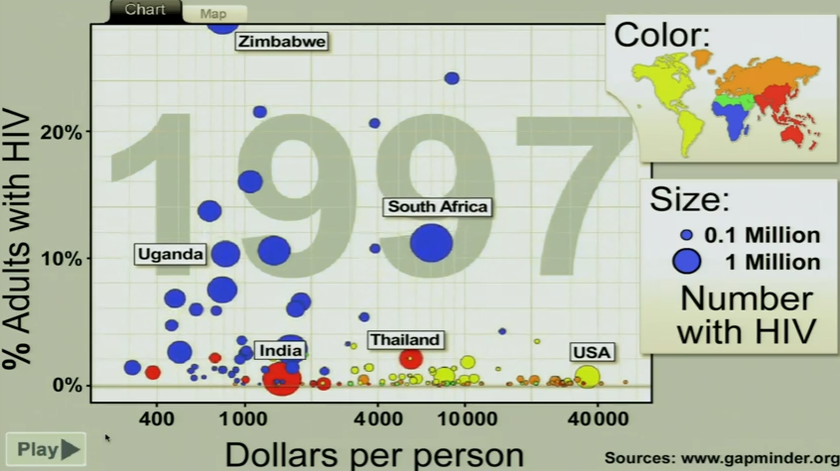
Displaying Content
Hans Rosling Trendalyzer TED Talks
Notes:
Trendalyzer – creates visualizations that move representing data sets over time
Effective use of color and size – data set - # infected, cost and time – 10 years

Slide 31
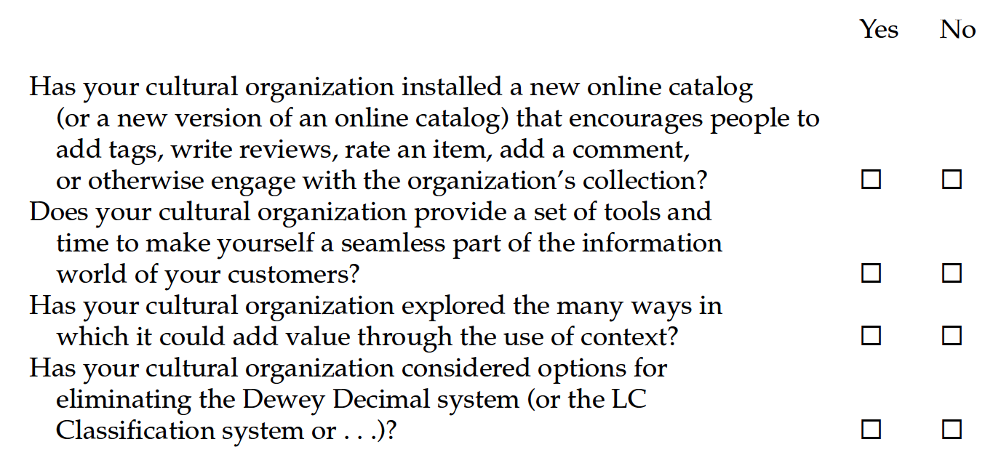
Tips for Adding Value by Context

Slide 32
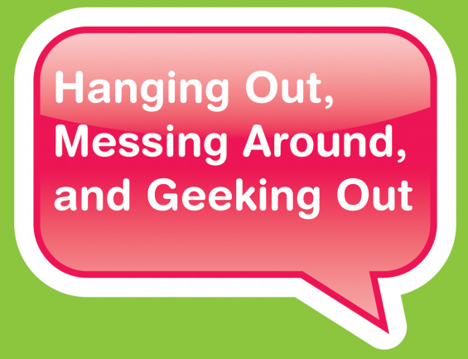
Connection
YOUmedia
Notes:
The 3rd C of the 5Cs - Connection
Goal of digitization ought to be be to build enduring connections with people to your content
Building conversations – discoverability, collaboration, sharing

Slide 33
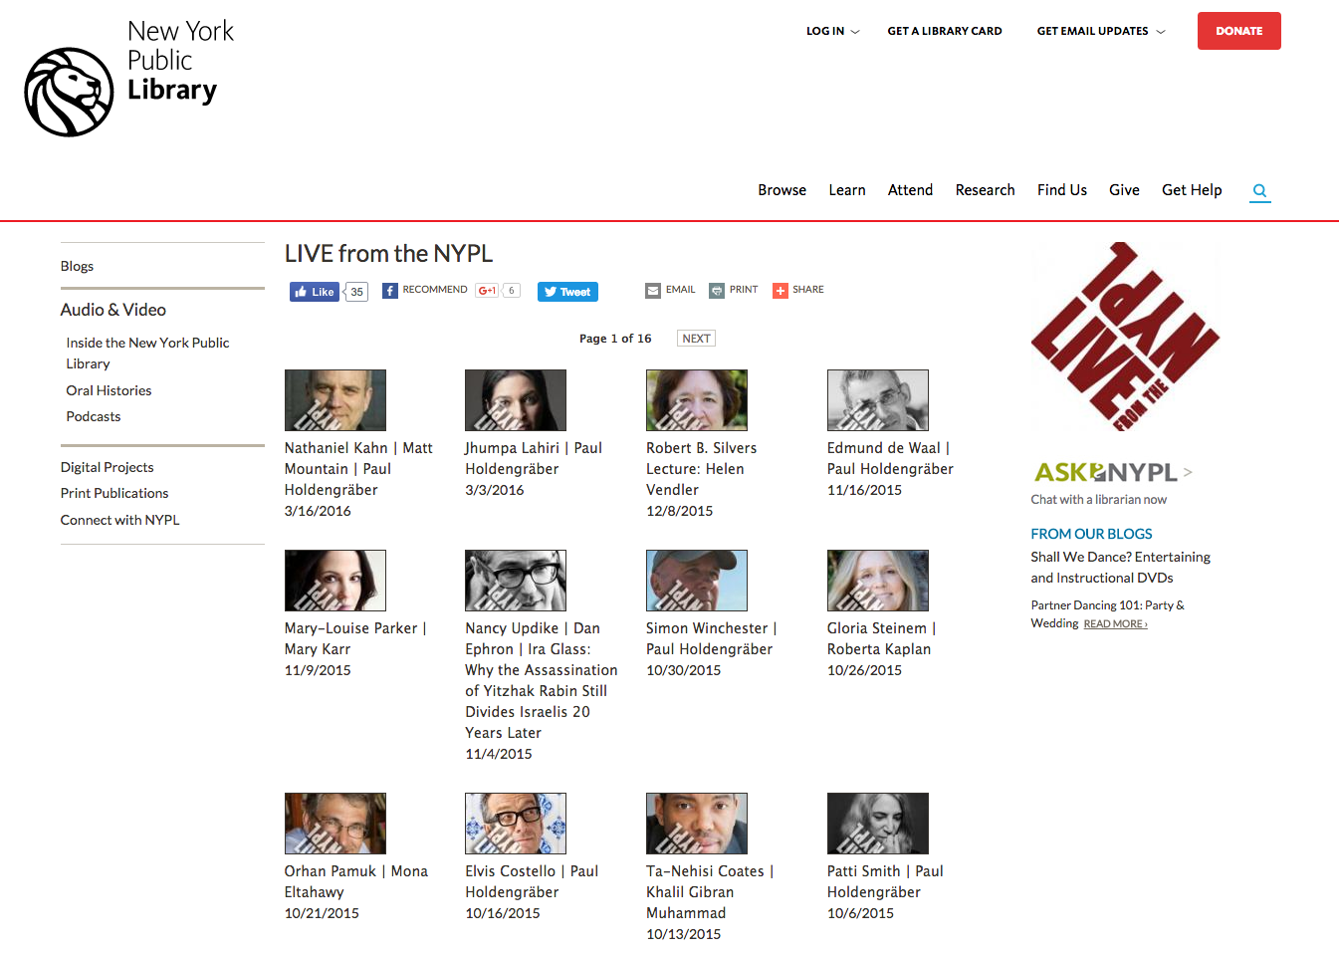
Connection
Notes:
Recorded conversations – Live at the NYPL

Slide 34
Connection
LibraryAware Community Award
Harwood – Turning Outward
Human Library
Getting in the Flow – Lorcan Dempsey
Repurposing space
Maker space
Community Publishing Portal
Others
Notes:
A way to engage in meaningful conversations

Slide 35
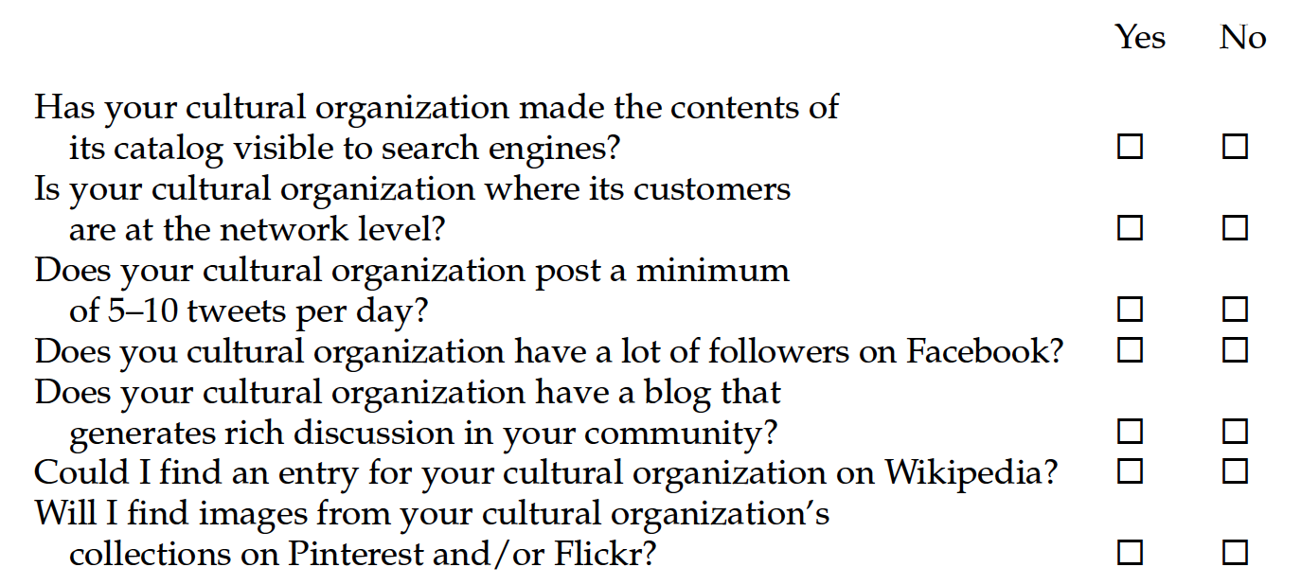
Tips for Adding Value by Connection

Slide 36
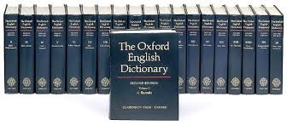
Collaboration
William Chester Minor
Fitzedward Hall
Notes:
OED – most like the first crowdsourced project
Project started in 1860 and it was hoped they could print the first edition 10 years later
William Minor – soldier in civil War – PTSD – shot & killed a man in London England
Sentenced to the Broadmor Criminal Lunatic Asylum
Built a large collection of first edition books – indexed the words in each book
Prepared thousands of “slips”

Slide 37
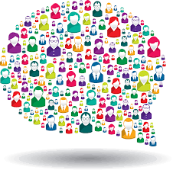
Collaboration
Crowdsourcing
  Knowledge discovery
  Implicit crowdsourcing
  Question answering
  Problem solving
  Citizen science
  Crowd voting
  Crowd funding
Notes:
Categories suggested by Mia Ridge

Slide 38
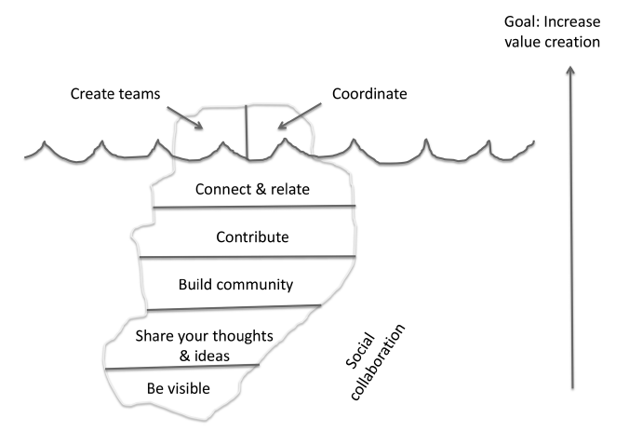
Collaboration Iceberg
Notes:
The goal of collaboration/crowdsourcing is to build enduring value
Very little work is done by the organization other than providing the tools – the rest is the “community”

Slide 39
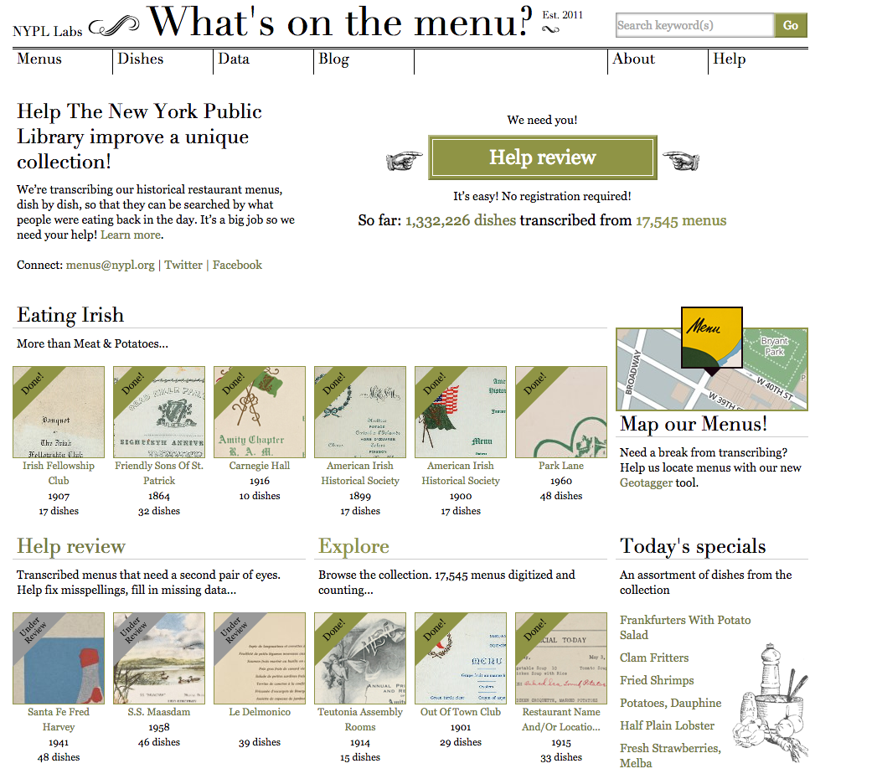
Notes:
NYPL What’s on the Menu
People could transcribe each item on the menu – name, description of the dish, and the price
Over 1 million dishes have been transcribed

Slide 40
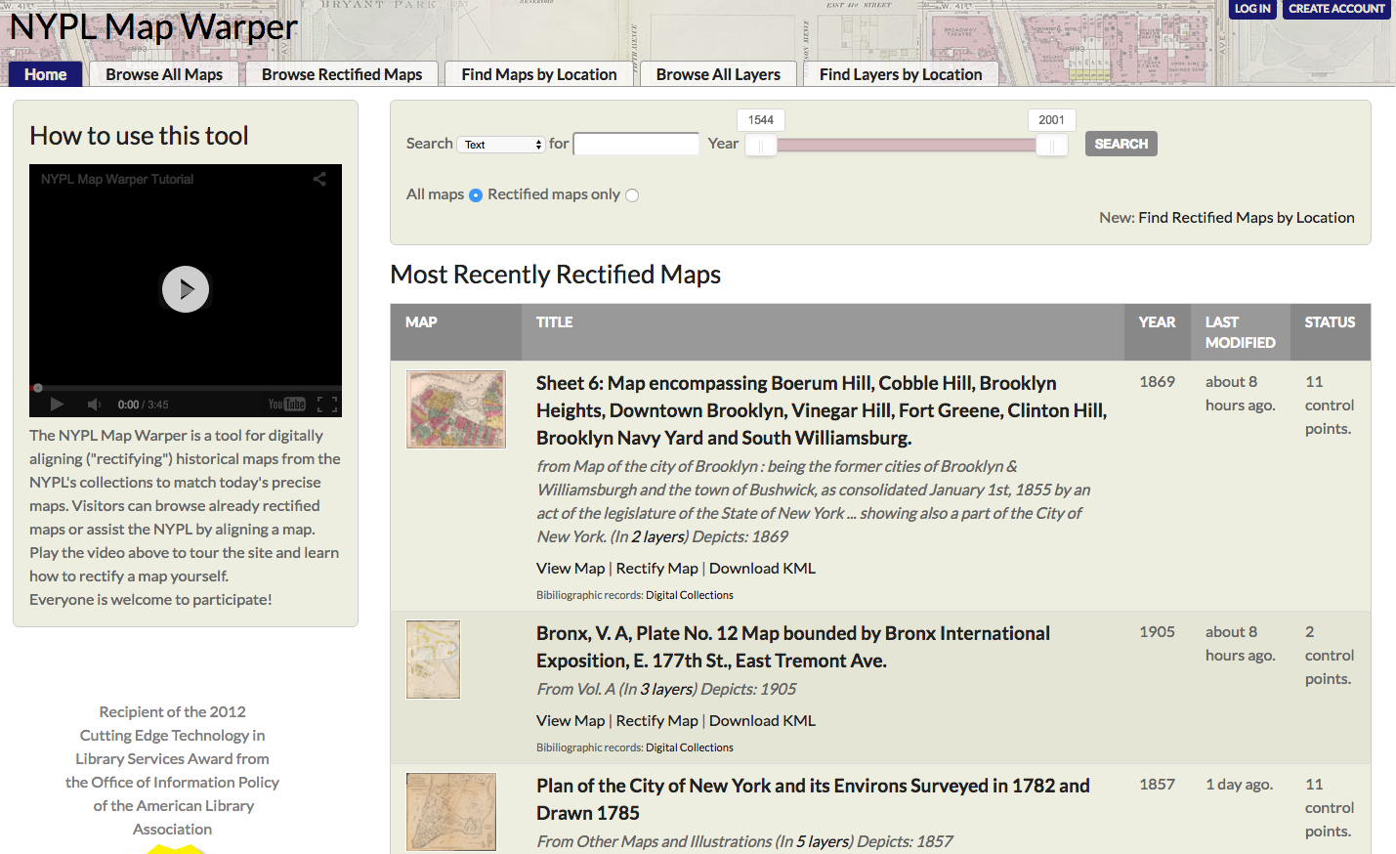
Notes:
NYPL Map Wrapper – overlay maps

Slide 41
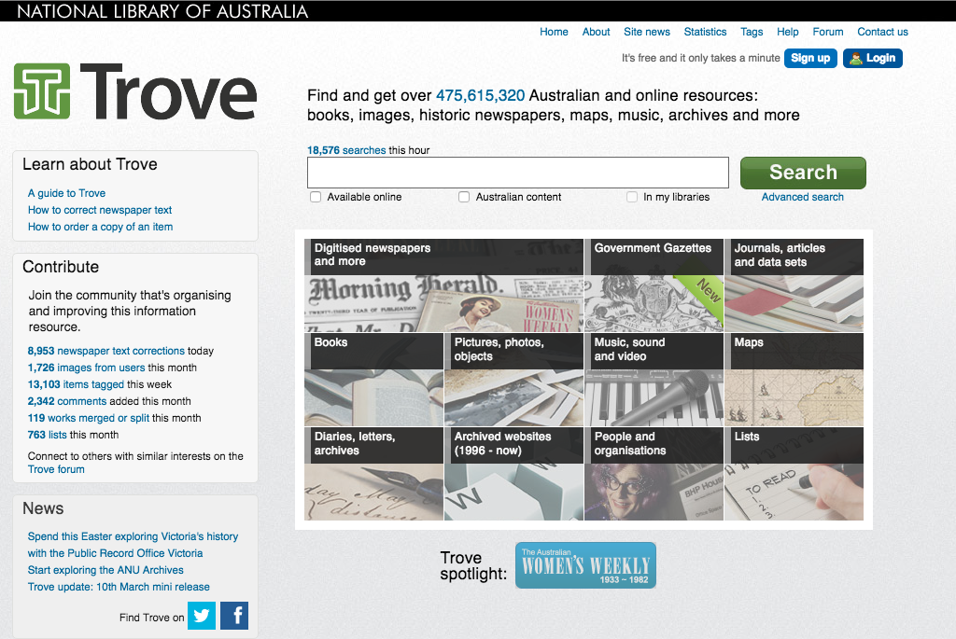
Notes:
National Library of Australia Newspaper transcription project
Notice the level of activity – almost 9,000 newspaper text corrections in one day
Over 100 million lines of newspaper text transcribed so far!

Slide 42
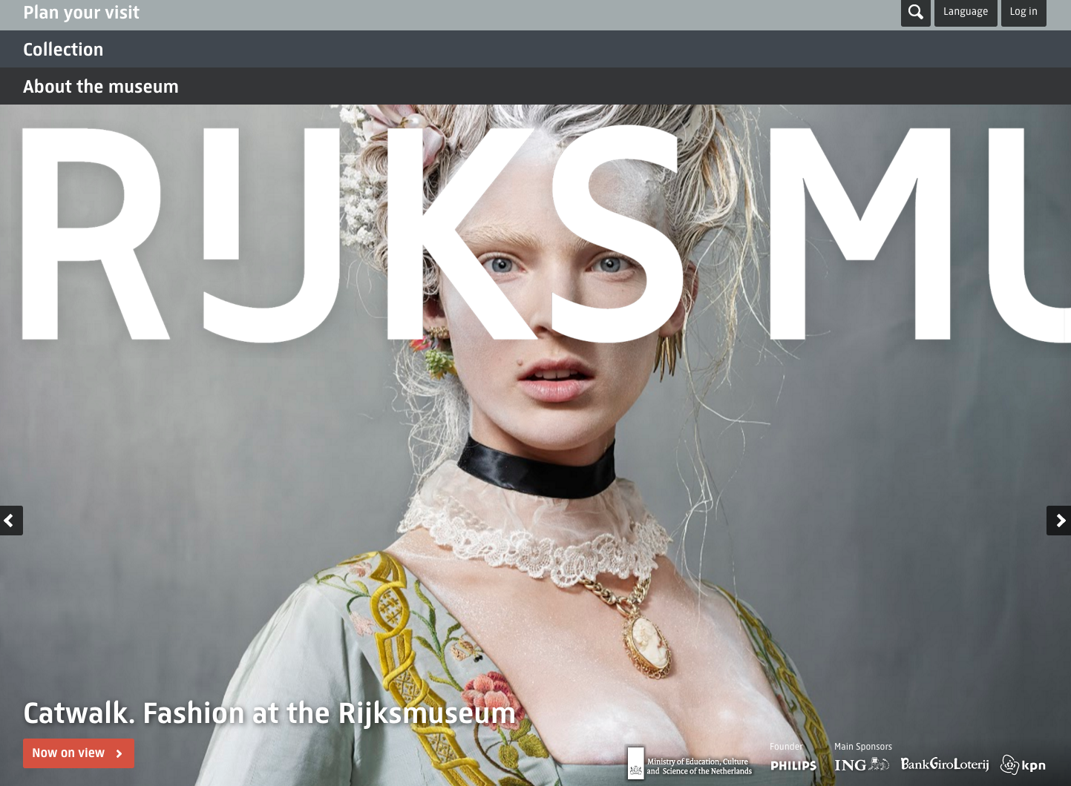
Notes:
The Rijks Museum provides lots of interesting ways to engage with their collections
Particularly interesting is that anyone can create their own “studio” as a way of organizing the museum’s content

Slide 43
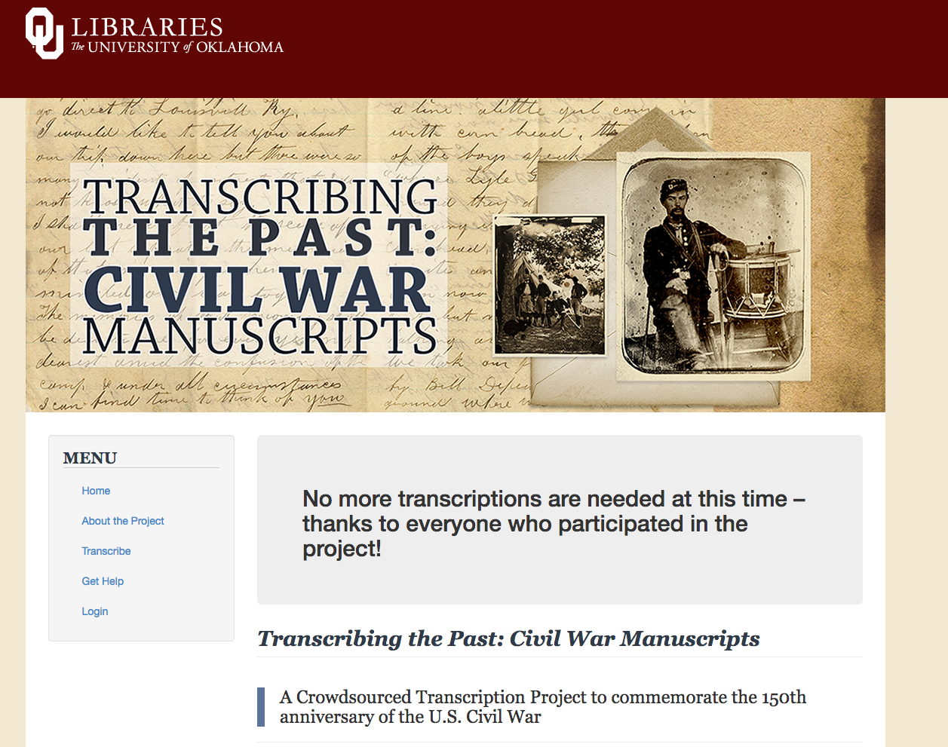
Notes:
University of Oklahoma Libraries were very successful with their transcription project

Slide 44
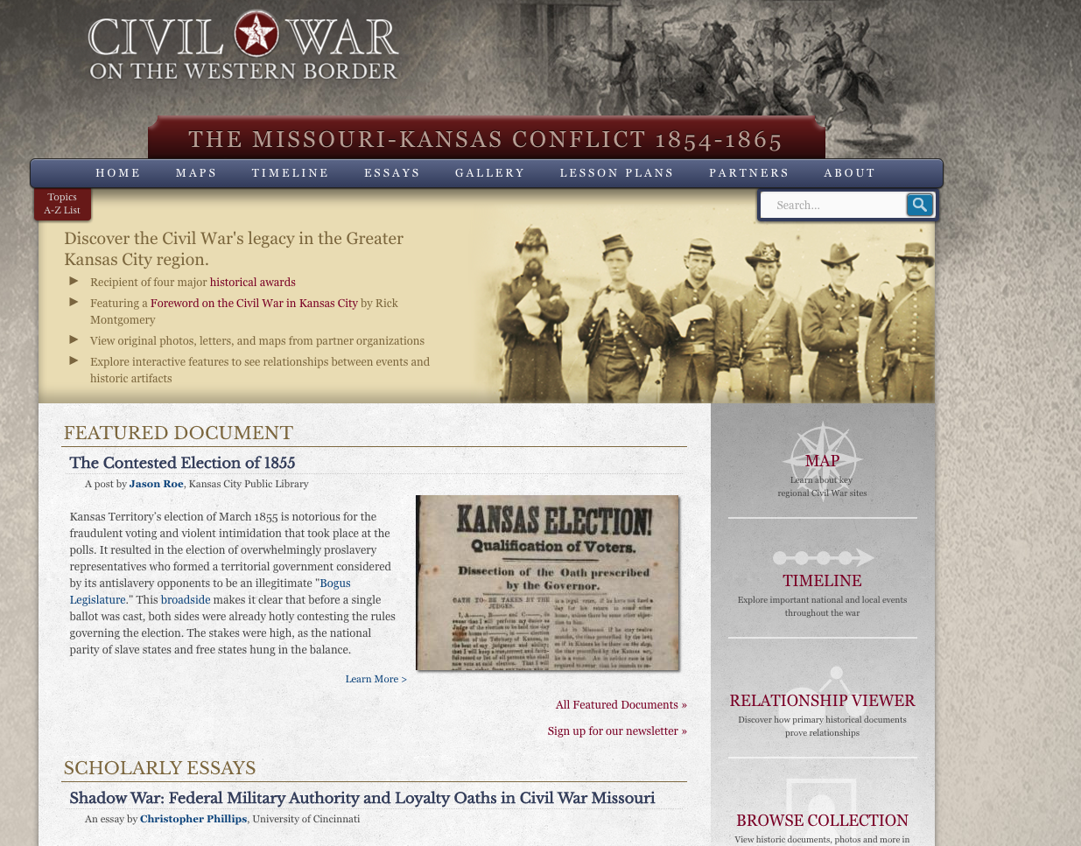
Notes:
The Kansas City Public Library has created an interesting Web site that engages people in a variety of ways

Slide 45
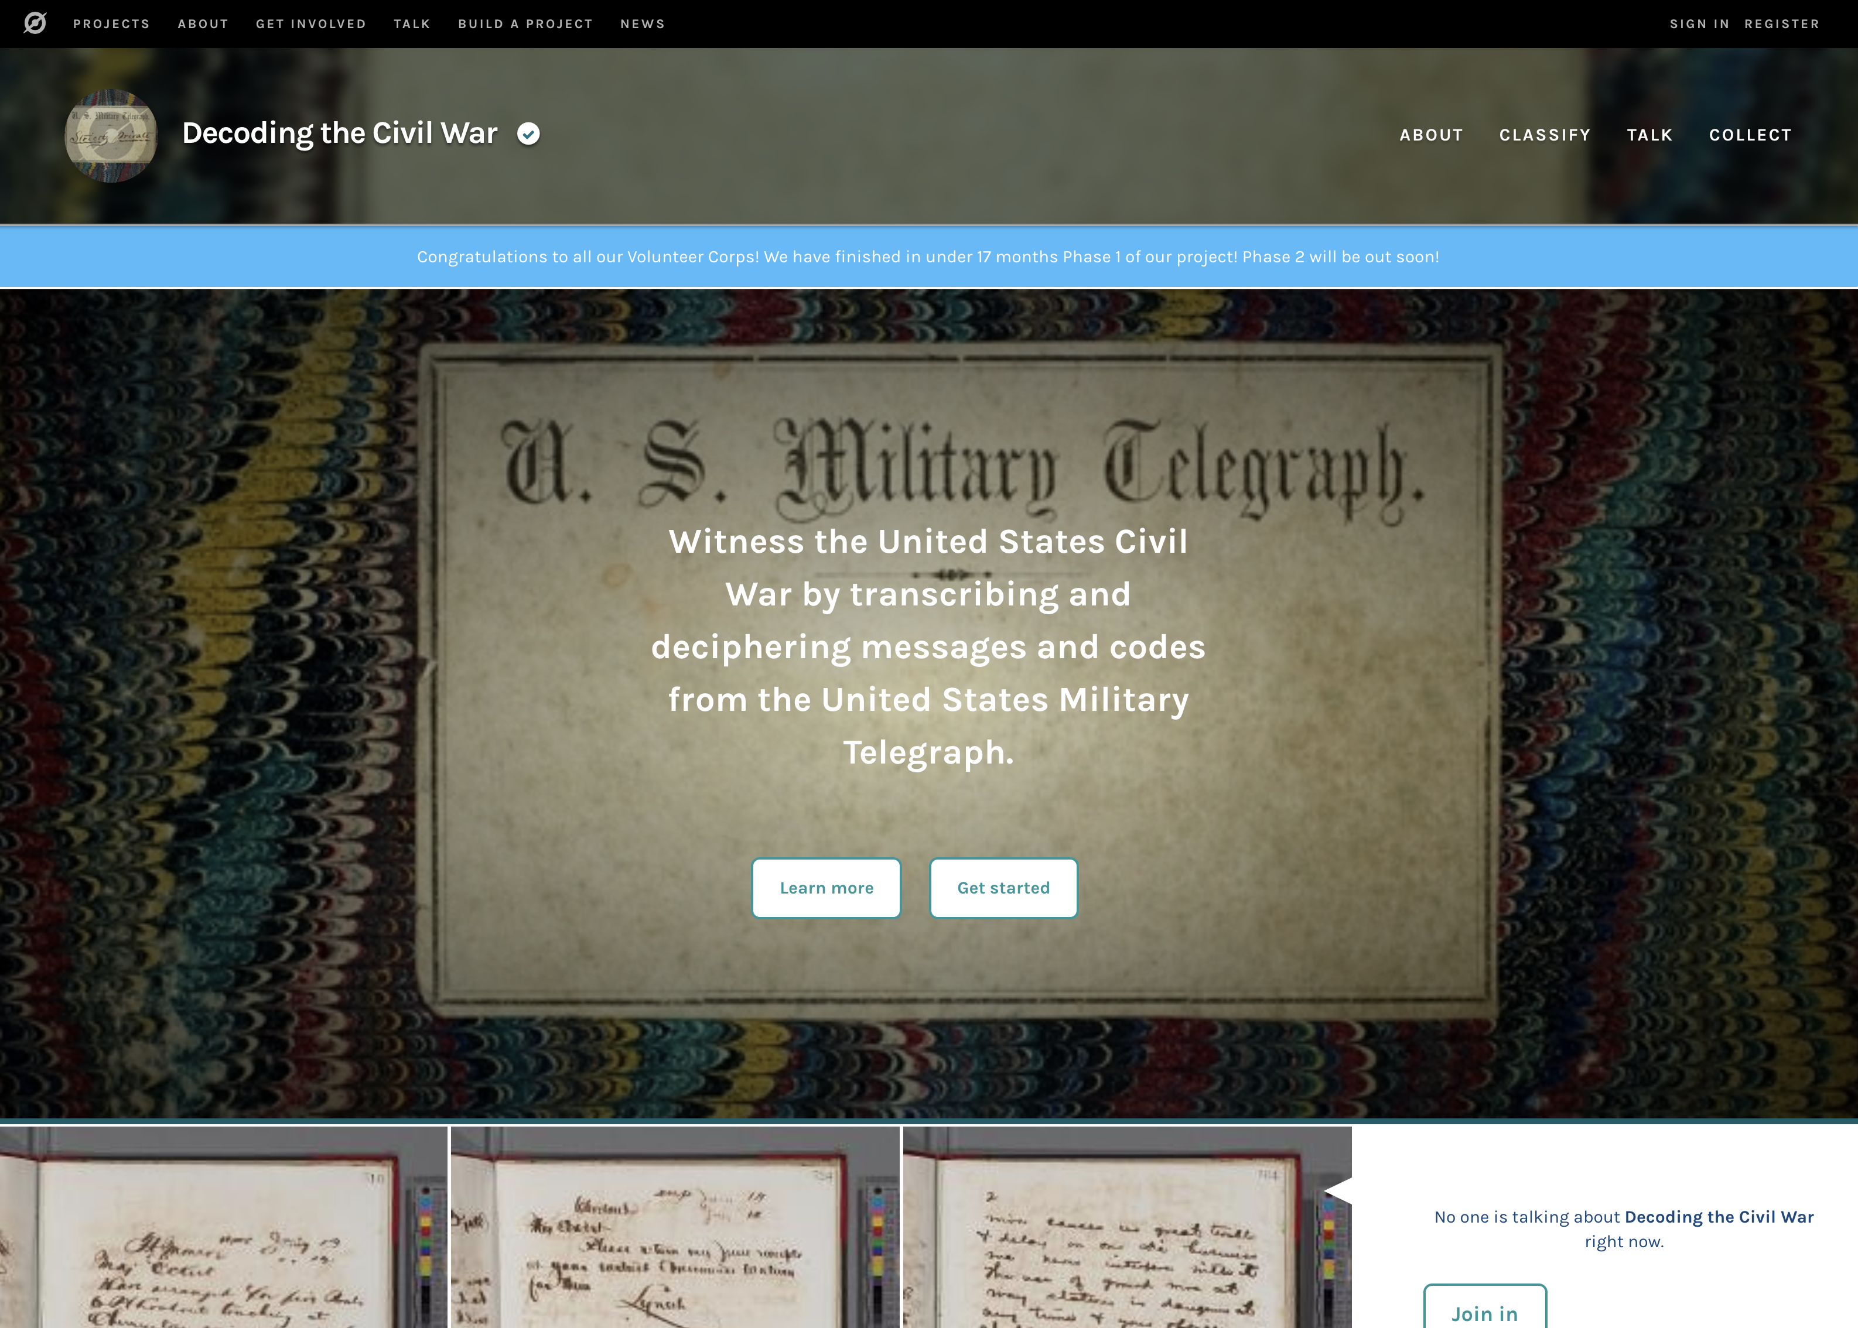
Notes:
Recently, the Library of Congress announce a new transcription project of telegraph messages

Slide 46
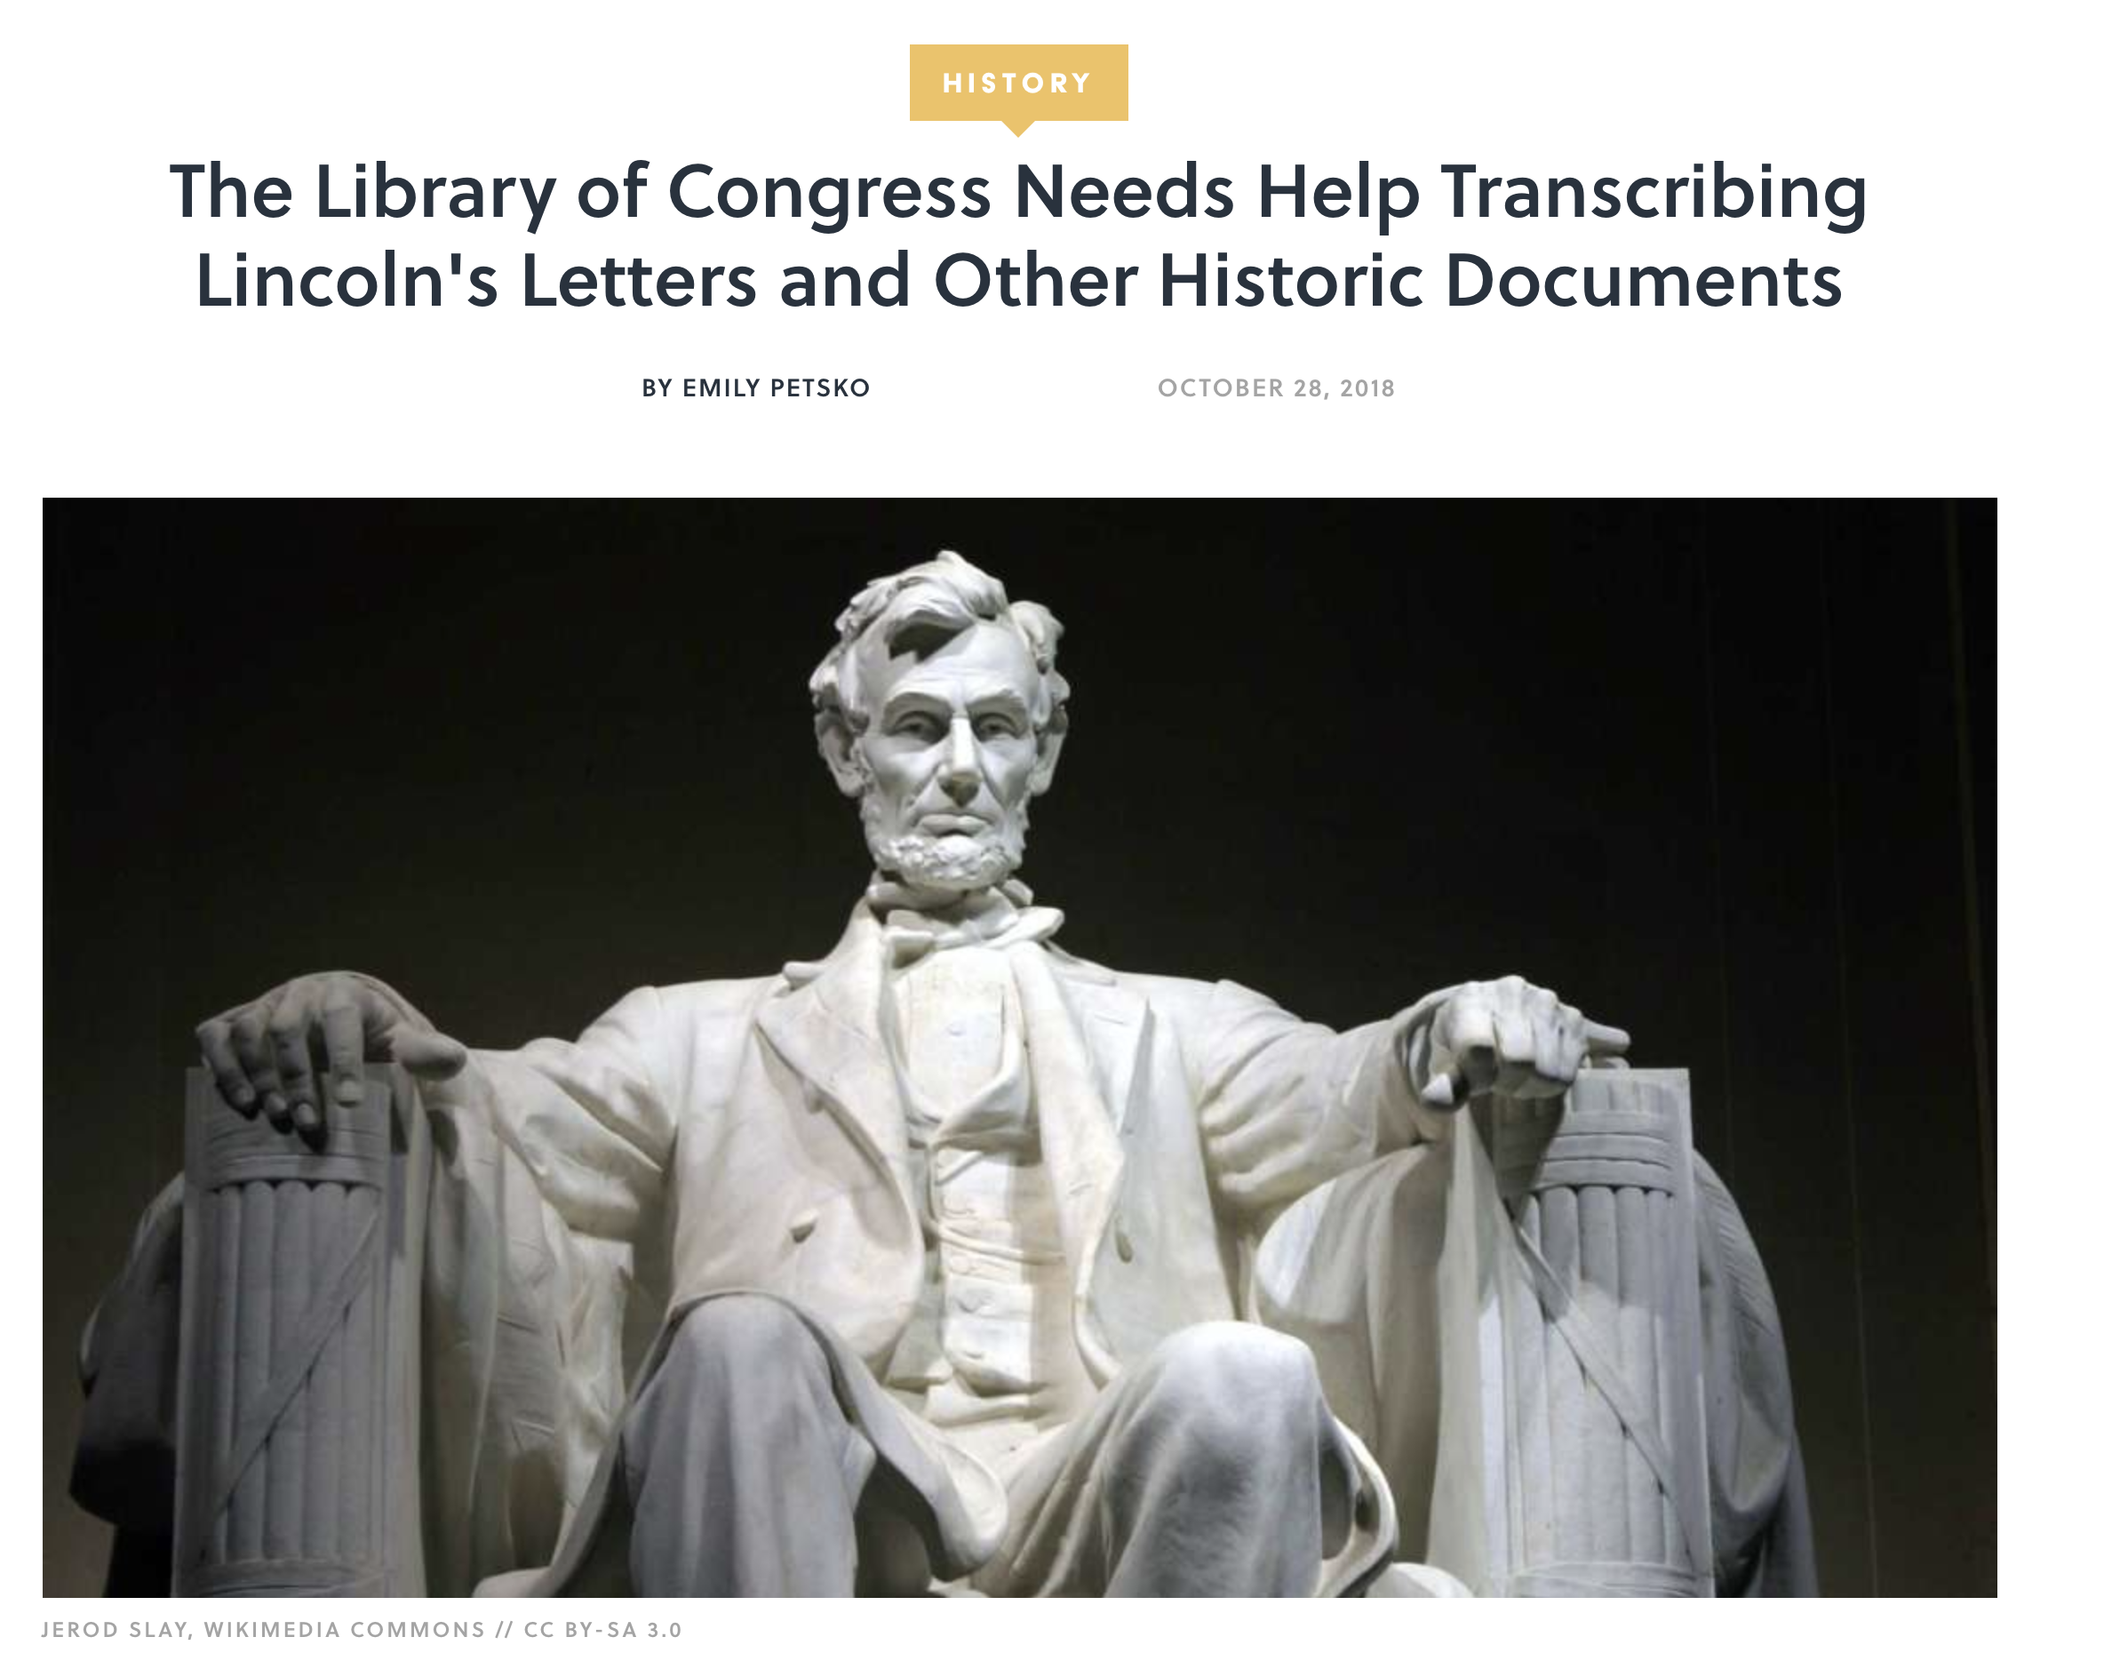
Notes:
And another transcribing project

Slide 47
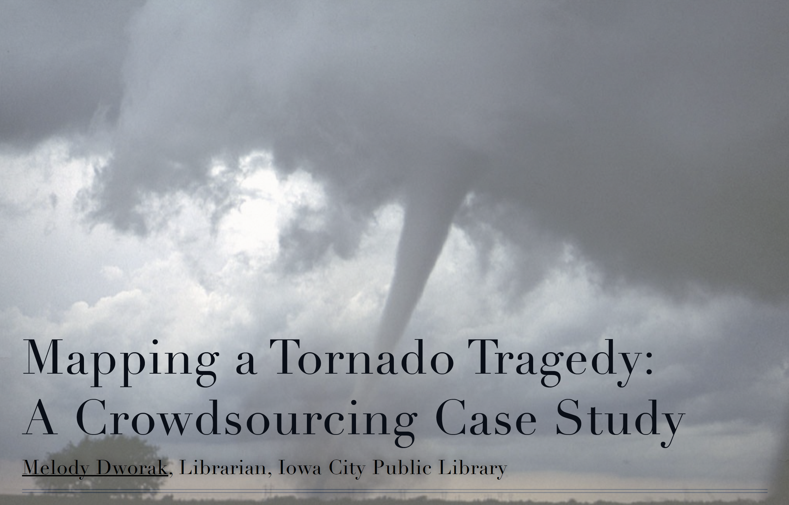
Notes:
And the Iowa City Public Library is creating a repository of materials related to a recent tornado that impacted the community

Slide 48
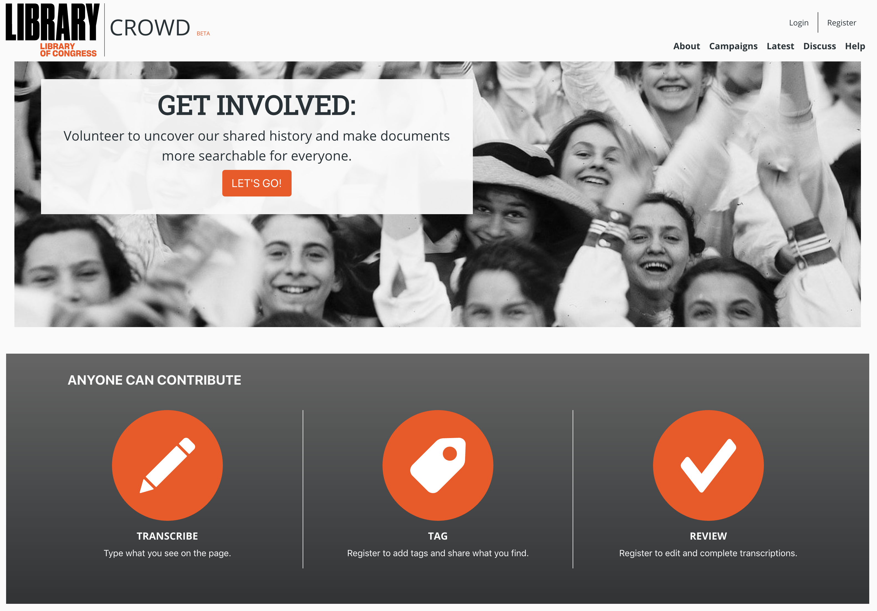

Slide 49
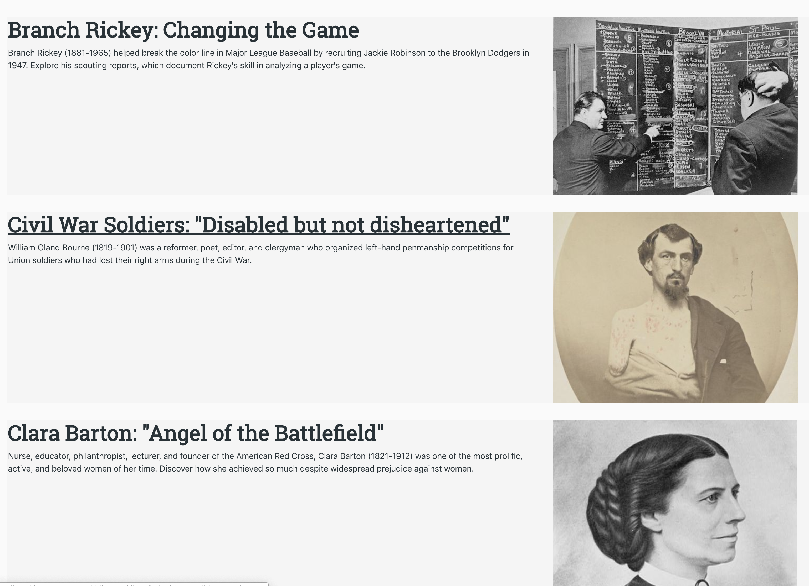
Notes:
Library of Congress transcription projects

Slide 50
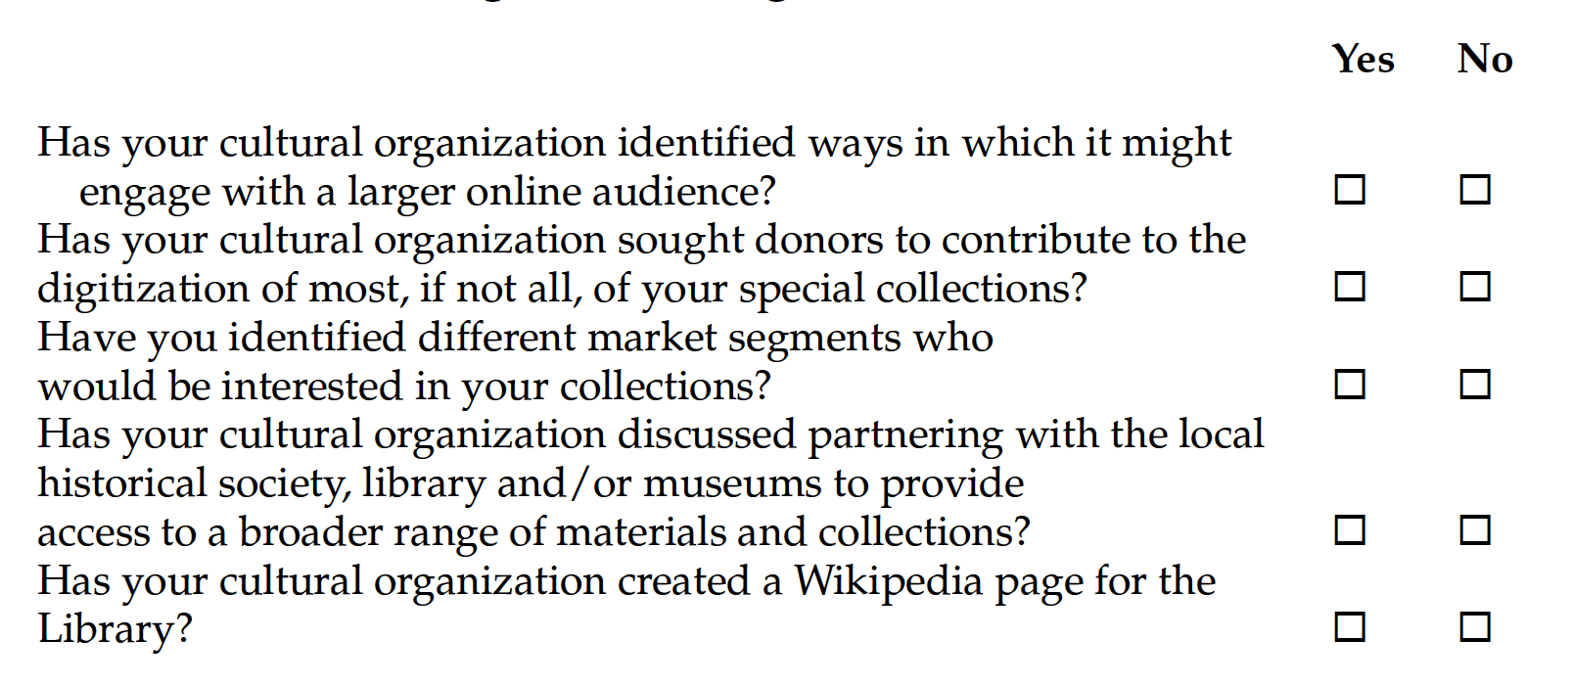
Tips for Adding Value by Collaboration
Notes:
Achieve goals the cultural organization would never have the time, money, or
staff resources to complete on its own.
• Achieve goals in a much faster time frame than if it worked on its own.
• Tap into the knowledge, expertise, and interest of the community.
• Add value to existing content through the addition of comments, tags, reviews,
and ratings.
• Improve the quality of existing content by correcting text or transcribing content
that can’t be converted to digital format using OCR software—with the
result that more content is correctly indexed (or indexed for the first time) and
thus more content becomes accessible.
• Making cultural organization resources discoverable in new and different
ways.
• Gaining insights about what is valuable from the customer’s perspective.
• The high level of community involvement is another way to demonstrate the
value of the cultural organization.
• Participants become personally invested and are much more vocal about the
value of the cultural organization in their lives.
• But perhaps the most important reason for engagement is that the community
that is involved with the cultural organization becomes much larger and is a
more active participant.

Slide 51
Community
The Concept of Platform – IBM, Apple, Android, Facebook
Lessons
  Start small and let it evolve
  Encourage hackers
  The goal is participation
  Openness promotes innovation & growth
  Harness the data – make the experience better
Notes:
The last of the 5Cs

Slide 52
Library as Platform
Infrastructure that is
as ubiquitous and persistent
as the streets and sidewalks
of a town.
David Weinberger
Notes:
Aspen Report – People, place, platform

Slide 53
Library as Platform
The mission of librarians is to improve society
through facilitating knowledge creation
in their communities.
David Lankes
The Atlas for New Librarianship

Slide 54
Library as Platform
Serve a geographically bounded community
Provide access to a variety of content
Provide links to other resources
Provide tools that encourage people to contribute
Encourage the generation of knowledge
Stack Overflow
Notes:
David Weinberger suggested a library platform -
Primarily serve a geographically bounded community
• Be open and serve all
• Provide access to a wide variety of content—regardless of format
• Provide links to other valuable resources
• Knowledge is no longer found only in books and other containers but rather is readily accessible via the Internet
• Provide tools that would encourage people to contribute in a wide variety of ways
• Provide resources that encourage others to create and flourish
• Encourage the generation of a knowledge network not simply access to information and knowledge resources
• Enable new products and services to be built
Good example is a Website – Stack Overflow

Slide 55
Library as Platform
Carl Grant Knowledge Creation Platform
  Discovery
  Social networking
  Predictive, proactive services
  Tools for knowledge creation
  Encourage serendipity
  Contextual support
Notes:
For academic libraries

Slide 56
Why Engage Our Communities
Achieve goals never do on your own
Tap into the knowledge, expertise and interest of the community
Add value to existing content
Improve quality of existing content
Gaining insights into what people want
Participants become personally invested

Slide 57
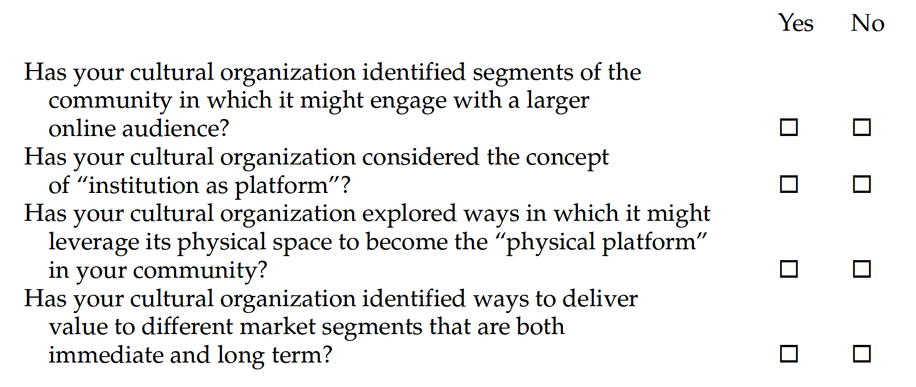
Tips for Adding Value using Community

Slide 58
The Adding Value Diamond

Slide 59
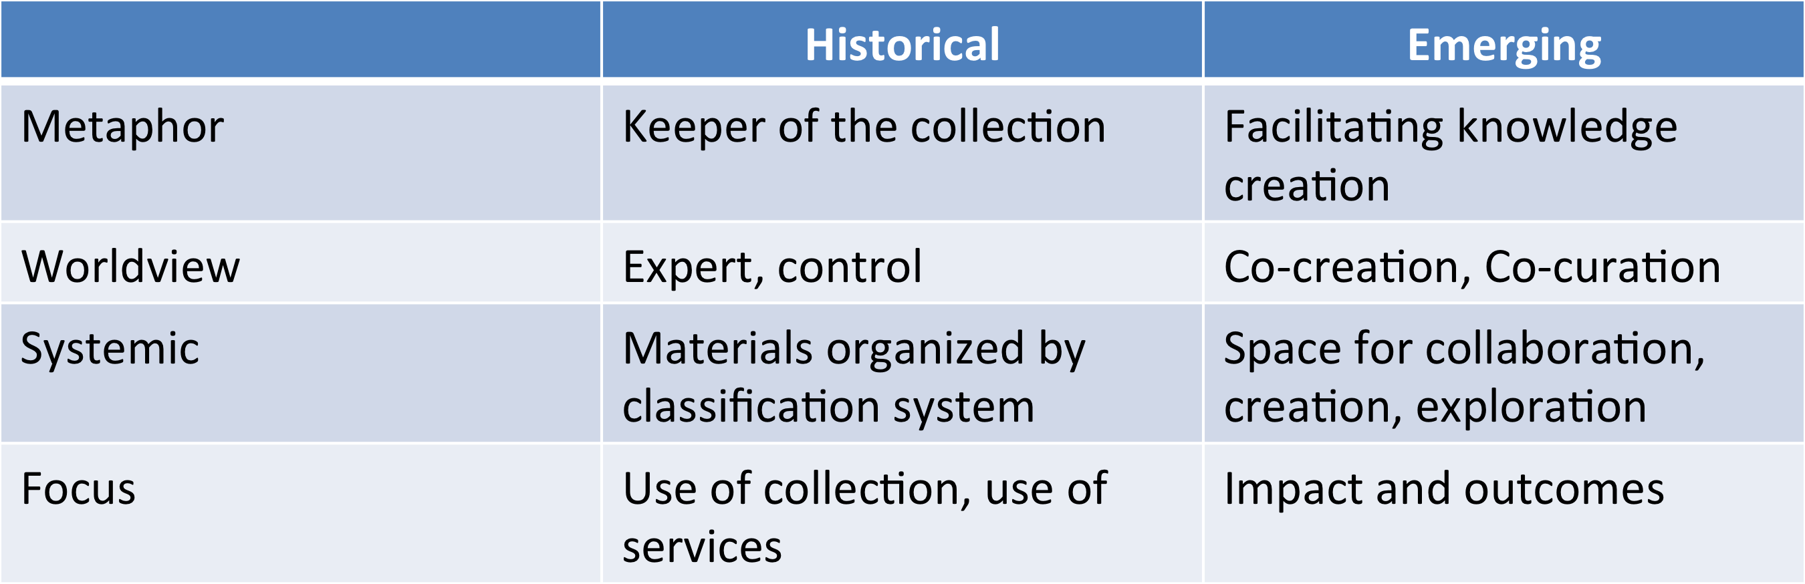
Library Futures

Slide 60
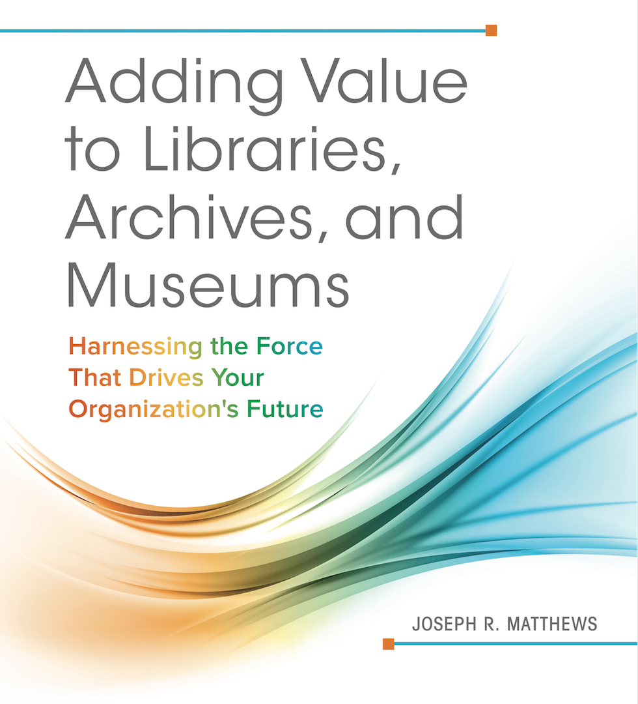
Shameless
Commerce
Plug
It’s a great
Book!

Slide 61
